Slide 1





THE FUTURE ENVELOPE
TOWARDS ZERO CARBON BUILDINGS
15‐16 December 2022 Bolzano/Bozen
Sustainability as a design parameter: tools, metrics, know-how
Claudia Di Noi
GreenDelta GmbH, Berlin, Germany
Collaborations
Sponsors
Organized by

Slide 2
Demand for sustainability: the EU Taxonomy
Classification system to guide sustainable investments
Highly affecting the building sector (directly and indirectly): new construction, renovation, installation, maintenance and repair, and acquisition & ownership
Life Cycle Assessment of the whole building according to Level(s) and EN15978 is required to comply with circular economy criteria
https://finance.ec.europa.eu/sustainable-finance/tools-and-standards/eu-taxonomy-sustainable-activities_en
https://environment.ec.europa.eu/topics/circular-economy/levels_en

Slide 3
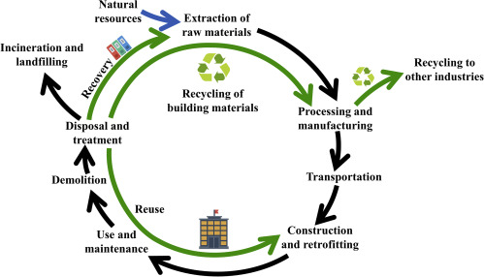
Life Cycle Assessment (LCA)
Methodology for quantification of environmental impacts of products, processes and services across the life cycle
Based on standards:
ISO 14040, ISO 14044
EN 15804 (construction products)
EN 15978 (buildings)
…
Huang, B. et al. (2020) A Life Cycle Thinking Framework to Mitigate the Environmental Impact of Building Materials https://doi.org/10.1016/j.oneear.2020.10.010

Slide 4
How to tackle complexity of sustainability
Sustainability should not be isolated from the technical building envelope performance
How to integrate sustainability assessment in the design process and benefit from it?
Know how: Sustainability consultancy and research, and capacity building
Sustainability metrics
Tool development for data management and sustainability assessment

Slide 5
Tools

Slide 6






Calculation of building LCA
Impacts and risks need to be calculated across the life cycle
Professional LCA software, free or licensed
LCA calculators (e.g. spreadsheets, )
LCA screening tools (e.g. spreadsheets, rating 1-5)
LCA software linked to a Common Data Environment (e.g. BIM)
Frontiers of LCA software: link with Artificial Intelligence
…

Slide 7
Collecting construction data for LCA
Lack of representative data and benchmarks is one of the main challenges when performing sustainability assessment of buildings
Common data sources (not exhaustive):
Generic LCA databases with building products: ecoinvent, GaBi, PEF…
Standardized LCA database of building products: Ökobaudat (DE)
Environmental Product Declarations: reports of LCA of specific construction products (usually as PDFs, but can be added to some LCA software: One Click LCA and openLCA)
https://nexus.openlca.org/databases
https://www.oekobaudat.de/

Slide 8

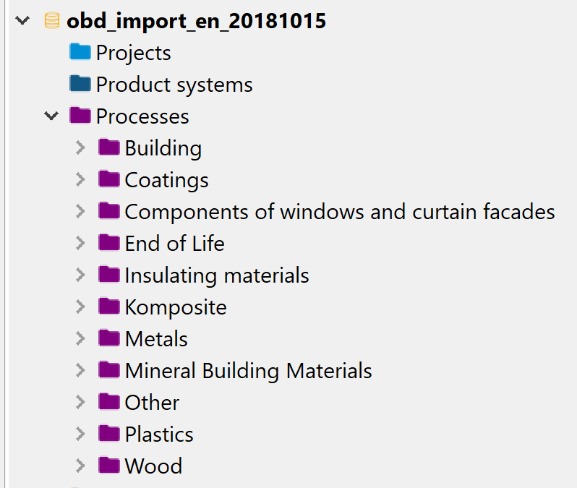
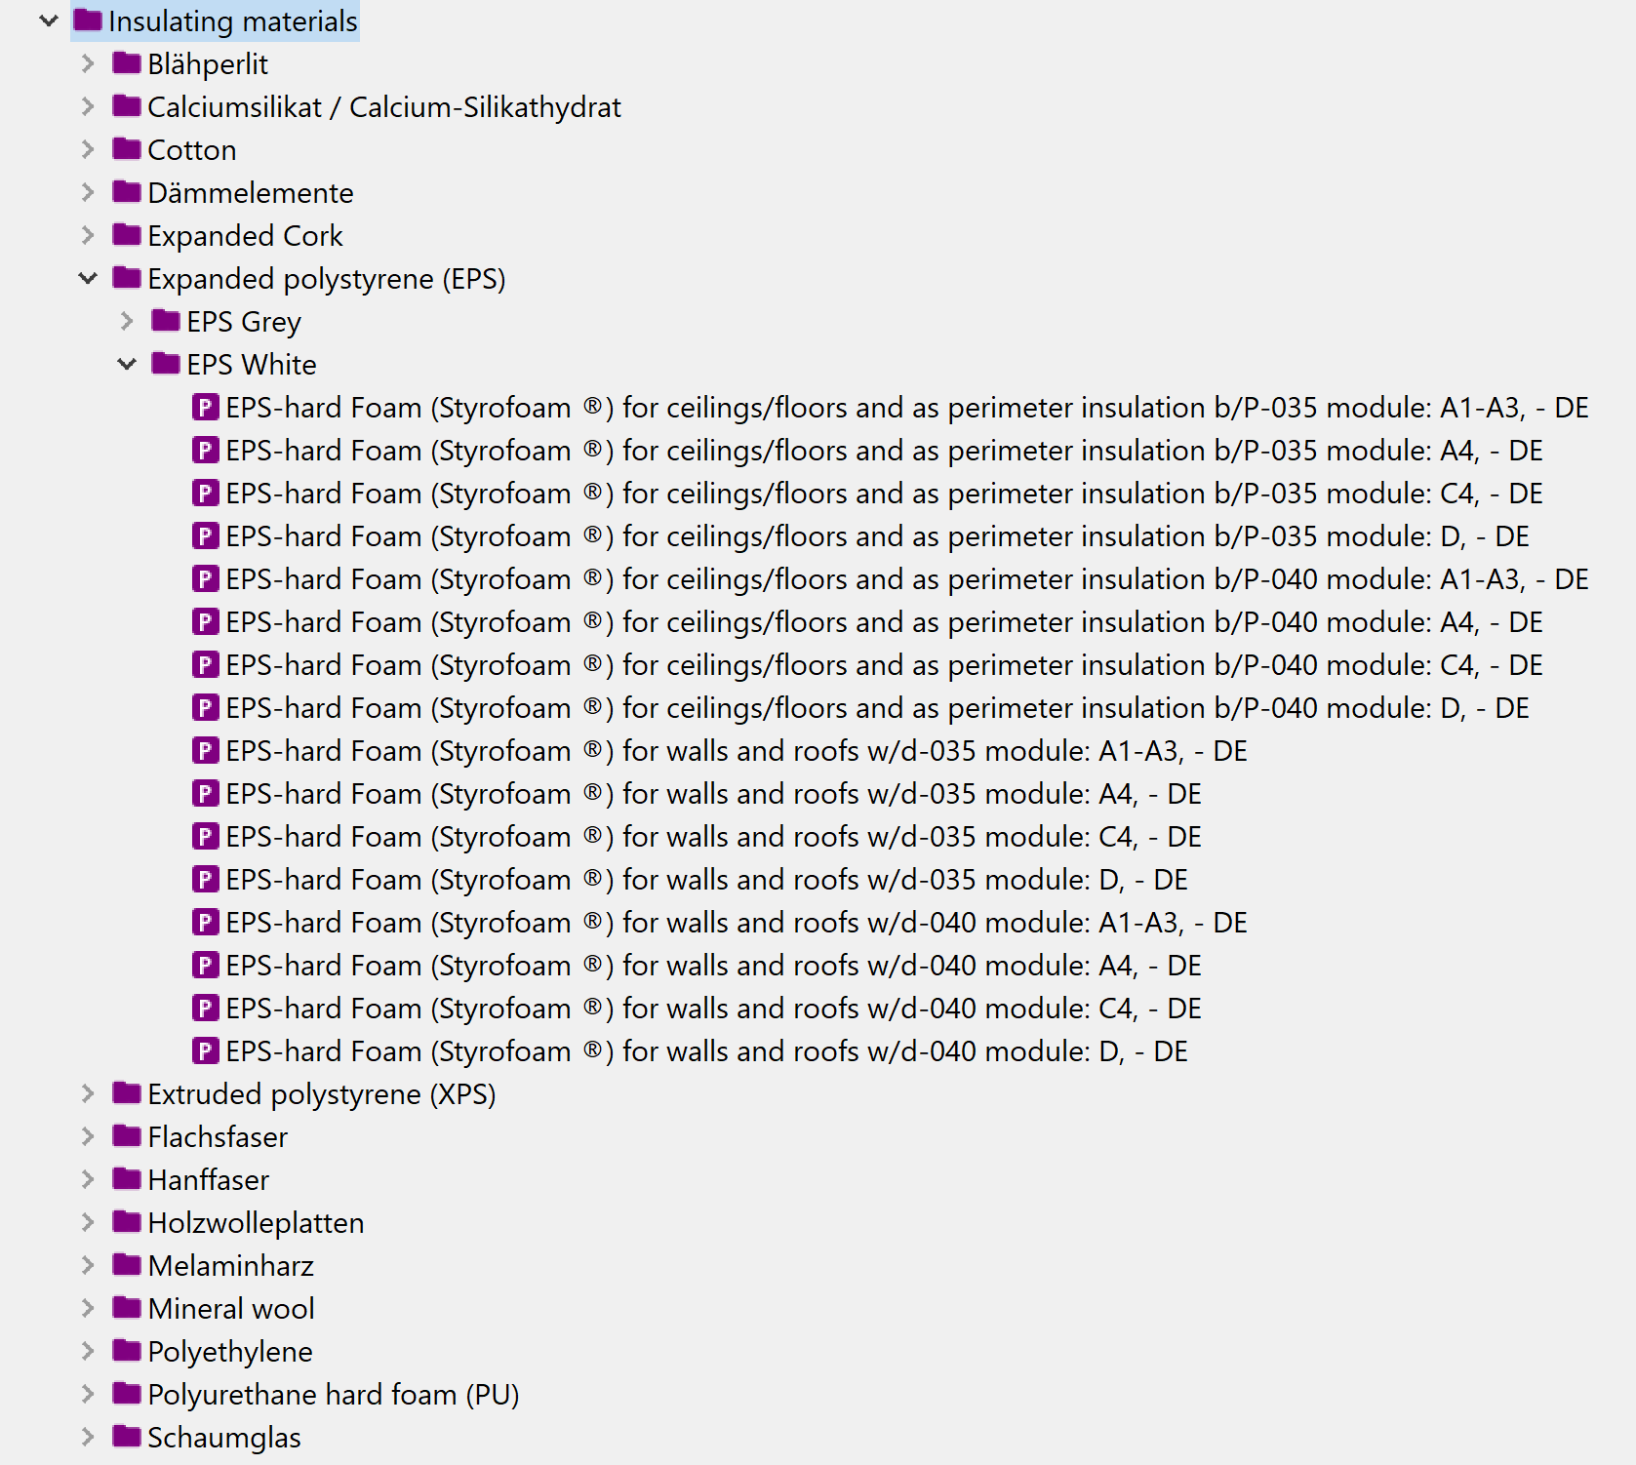
Example 1: Ökobaudat in openLCA
Construction materials database, provided by the German Federal Ministry of Transport, Building and Urban Development
13,000 datasets representing EPDs
https://nexus.openlca.org/database/%C3%96kobaudat

Slide 9
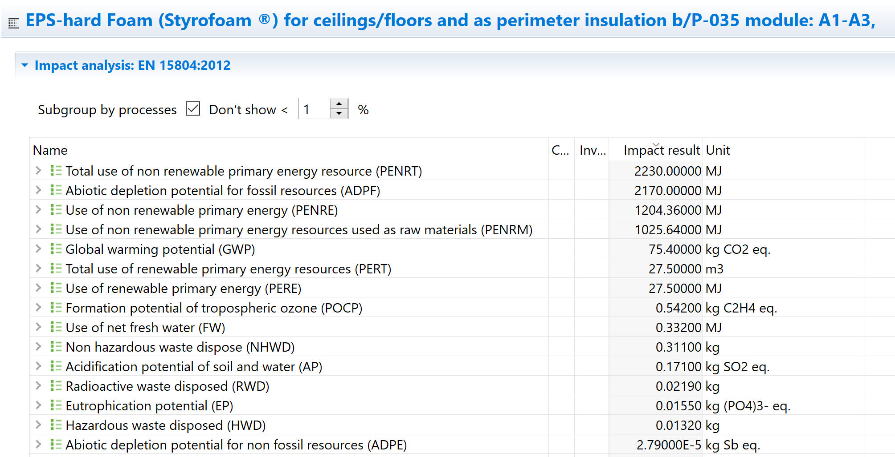
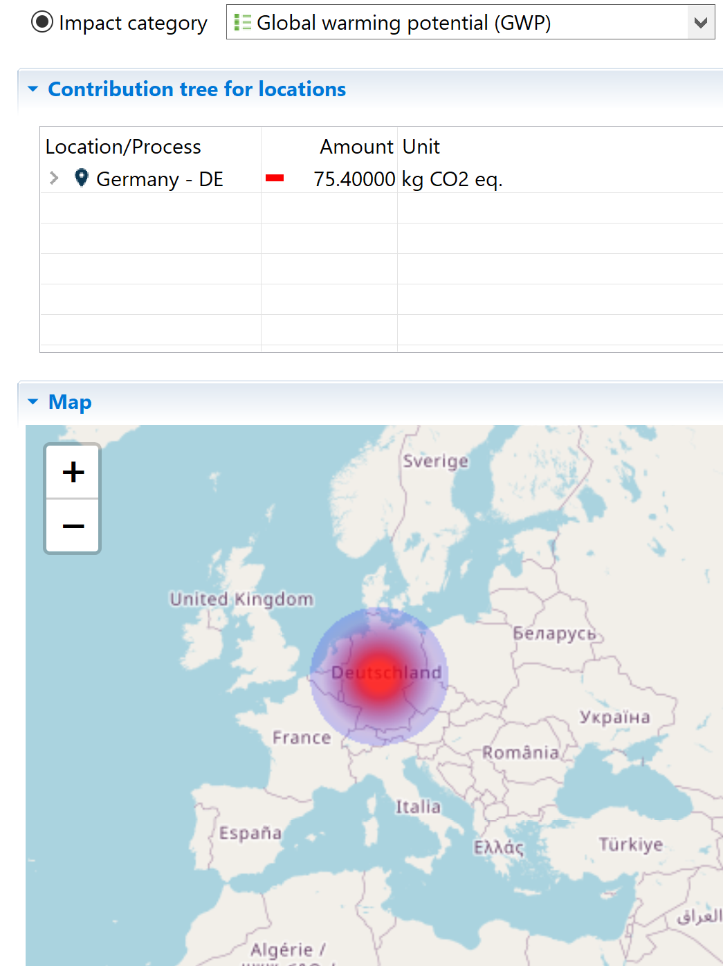
Example 1: Ökobaudat in openLCA
Calculate life cycle stages (production, transport, use, end of life…)
Combine datasets to create your own case studies (building components or full buildings)
https://nexus.openlca.org/database/%C3%96kobaudat

Slide 10
Example 2: LCA and artificial intelligence tool
End of life is one of the most uncertain stages of building component life cycles
Construction and demolition waste is a major problem (1/3 of all waste in EU)
Proposal: combining a digital product description – the “Digital Product Passport”– with intelligent sorting technologies supported by artificial intelligence (AI)
https://environment.ec.europa.eu/topics/waste-and-recycling/construction-and-demolition-waste_en
Notes:
Example: the materials used in the manufacturing processes and their properties are stored in the life cycle record and made available for material recovery – i.e. for sorting, recycling, and subsequent reuse.

Slide 11
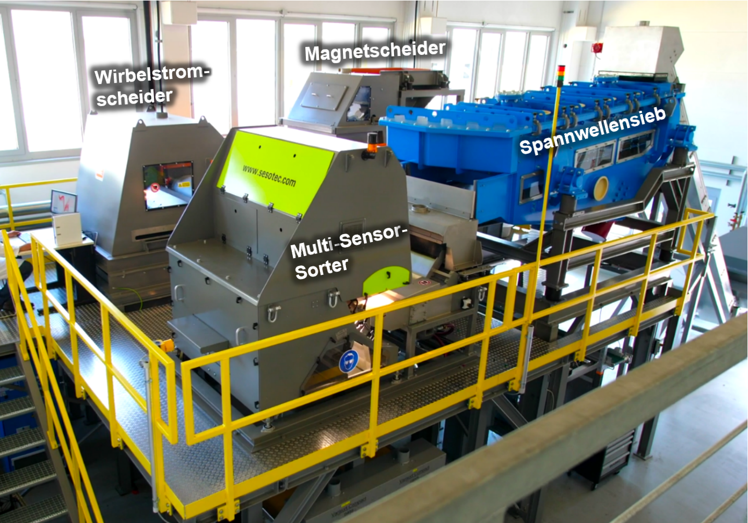

Example 2: LCA and artificial intelligence tool
Digital Product Passport
Materials
Joining techniques
Disassembly effort
Harmful materials
Durability
Users
….
Product
Waste
Artificial Intelligence
© Fraunhofer IWKS
Sorting plant
https://www.recirce.de/
1. Sorted waste
2. Best end of life pathway
LCA tool to calculate impacts of different end of life pathways

Slide 12
Metrics

Slide 13
Areas of protection
inventory
Resource depletion
Damage of resources
Impact assessment methods: Environmental Footprint, Recipe, CML…
Σ commodity
Σ Land use
Σ CO2
Σ HFE
Σ P
Σ SO2
Σ NOx
Σ CFC
Σ Cd
Σ PAK
Σ DDT
…
Land use
Global warming
Damage of ecological system
Ozone depletion
Acidification
Damage of health
Eutrophication
Ecotoxicity
…..
Human-toxicity
…..

Slide 14


Metrics beyond carbon and LCA indicators
Circularity: Material Circularity Indicator (Ellen MacArthur Foundation), Circularity Index (Cullen, 2017)
Criticality: raw materials important for the EU economy but with high supply risks (e.g. PV cells)
Costs: Life Cycle Costing
Social impacts and risks: Guidelines for social Life Cycle Assessment of Products and Organizations (UNEP/2020)
https://ellenmacarthurfoundation.org/
Cullen, Jonathan M. 2017. “Circular Economy: Theoretical Benchmark or Perpetual Motion Machine?” Journal of Industrial Ecology 21 (3): 483–86. doi:10.1111/jiec.12599.
United Nations Environment Programme (2020). Guidelines for Social Life Cycle Assessment of Products and Organisations 2020. https://wedocs.unep.org/20.500.11822/34554
https://nexus.openlca.org/databases

Slide 15
Know-how

Slide 16
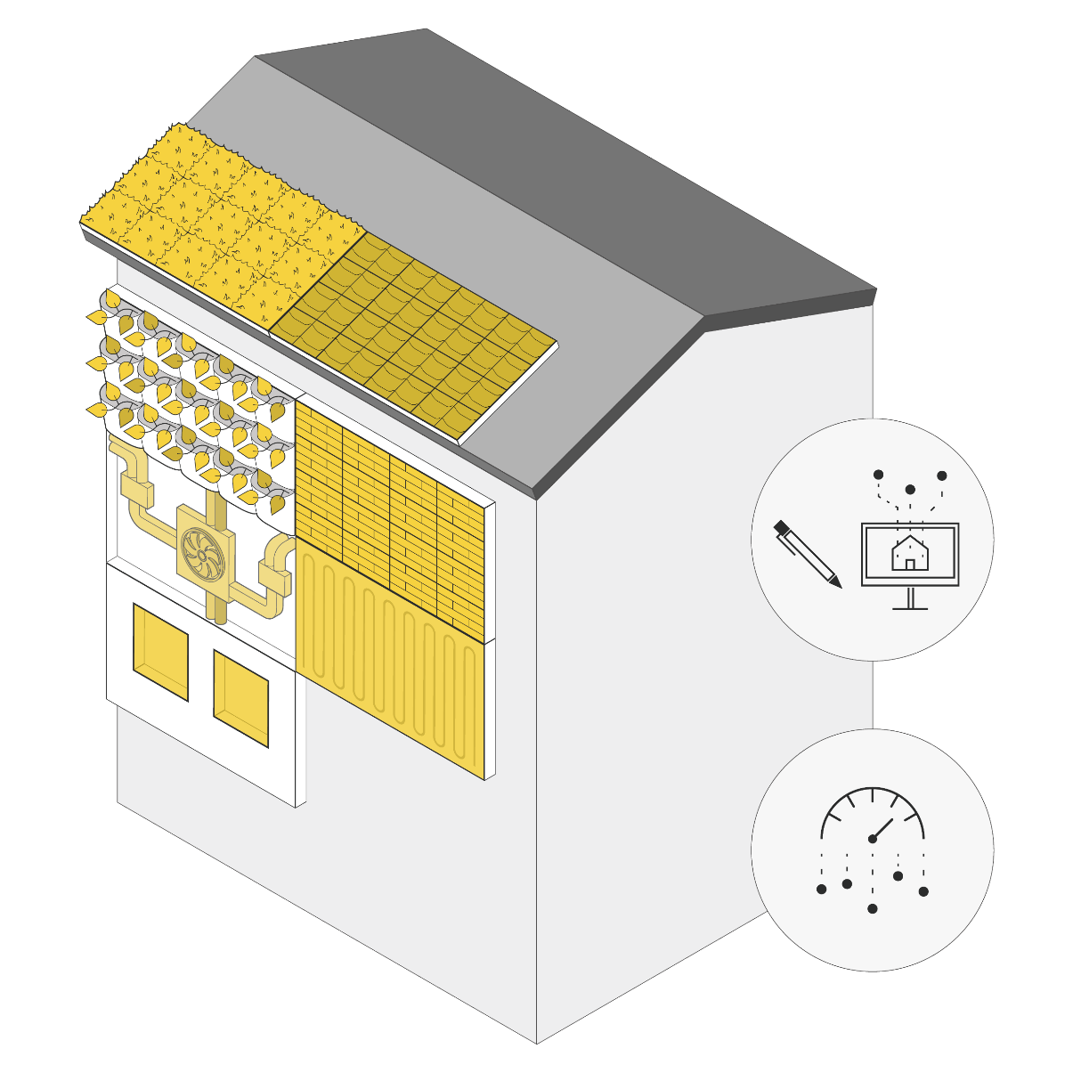

Life Cycle Assessment in practice
Application of LCA for the design of building envelopes for renovation
H2020 EU project: INFINITE (2020-25)
Industrialized retrofitting principles:
OFF-SITE PREFABRICATION
MULTI-FUNCTIONAL ENVELOPE
DIGITALIZATION
3 case studies (residential buildings):
ITALY
SLOVENIA
FRANCE
Green envelope
BIM
Energy and fresh air distribution
Smart glazing
Building management
Solar-thermal generation
Photovoltaic energy generation
https://infinitebuildingrenovation.eu/

Slide 17
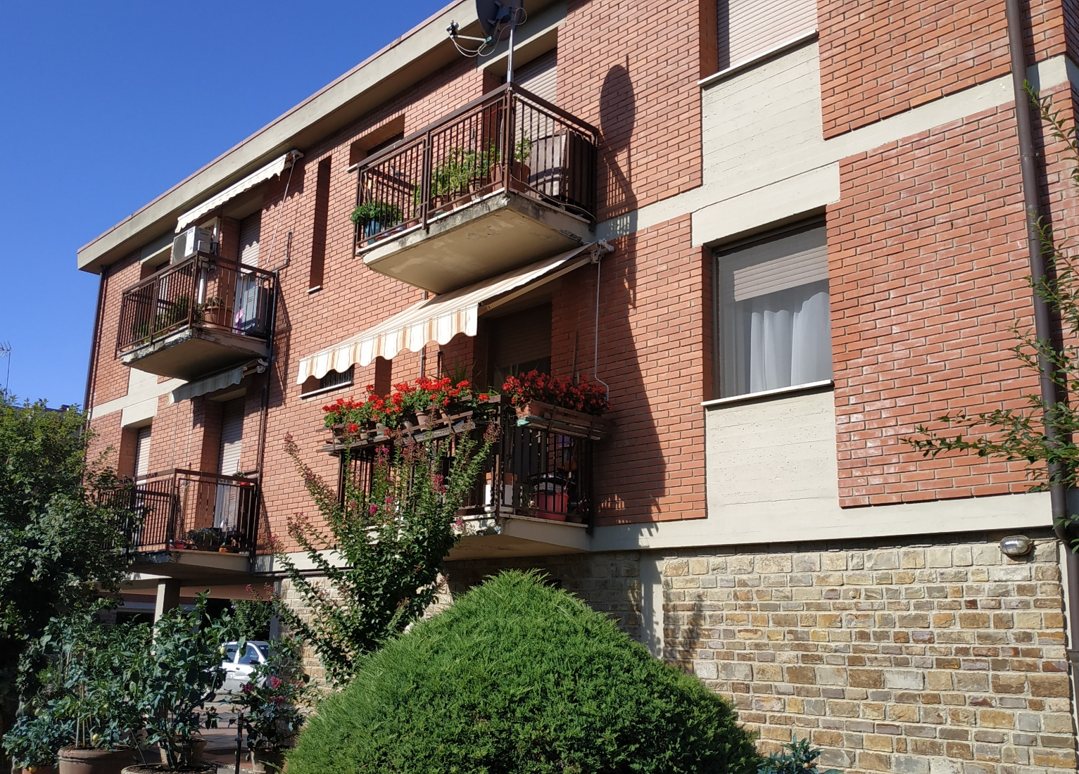

The Italian case
Location: Greve in Chianti, Tuscany, Italy
Destination: social housing
2 twin buildings with 4+4 dwellings
Year of edification: 1978-79
Reinforced concrete frame structure
Autonomous heating and domestic hot water systems
Number of residents: 15
Residents: elderly, retired (most residents have lived there for 30-40 years)

Slide 18
Comparative LCA: industrialized vs traditional retrofit
Traditional and industrialized retrofit need to achieve the same function: providing a living environment to the inhabitants of the Italian demo building over a reference study period of 50 years and achieving the following performance:
Parameter | Value | Unit
Indoor air temperature (winter) | 19-21 | °C
Indoor air temperature (summer) | 25-27 | °C
Indoor humidity | 30 winter, 50 summer | %
Max CO₂ concentration | 1000 | ppm
Illuminance |  | lux
Self-sufficiency | 48 | %
Notes:
(These are the characteristics that need to be achieved by all compared renovated buildings, either with materials or with additional energy use)

Slide 19
Setting a comparative LCA study: data collection
Industrialized retrofit: primary data from technology providers and energy simulations
Traditional retrofit: bill of quantities adapted to the specific building
 | Industrialized retrofitting | Traditional retrofitting
Envelope | Timber-based insulated façade (ventilated) Timber-based insulated roof (ventilated) New windows | Insulated façade (ventilated) Insulated roof (ventilated) New windows
Systems | Centralized heat pump Semi-decentralized ventilation, heating and cooling per dwelling PV panels (integrated in roof and façade) Solar thermal panels (integrated in façade) | Centralized heat pump connected to split units per dwelling Centralized ventilation PV panels (roof)

Slide 20

Life cycle stages
Industrialized retrofit
Raw materials
Component assembly off-site
Installation on-site
Operation
Maintenance
End of life
Component production
Manufacturing
Traditional retrofit
Raw materials
Installation on-site
Operation
Maintenance
End of life
Component production
Manufacturing

Slide 21
LCA results (starting point)
The higher the worse
Software: openLCA
Database: ecoinvent 3.8 cut-off
Method: EF 3.0
*Results referred to 1 building, reference life time: 50 years

Slide 22
Life cycle stage contribution
*Results referred to 1 building, reference life time: 50 years

Slide 23
Industrialized retrofit impacts/ analysis
Carbon footprint contributions
*Results referred to 1 building, reference life time: 50 years

Slide 24
Where to improve in industrialized design?
Raw materials acquisition
Technology production
Technology installation
Use
Maintenance
Technology EoL
Life cycle stages
Pathways
1. Alternative materials
2. Technological improvement over time
3. Extended service life
4. Design for assembly and disassembly
5. Refine energy simulations

Slide 25
Testing the pathways
Pathway 1: alternative material-> change compensation layer in timber façade (stone wool -> wood fibre)
Pathway 3: extended service life -> increased service life of solar panels (10->25 years)
*Results referred to 1 m² of timber façade, without cladding
*Results referred to 1 building, reference life time: 50 years

Slide 26
Conclusions and the way forward
We have tools and metrics, we need to apply them
Empower AEC professionals
Empower countries (e.g. national databases)
Work on communication of results
Work on setting benchmarks
Connect sustainability research with industry
The European Green Deal: “Companies making ‘green claims’ should substantiate these against a standard methodology to assess their impact on the environment”.

Slide 27


Contact: Claudia Di Noi, dinoi@greendelta.com
GreenDelta GmbH
Kaiserdamm 13, 14057 Berlin, Germany
www.greendelta.com

