Slide 1




THE FUTURE ENVELOPE
TOWARDS ZERO CARBON BUILDINGS
15‐16 December 2022 Bolzano/Bozen
BUILDING OF SUSTAINABLE ENVELOPES WITH INNOVATIVE PRECAST CONCRETE ELEMENTS
Ing. PIERO BERNABÉ
PROGRESS AG
Collaborations
Sponsors
Organized by
Notes:
Welcome, thank you for your attendance today
I‘m going to spend some time explaining about our solutions for sustainable envelopes with innovative precast elements.

Slide 2
DEFINITION OF SUSTAINABILITY
HOUSING QUALITY
DESIGN QUALITY
WORKING CONDITIONS
DURABILITY
SUSTAINABLE ENVELOPES
EFFICIENCY x DURABILITY
ENVIRONMENTAL IMPACT x COSTS
WASTE
EMISSIONS
ENERGY EFFICIENCY
COSTS
Notes:
Building envelopes can contribute substantially towards achieving carbon neutrality and sustainability of the constructions.
Achievement of sustainability is not limited to the correct choice of materials: CO2 emissions depends also on the fabrication processes, transport distances,
the operational energy of buildings, the durability of buildings and their components, waste generated during all processes, and on what happens to the envelope components when they reach their End of Life.
Also housing quality, comfort and wellbeing for the users are important factors to increase the efficiency of our buildings and therefore sustainability. And envelopes have a strong impact on these points.
These 8 clusters are the most important aspects when evaluating the sustainability of a building system. The 4 positive aspects are to be maximized, the 4 negative aspects are to be minimized.
Today I will spend some time explaining to you about our innovative system to build external bearing walls and envelopes with concrete precast elements and also about the sustainability value of this solution.

Slide 3
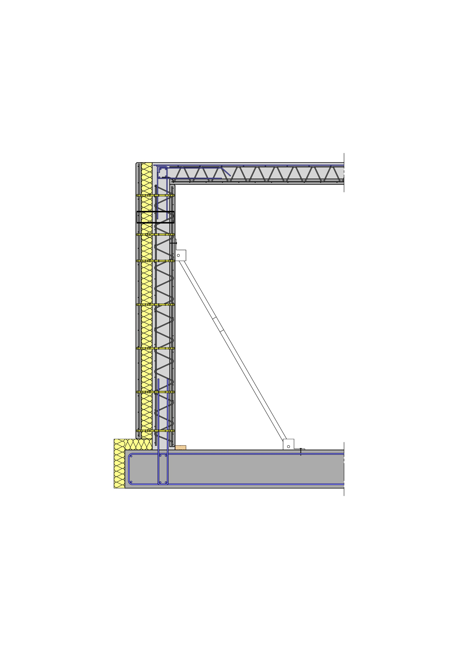
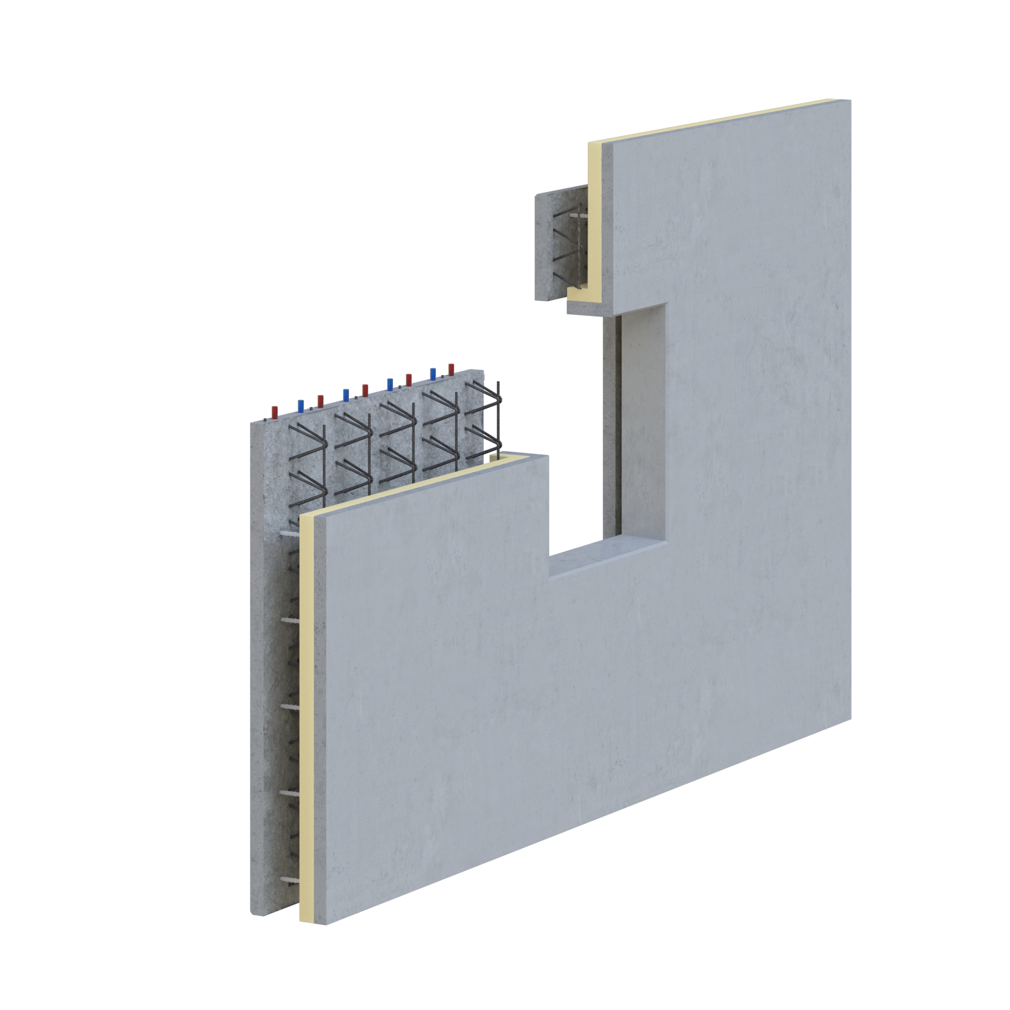
SYSTEM DESCRIPTION
outdoor shell
integrated mineral insulation
heating and cooling tubing
steel reinforcement
inner shell
electrical parts
in-situ concrete
bearing structure
GREEN CODE THERMO WALL®
Notes:
The GREEN CODE Thermo Wall is built as two precast concrete shells: the outer shell with integrated insulation and the inner shell as part of the bearing structure of the wall, with integrated steel reinforcement and technological elements like electrical parts or heating and cooling tubing.
On the construction site these two shells have to be filled with in-situ concrete to complete the bearing part of the wall and to connect the elements together.
The majority of the bearing structure, of the technical parts and of the envelope are prebuilt inside the factory to create a hi-technology precast element.
The external visible part of the wall element can be designed with multiple different styles. For example colours, a polished concrete surface or textures.

Slide 4
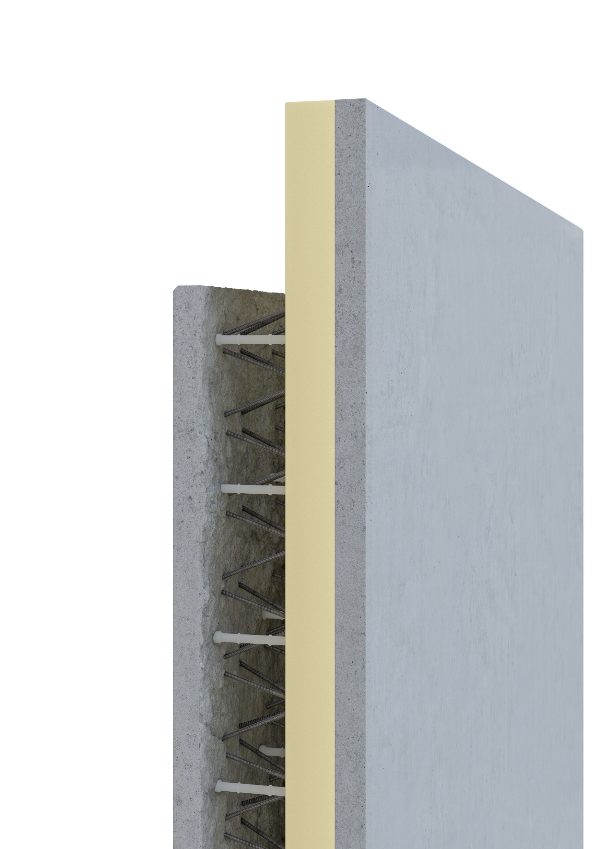
INSIDE FUNCTIONS
structural bearing parts (concrete and reinforcement)
thermal insulation (also as mineral insulation)
electrical parts
heating and cooling as a rediant system with tubes integrated in the inner concrete shell
thermal energy storage in the mass of the concrete
acoustic insulation
external finish and a visible facade
Notes:
Within the elements are a lot of integreted functions:
structural bearing parts (concrete and reinforcement)
Thermal Insulation (also as mineral insulation)
Electrical parts
Heating and cooling as a radiant system with tubes integrated in the inner concrete shell
Thermal energy storage in the mass of the concrete
Acoustic insulation
External finish and a visible facade
And all this functionality with just 3 materials: concrete, reinforcement steel and different types of insulation. Technical installations are made from recycled plastic and this can be separated for recycling.

Slide 5
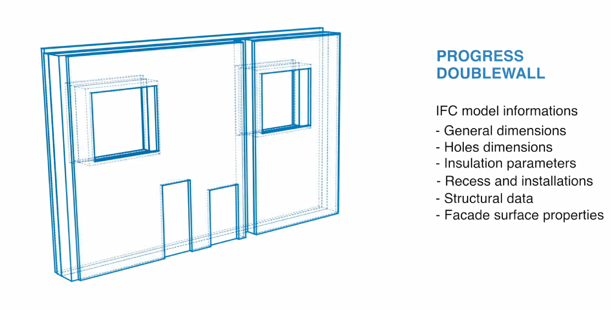
MODEL TO FABRICATION
Notes:
To combine all of these functions, an integrated design process is strictly necessary.
For the construction of the elements we build a very complete digital twin of the wall with all the information that we need to build the product:
dimensions
Reinforcement type
Materials
We share this model with our design team and then use this digital twin to input all necessary information into our high-tech machinery, which enables us to construct the finished product in the factory with a very high level of automation.

Slide 6

MODEL TO FABRICATION
Notes:
To combine all of these functions, an integrated design process is strictly necessary.
For the construction of the elements we build a very complete digital twin of the wall with all the information that we need to build the product:
dimensions
Reinforcement type
Materials
We share this model with our design team and then use this digital twin to input all necessary information into our high-tech machinery, which enables us to construct the finished product in the factory with a very high level of automation.

Slide 7
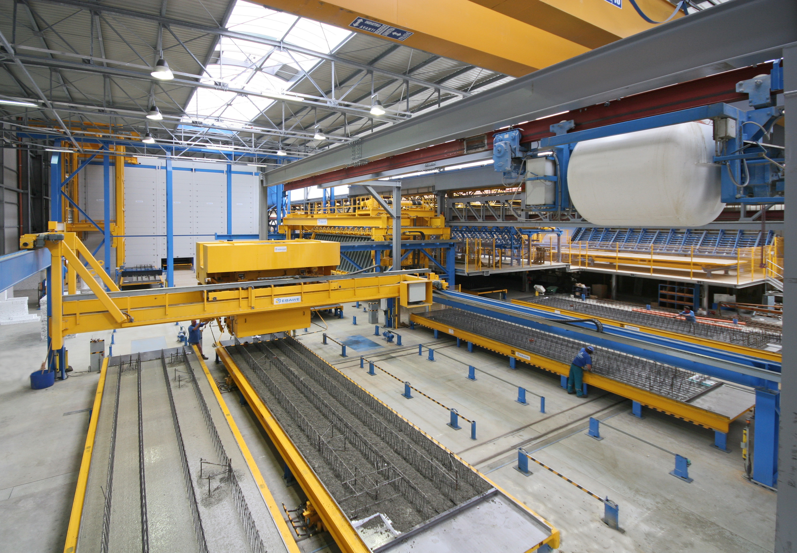
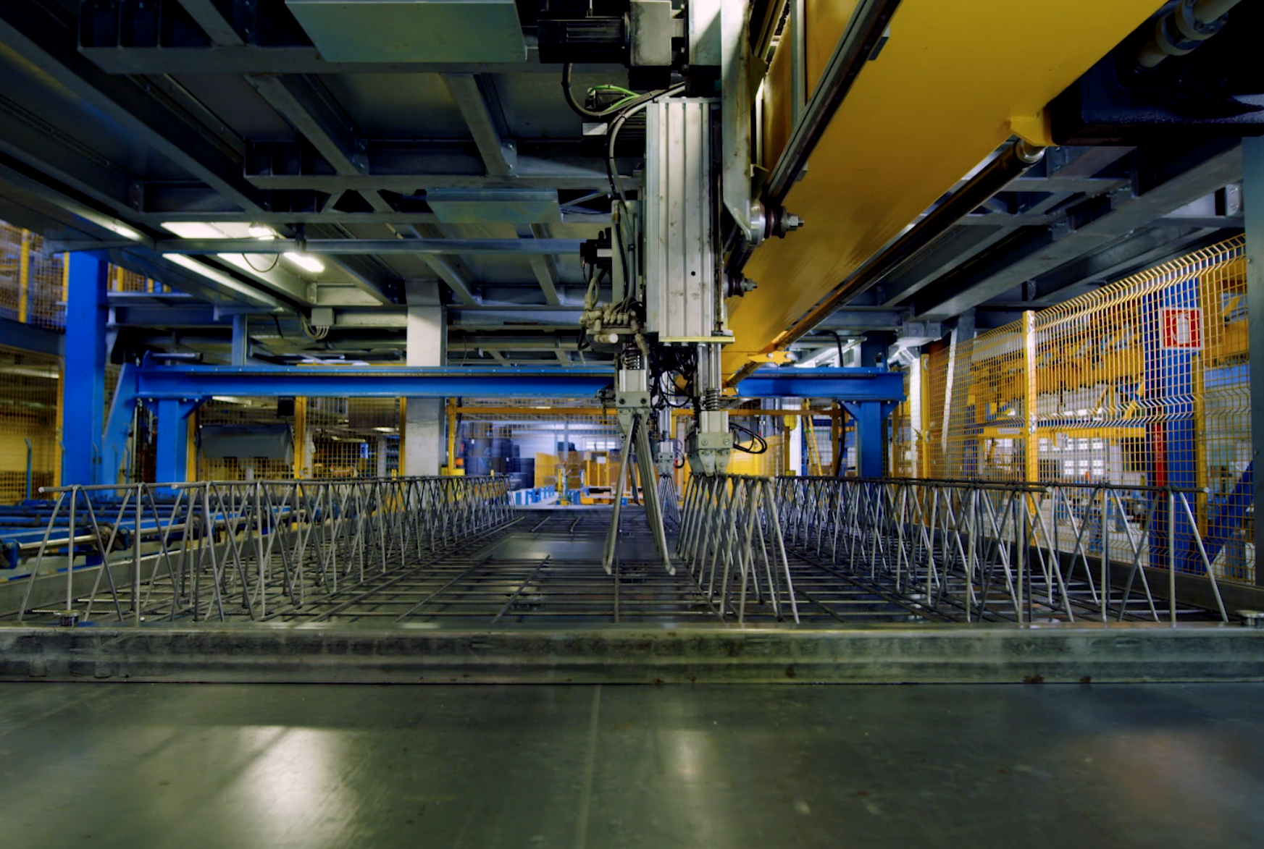
AUTOMATED PRODUTION

Slide 8
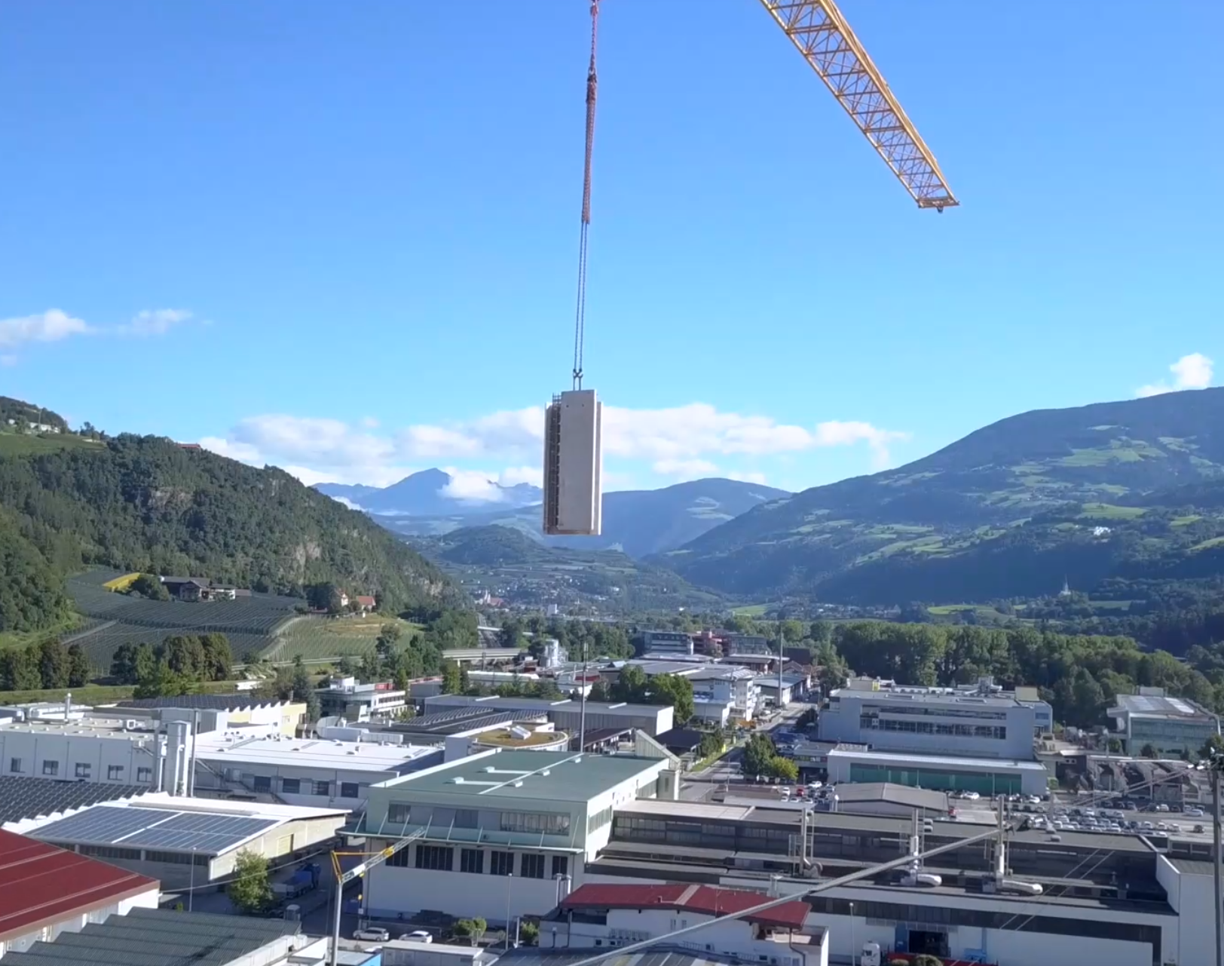
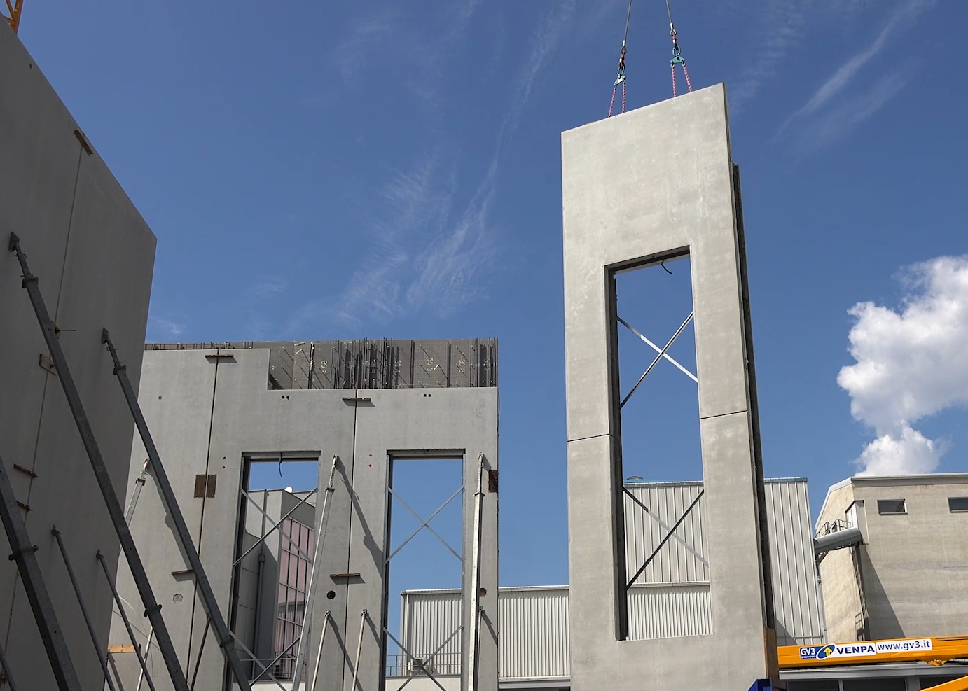
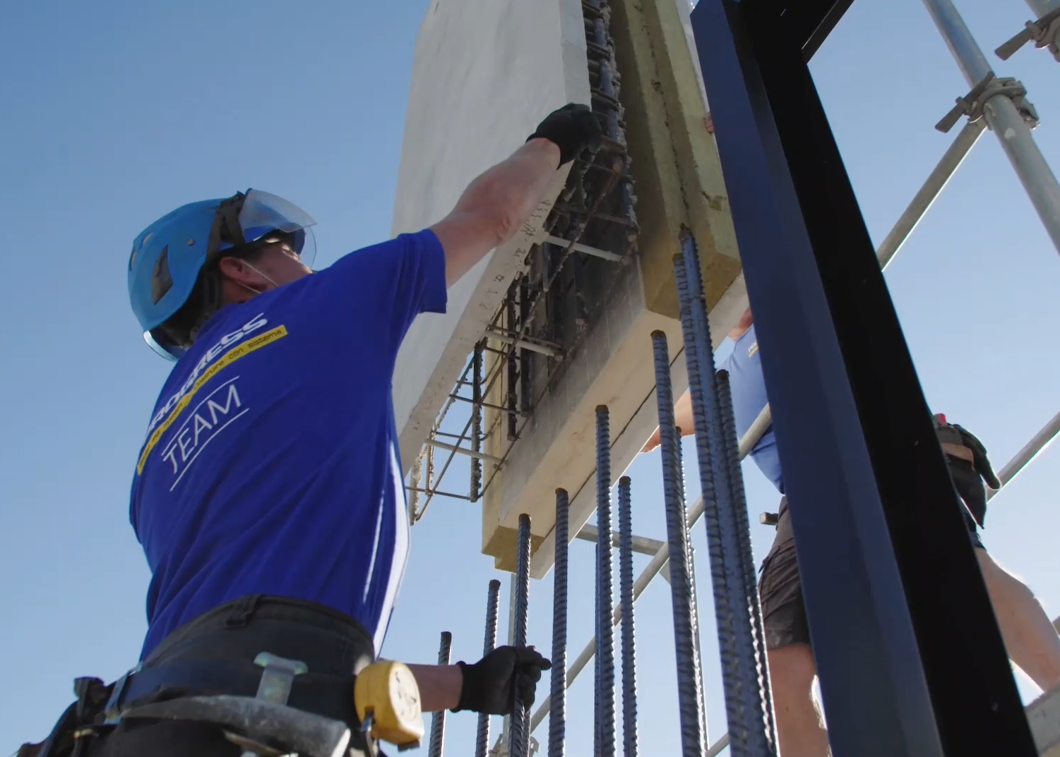
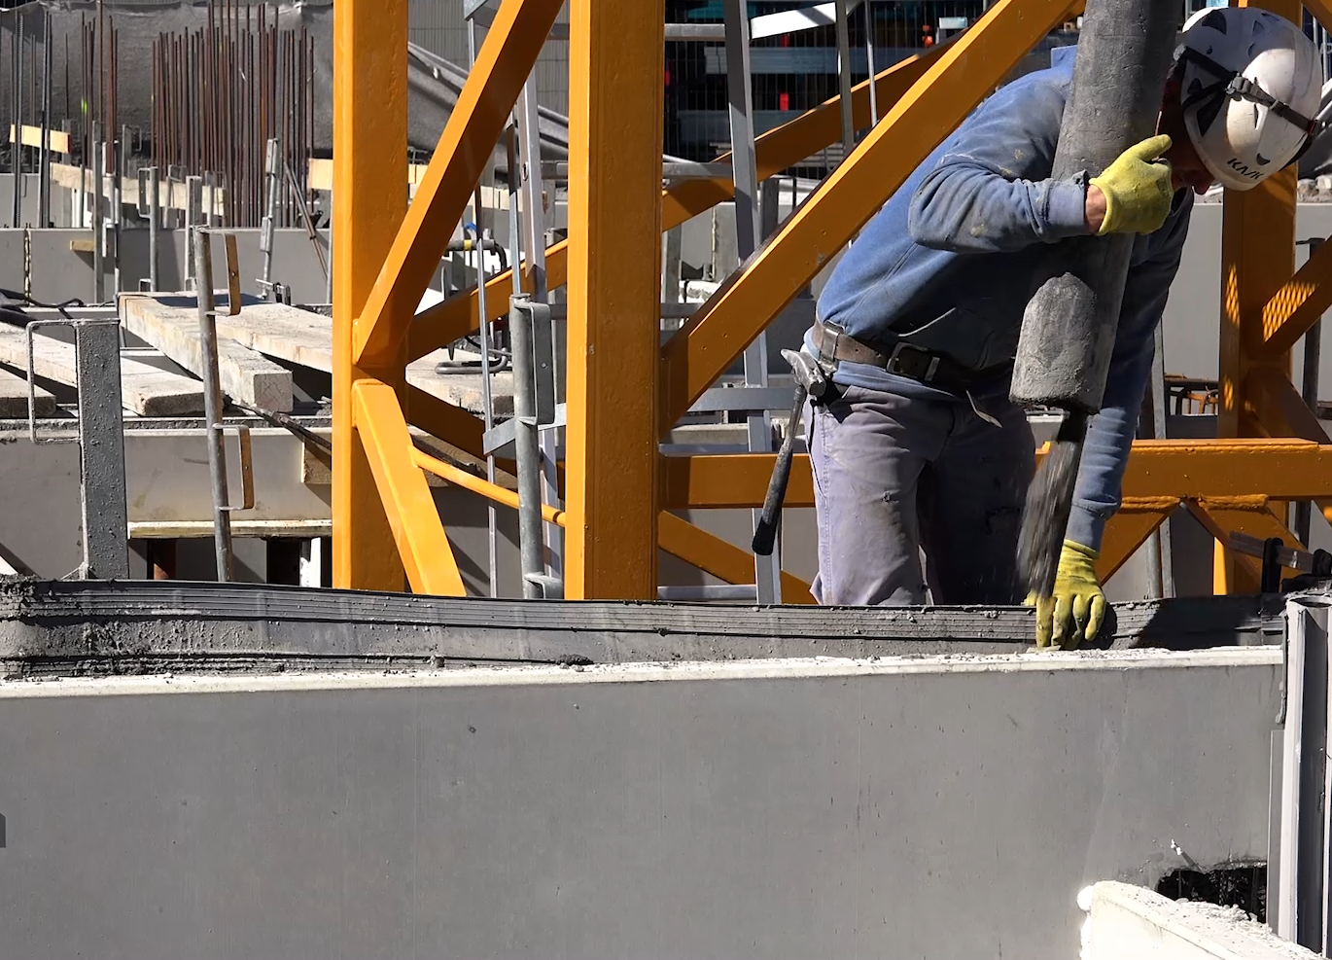
CONSTRUCTION SITE
Notes:
On the construction site, we have a very simple process with the only requirements being the mounting of the elements and the filling with in-situ concrete.
The connections between the elements are very simple and a lot of functions and technical parts have already been constructed in the factory.
There is a very low possibility of errors on the construction site and this saves a lot of time.
We previously compared traditional building methods with this precast system on a 8 story building:
With the GREEN CODE Thermo Wall we saved 40% on construction time with 60% fewer workers on the construction site.

Slide 9
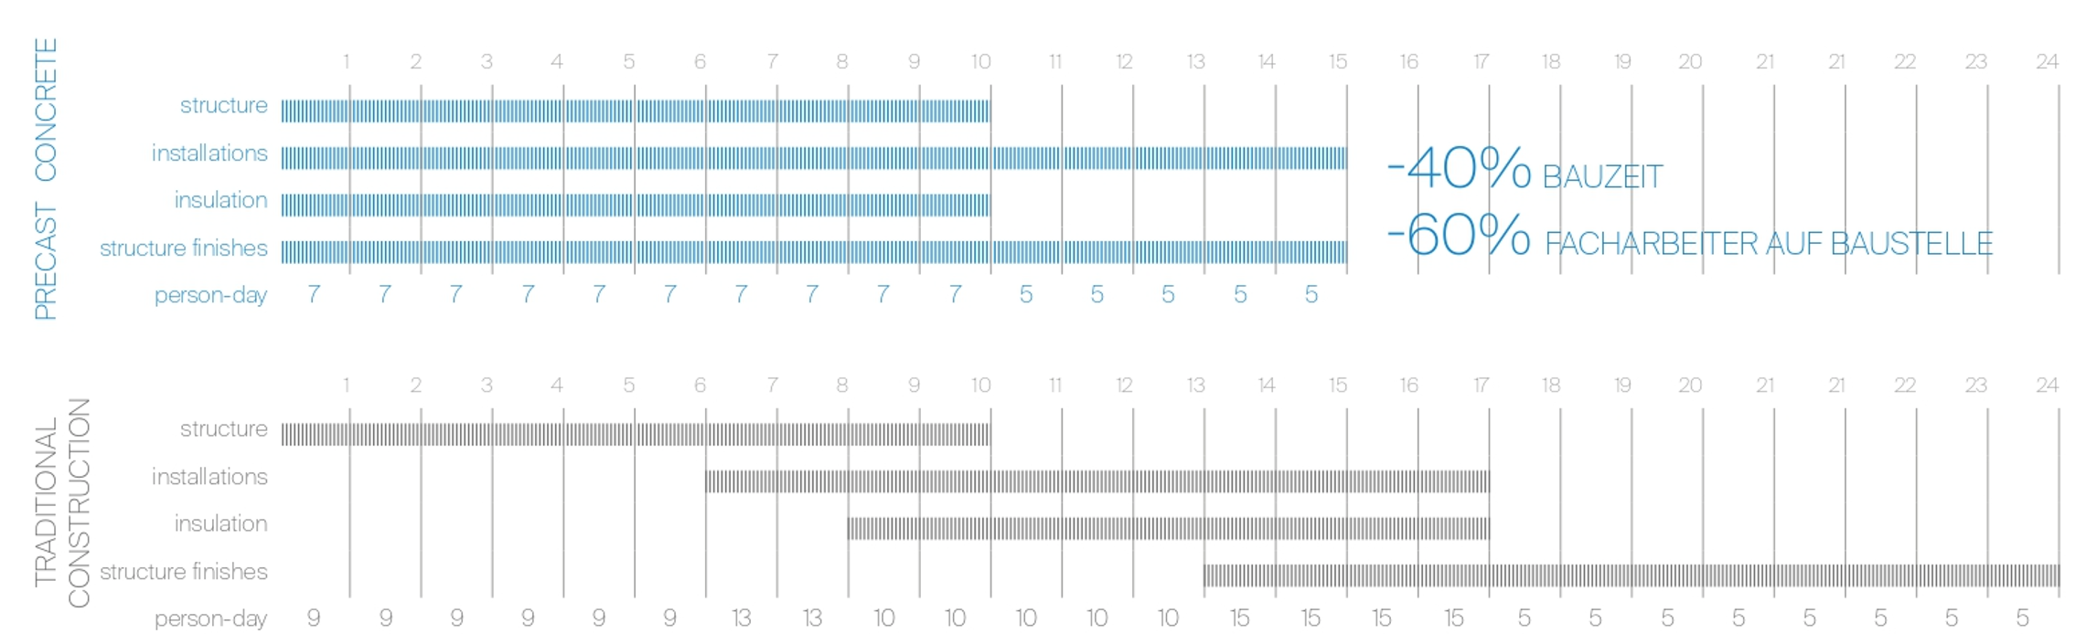
COMPARED BUILDING METHODS
- 40 % construction time
- 60 % fewer workers on the costruction site
Notes:
We previously compared traditional building methods with this precast system on a 8 story building:
With the GREEN CODE Thermo Wall we saved 40% on construction time with 60% fewer workers on the construction site.

Slide 10
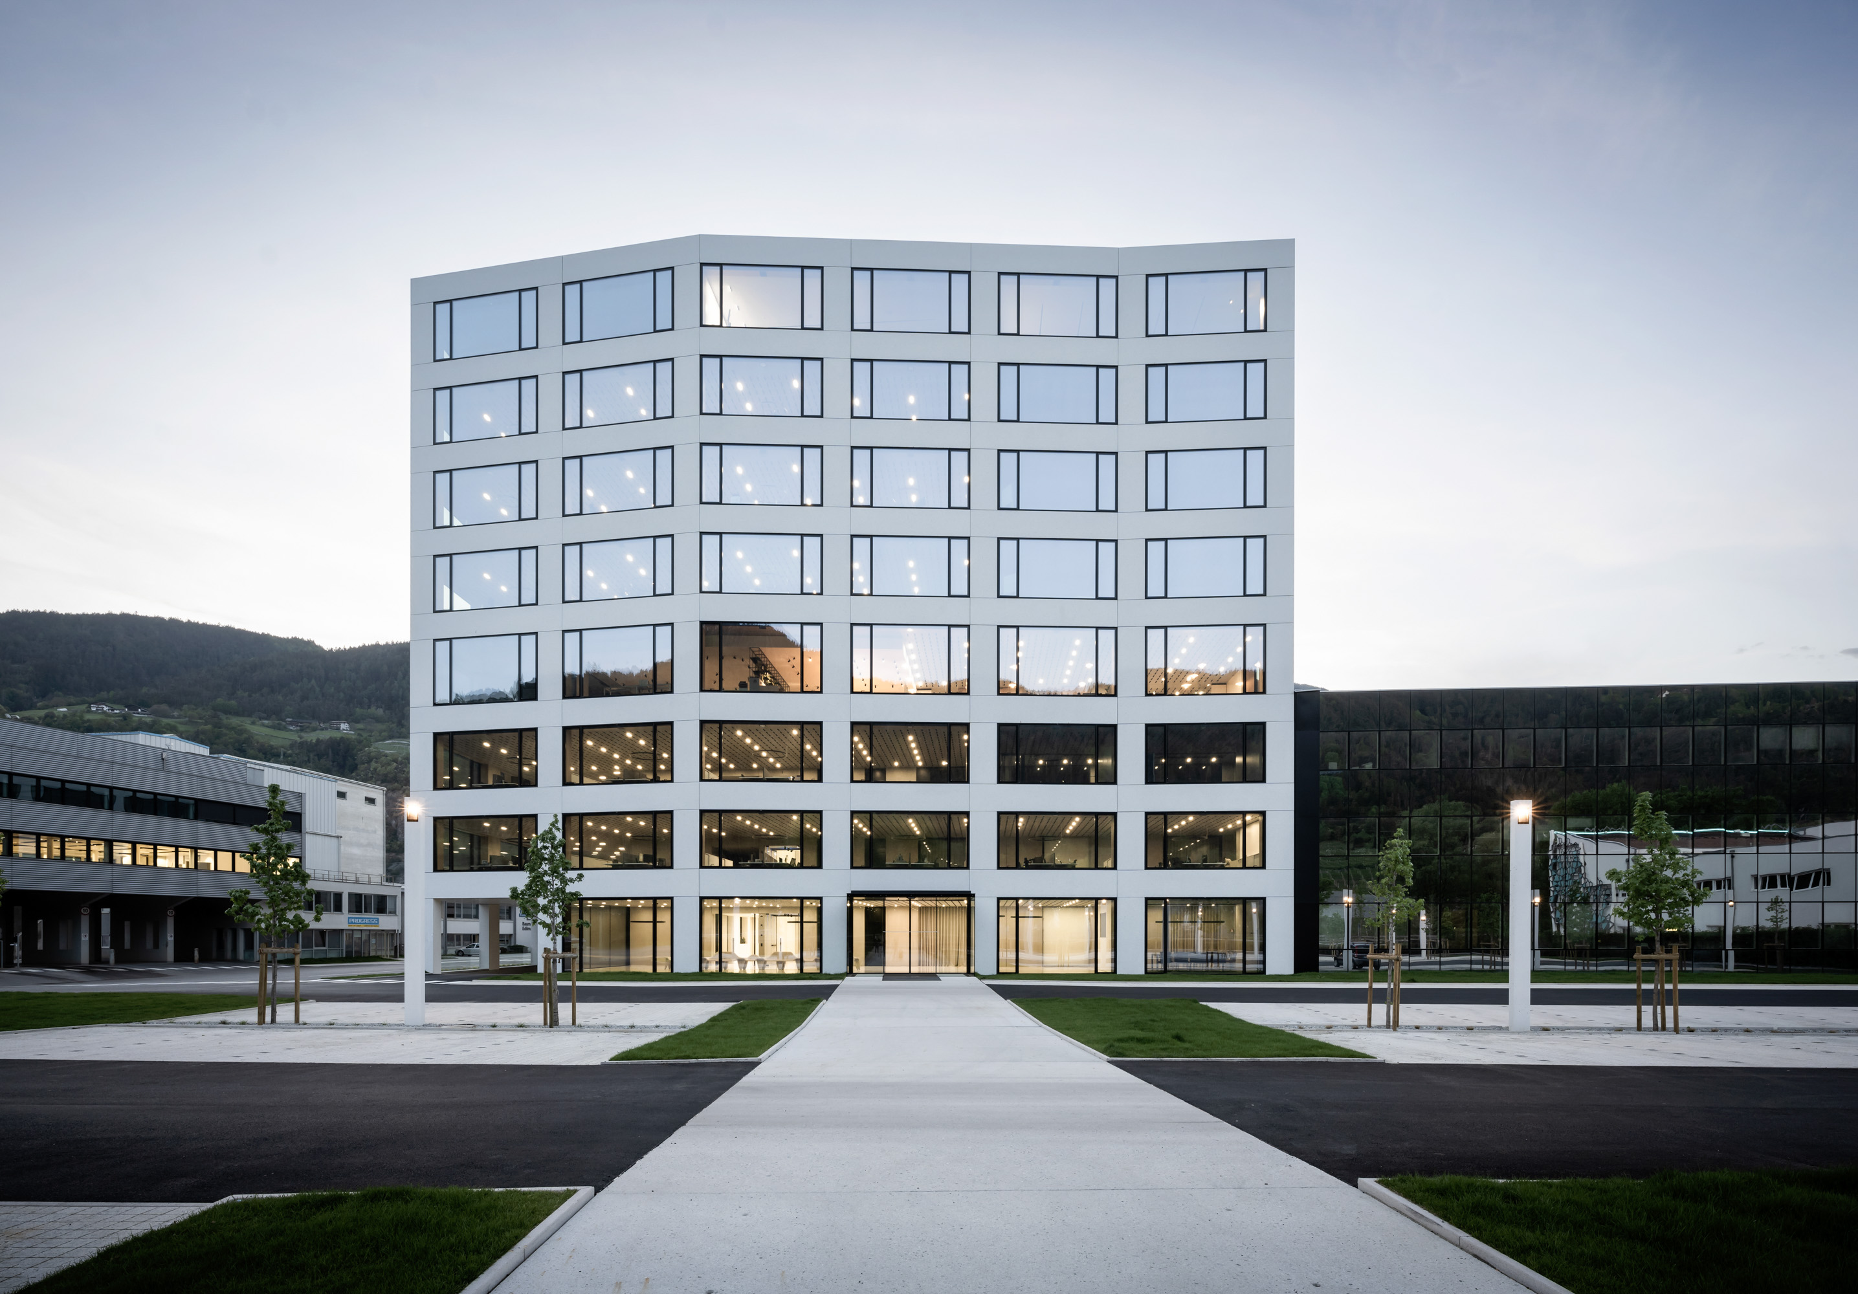
HEAD OFFICE - BRIXEN
Notes:
I want to show you multiple examples of buildings where we used GREEN CODE Thermo Wall for the external walls.
I want to show you how individualised this system can be.
This is our Head Office in Brixen built with precast facade in white polished concrete with local white marble gravel.

Slide 11
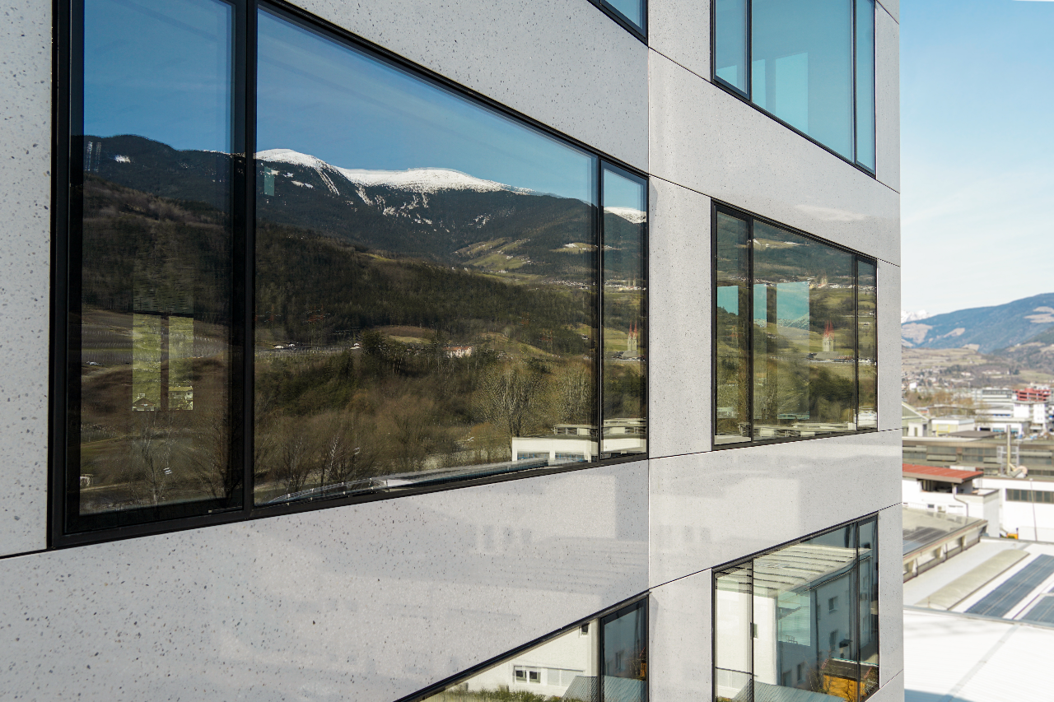
WITHE POLISHED MARBEL CONCRETE FACADE

Slide 12
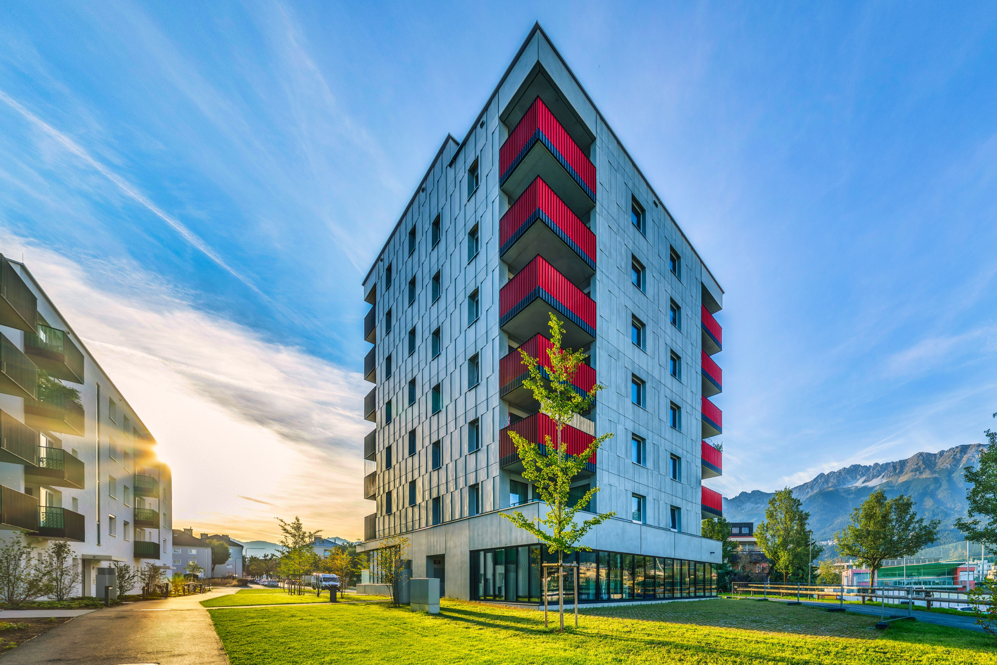
RESIDENCIAL BUILDING – INNSBRUCK
Notes:
This is a residential building in Innsbruck with fair-faced concrete.

Slide 13
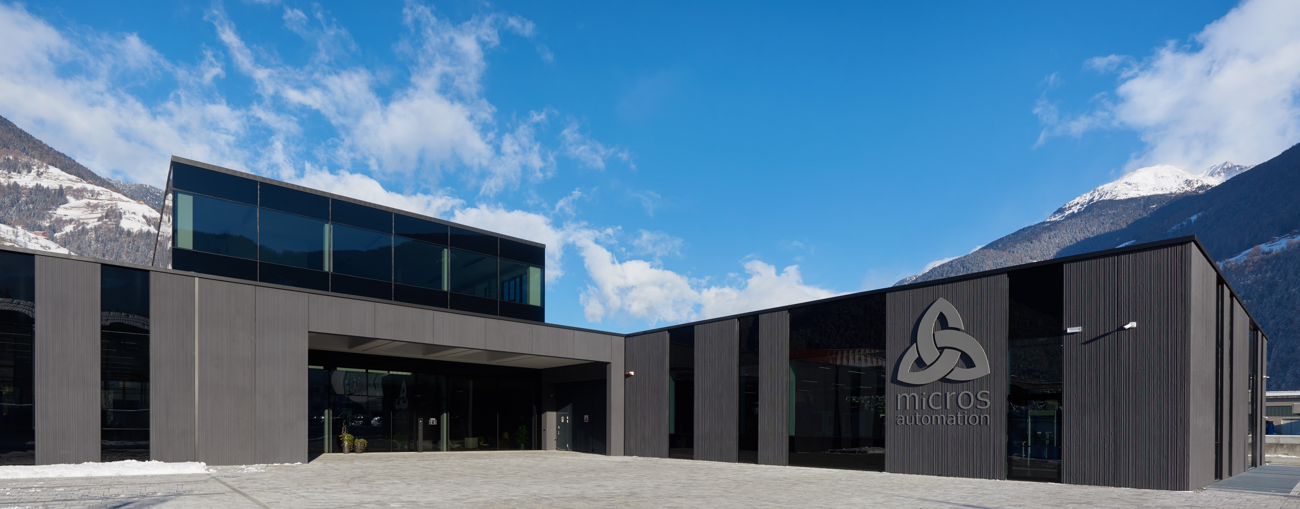
INDUSTRIAL BUILDING – GAIS
Notes:
This is an example of an industrial building. Heavy loads and large dimensions can also be built with the same type of elements.

Slide 14
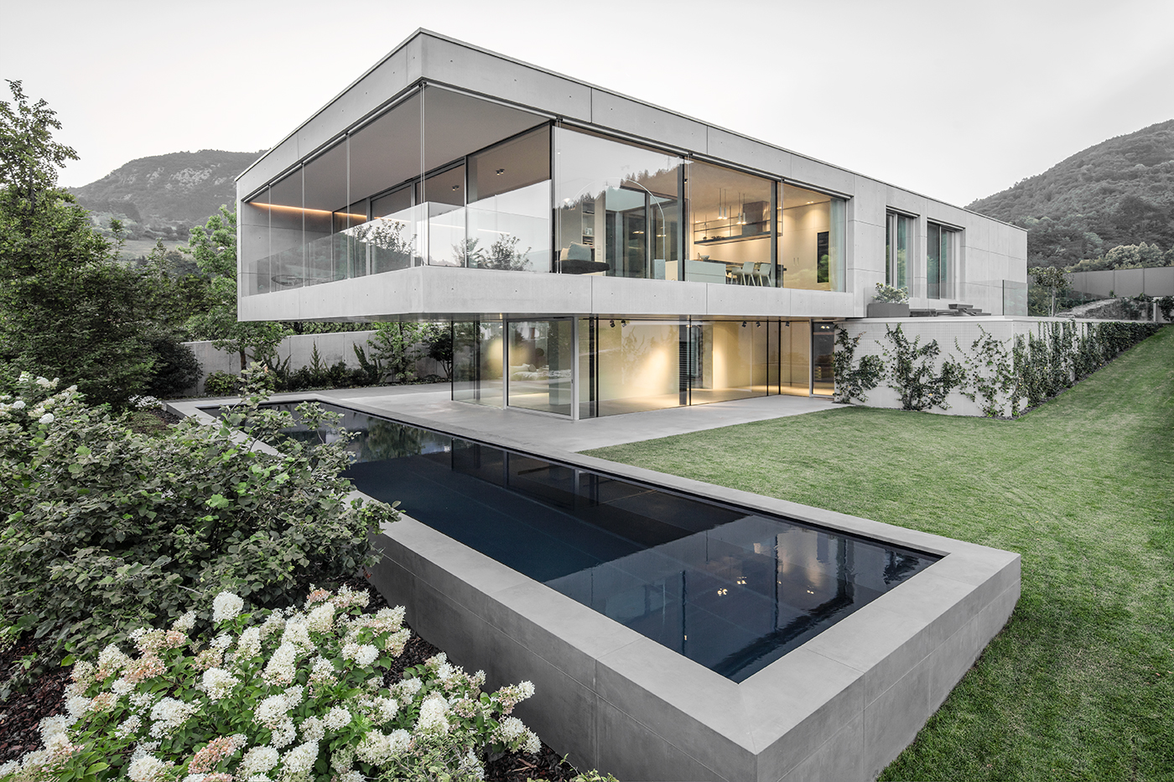
VILLA – TRENTO
Notes:
This is a luxury villa in Trento that also has precast fair-faced concrete facade.
The same types of elements for different types of projects with very individual architectural design. And this with just the same 3 materials: concrete, steel and mineral insulation.

Slide 15
DEFINITION OF SUSTAINABILITY
HOUSING QUALITY
DESIGN QUALITY
WORKING CONDITIONS
DURABILITY
SUSTAINABLE ENVELOPES
EFFICIENCY x DURABILITY
ENVIRONMENTAL IMPACT x COSTS
WASTE
EMISSIONS
ENERGY EFFICIENCY
COSTS
Notes:
Now i want to spend some time to explain to you the sustainability advantages of this type of building system, based on these 8 categories:
Housing quality
Design quality
Working conditions
Durability
Waste
Emissions
Energy efficiency
Costs

Slide 16

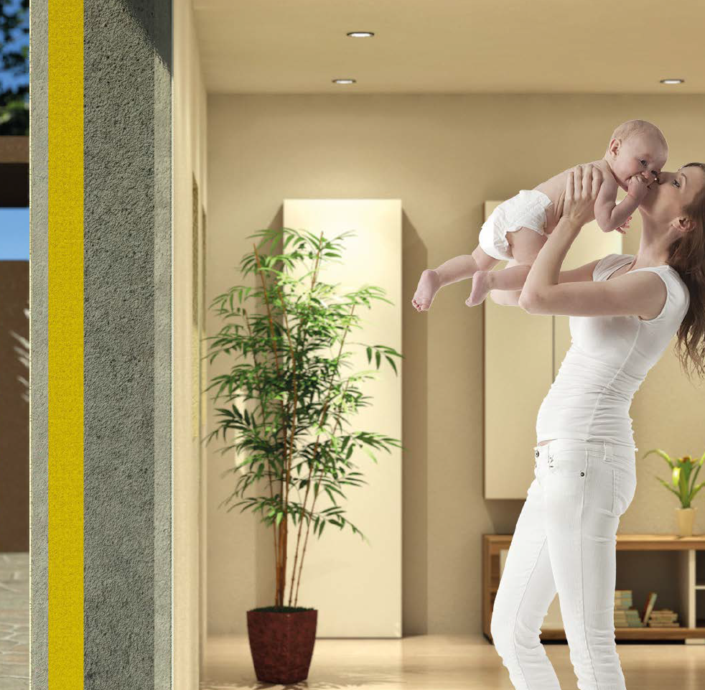






HOUSING QUALITY
Green Code Thermo Wall®
Notes:
The combination between precast elements with integrated steel reinforcements and the in-situ concrete allows a lot of flexibility and also the possibility to build hyperstatic wall-slab connections for strong and earthquake-proof buildings.
The outer and also the inner hi-quality surfaces need very low finishing works after the installation and are low maintenance throughout the lifetime of the building, even when factoring in extreme weather conditions on the outside.
With the right combination between insulation and the thermal activation of the concrete mass we have the best indoor quality conditions with very low energy demand.
The concrete outer shell protects for fire, and the mass of concrete protects for outer noise.

Slide 17

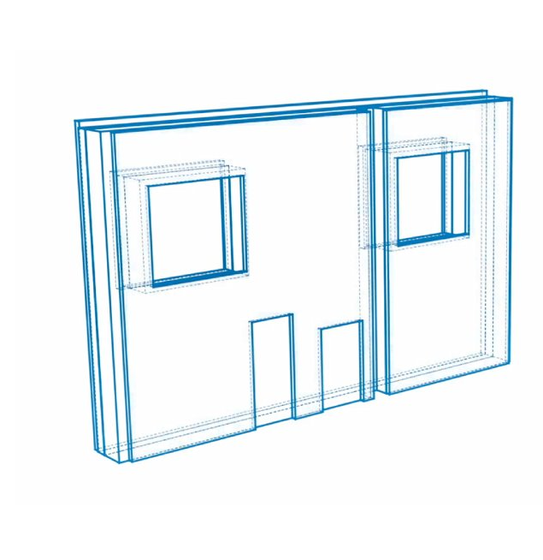

DESIGN QUALITY
Notes:
For a sustainable solution, we have to design the walls so that we use as little material as possible: thin walls to save on concrete and for less structural weight, high quality engineering to save on steel and the right type and thickness of the insulation with details to avoid thermal bridges.
Technical installations are integrated within the elements.
This design quality and this complexity needs integreted digital models to manage this amount of information.
With a digitally controlled, automated production of these hi-tech elements it is possible to reach the necessary quality and technical safety for the end product.

Slide 18

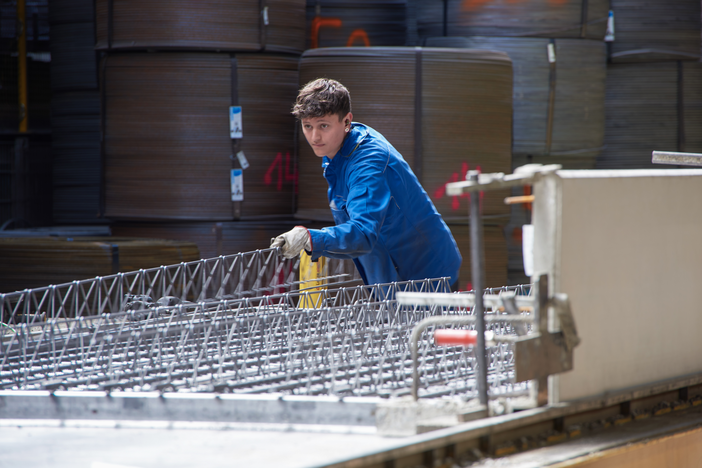
WORKING CONDITIONS
Notes:
Working conditions and safety are also a very important part of a sustainable building solution.
More work can be done in the factory in higher quality and more controlled conditions compared to the construction site.
Also, the finished buildings guarantee a higher level of wellbeing for the users as well as structural, earthquake and fire safety.

Slide 19
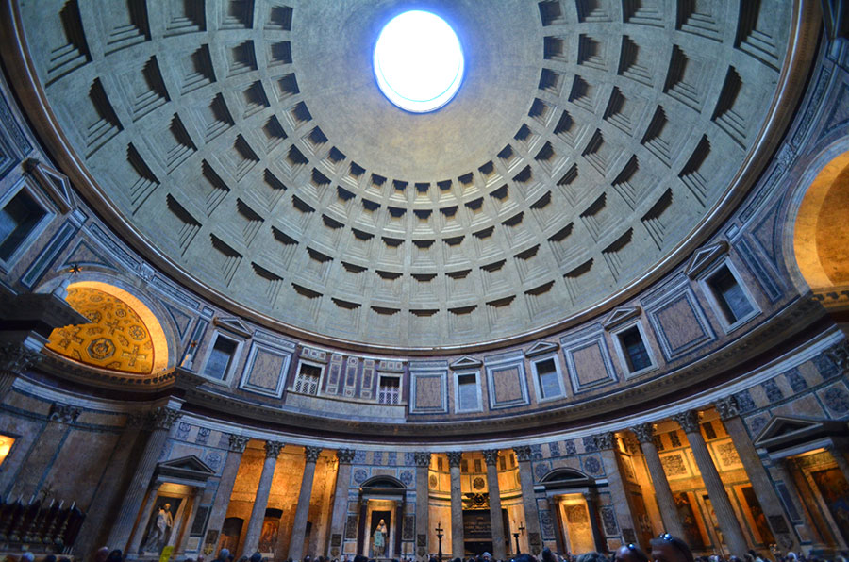

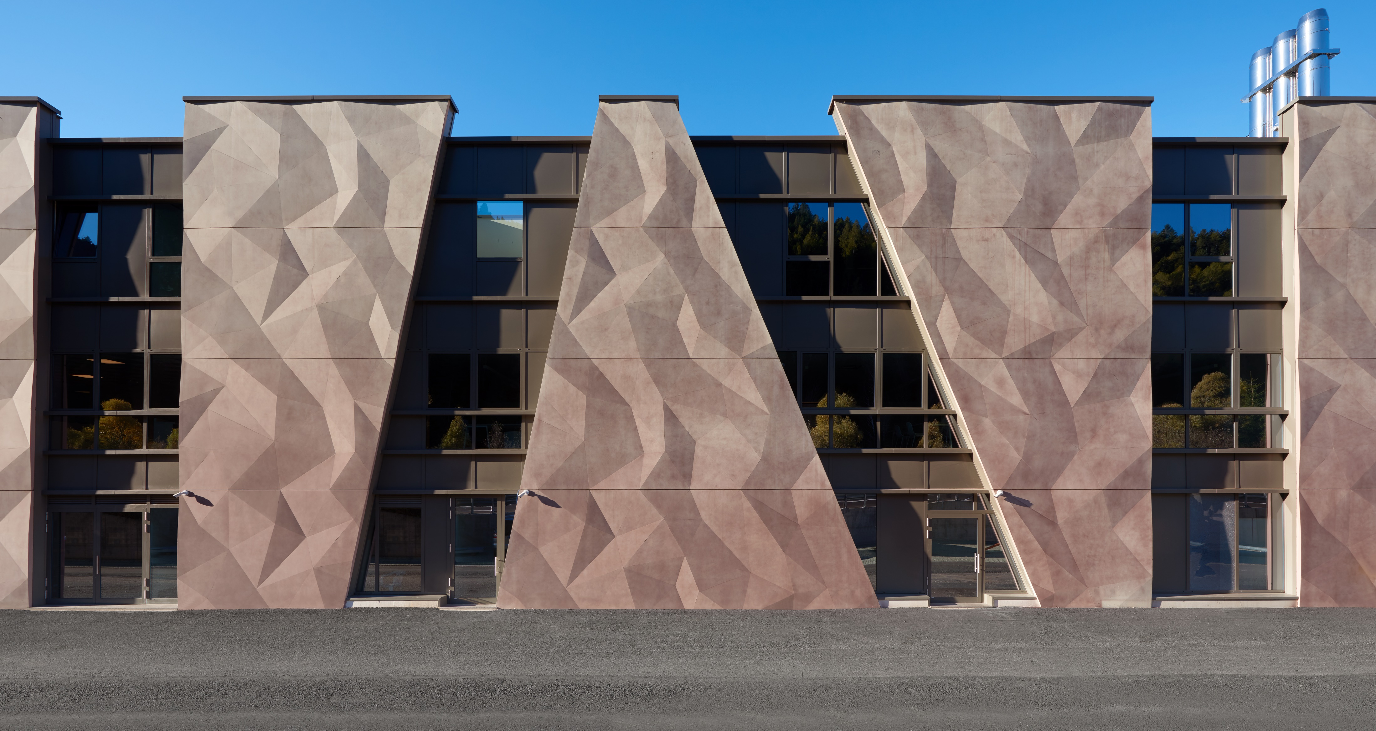
DURABILITY
Notes:
The Pantheon in Rome has existed for more than 2000 years. And it is made of concrete.
So we know that concrete has a very long lifetime!
We must design our buildings to be as long lasting as possible, to amortise the enviromental impact over a long period.
A facade normally has a shorter lifetime compared with the main building, however the concrete of the precast facade elements is a high-quality material with high durability and very low maintenence costs.

Slide 20


WASTE
3 materials
Ø waste
Ø packaging
100 % recycled
Notes:
The technological precast elements are designed as a very simple construction consisting of a few optimally integrated materials.
This is important to reduce waste in the building phase and to facilitate recycling.
In the factory the production works with no concrete, steel or insulation scraps. We can save between 10 to 15% on raw materials with a scrap free production.
The product with technological parts inside reach the construction-site with no types of packaging.
And at the end of the lifetime of the building, materials can be separated and recycled.

Slide 21

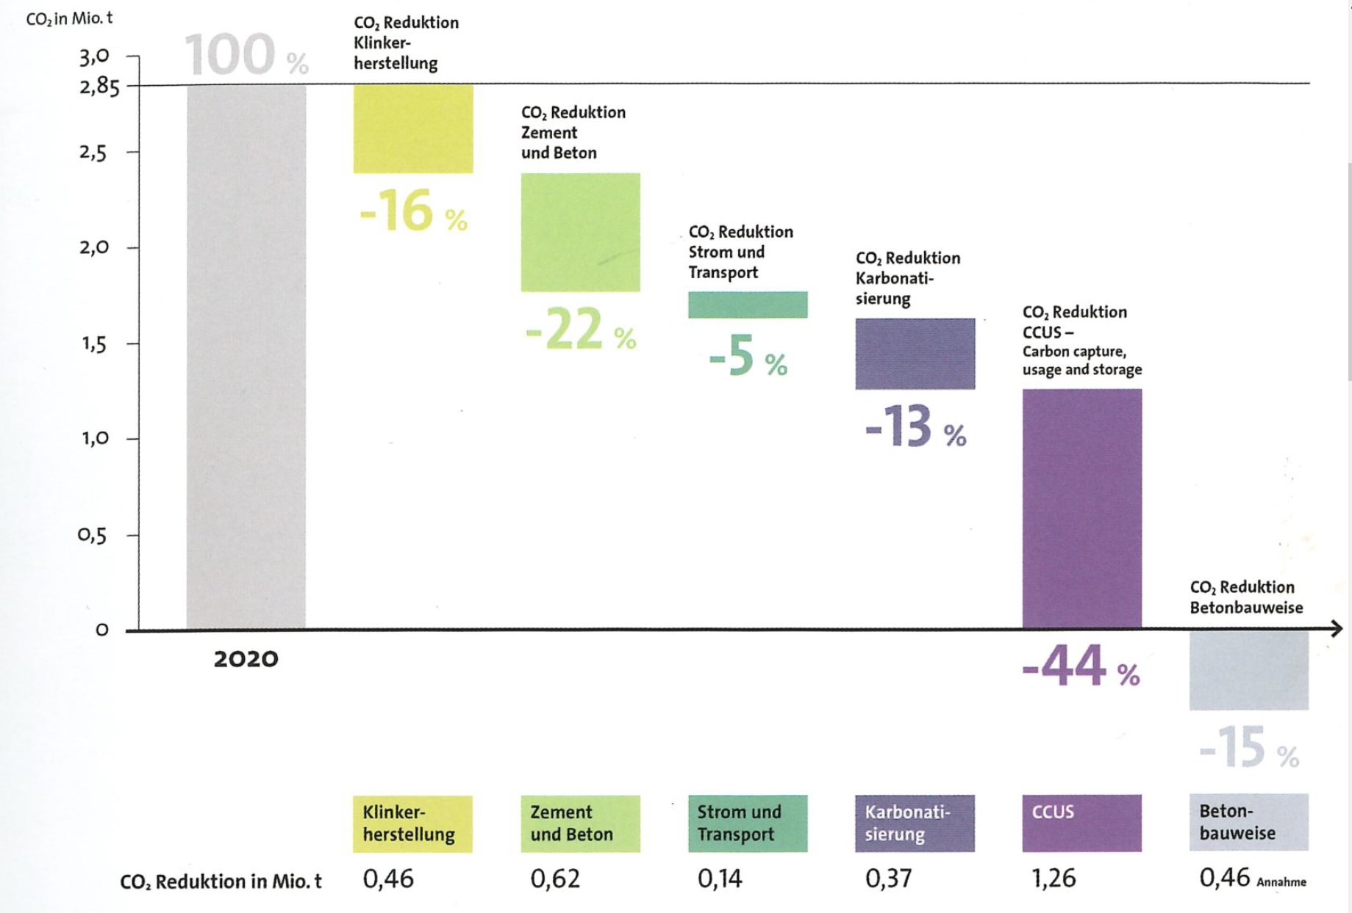

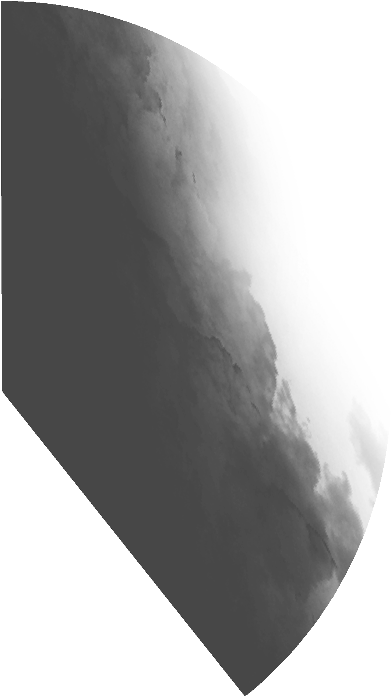
EMISSIONS
CO₂ Roadmap from the cement industry
Global annual CO₂ emissions
other
28 % operating functions of building
transport
industry
11 % materials & construction
Notes:
Buildings produce about 40% of global annual emissions - about 11% for Materials and construction, and 28% for the operating functions of the building.
To reduce emissions it is important to optimize the production of the materials and the quantity of used materials, but is much more important to reduce the operational energy demand of the buildings and consequent emissions.
The cement industry and also the concrete industry is now working on big improvements in the production process of cement and on the optimization of concrete recipes to use less cement.
These facts will massively reduce the CO2 emissions of the concrete sector in the future.
Precast factories, with an industrialized organization of the production and with high-level quality controls, are in the best position to accelerate this evolution.

Slide 22
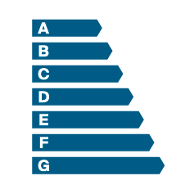
ENERGY EFFICIENCY
thermal activation
Notes:
High-quality insulation with good design to minimize thermal bridges, allow a very high level of energy efficiency of the envelope in winter and also in summer.
The internal concrete section of the walls can be integrated with thermal activation to heat or to cool in a very efficient way and with the highest quality conditions for the users.

Slide 23
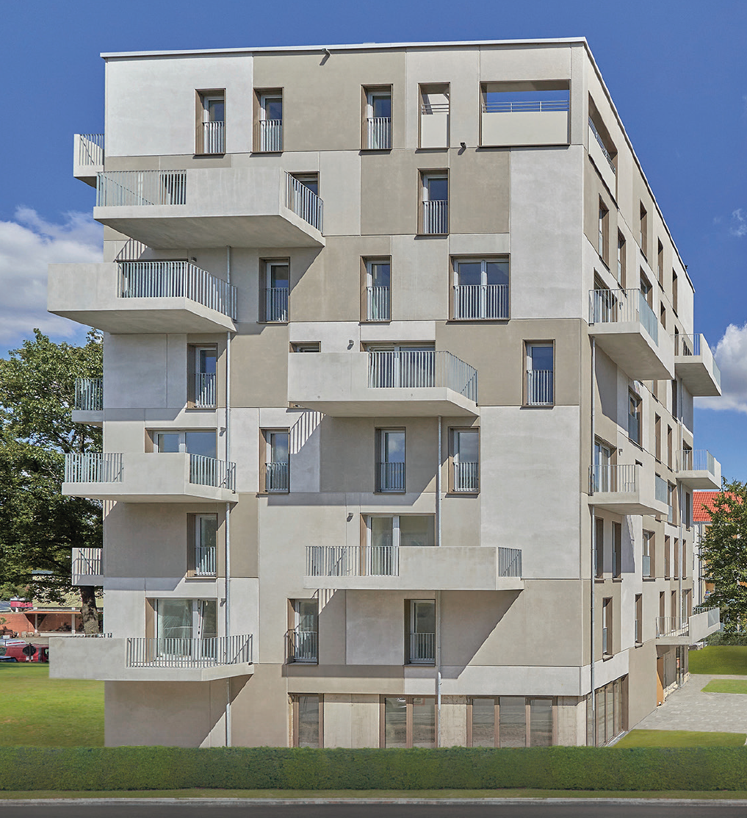
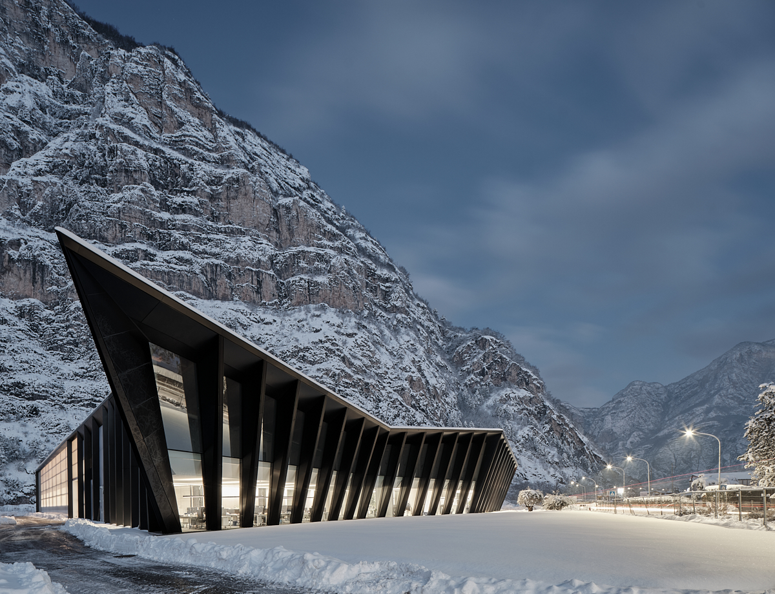
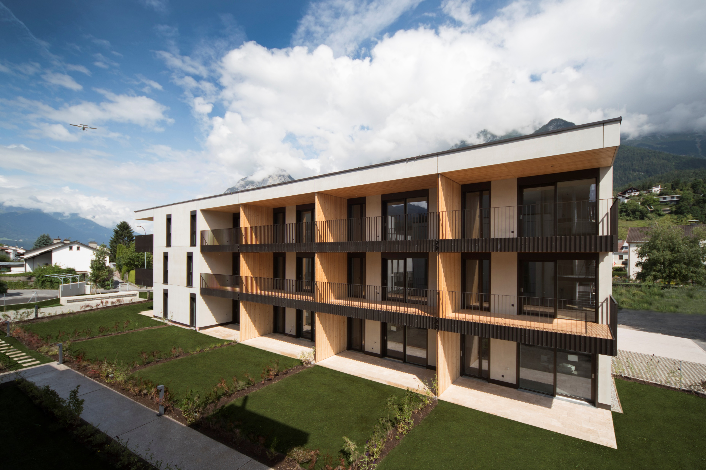

COSTS
Notes:
Good systems have to also be cost efficient.
Digital design and optimized industrial fabrication make high-level individualized buildings that are accessible to many people.
This is also an important aspect of sustainability.

Slide 24
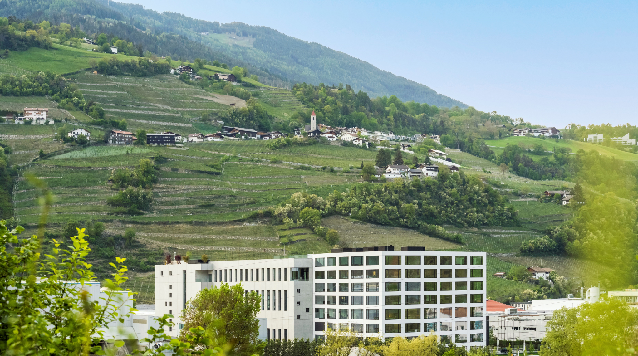


MISSION PROGRESS GROUP
OUR MISSION IS TO CREATE SUSTAINABLY BETTER LIVING CONDITIONS FOR EVERYONE
Notes:
With innovative high-quality concrete precast GREEN CODE Thermowall elements, we can build sustainable envelopes and improve living conditions for the people we service.

Slide 25
THE FUTURE ENVELOPE
TOWARDS ZERO CARBON BUILDINGS
15‐16 December 2022 Bolzano/Bozen
Thank you for the attention
Collaborations
Sponsors
Organized by
Notes:
Thank you for the attention…

