Slide 1




THE FUTURE ENVELOPE
TOWARDS ZERO CARBON BUILDINGS
15‐16 December 2022 Bolzano/Bozen
Challenge scenarios and trend indicators for building envelope innovation
MARTINO MILARDI
UNIVERSITA’ MEDITERRANEA REGGIO CALABRIA
Collaborations
Sponsors
Organized by

Slide 2


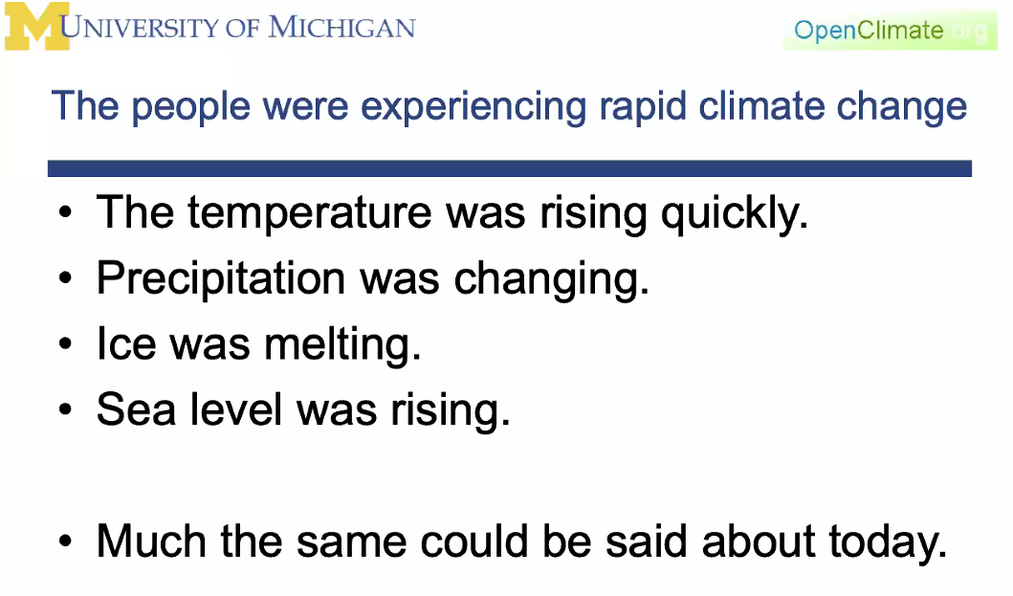

The challenge scenarios
…some known critical issues…
The climate change
New emerging Markets in response to Climate Change and Decarbonisation
Net Zero Carbon; Circular economy; Embodied Carbon; Elecrification/Storage etc; Offsetting;
Renovation Wave; Intelligent/Hybrid BMS; Positive Energy/Decarbonisation strategies; Renewables;
Smart Cities; Building Operation; Carbon Capture; etc.

Slide 3


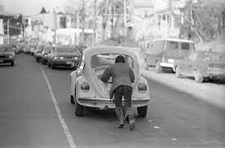
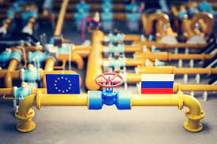
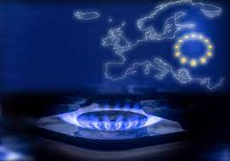
The challenge scenarios
…some known critical issues…
Crisis, security and energy transition

Slide 4

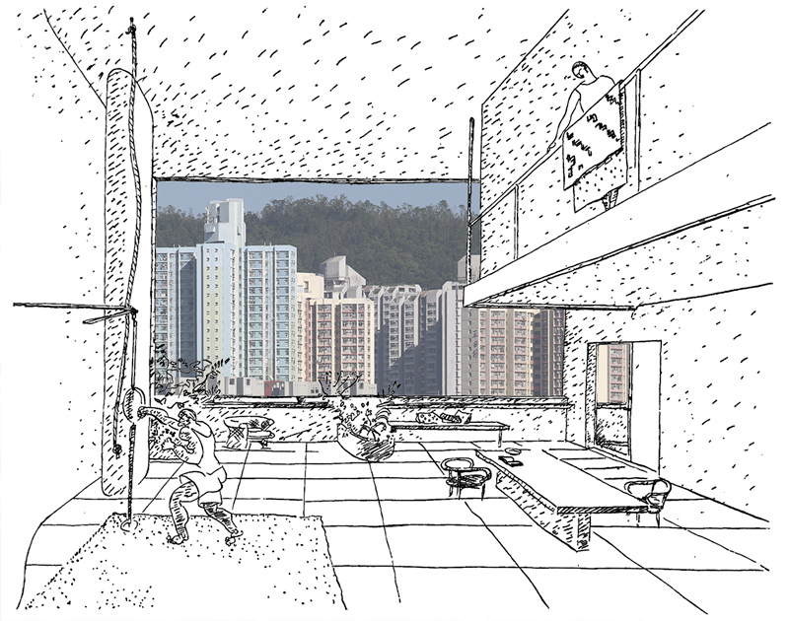
The challenge scenarios
…some known critical issues…
The change of living after the covid 19
New emerging Markets in response to Covid
Staff well-being: Comfort, air quality, etc.
ESG, Shareholders, competition, reportage, leadership, etc.
Building operation: Monitoring, Information feedback, AI/ML
Source: Photomontage of contemporary metropolitan landscape with the hanging garden of a collective residence by Le Corbusier (1928).
Source: https://urbanpromo.it/2020/eventi/nuovi-paradigmi-urbani-e-abitativi-per-le-citta-post-pandemia/

Slide 5
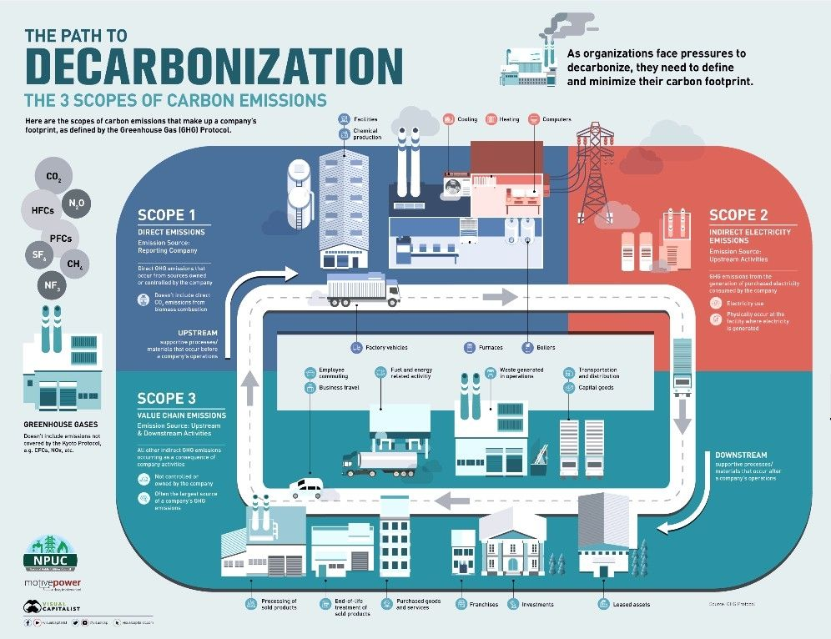
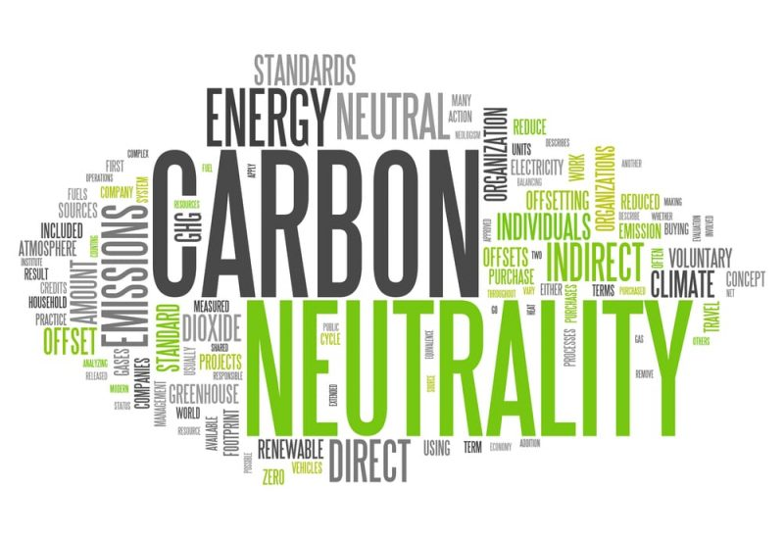
The challenge scenarios
…some known critical issues…
Cycles and carbon-neutral envelopes
Source: Ciardullo and Dyson, Yale Center for Ecosystems and Architecture 2022
Source: https://www.visualcapitalist.com/decarbonization-101-what-carbon-emissions-are-part-of-your-footprint

Slide 6
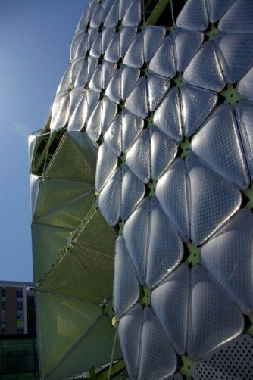
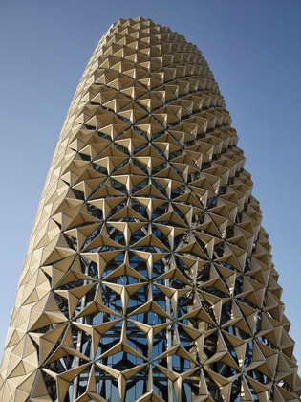
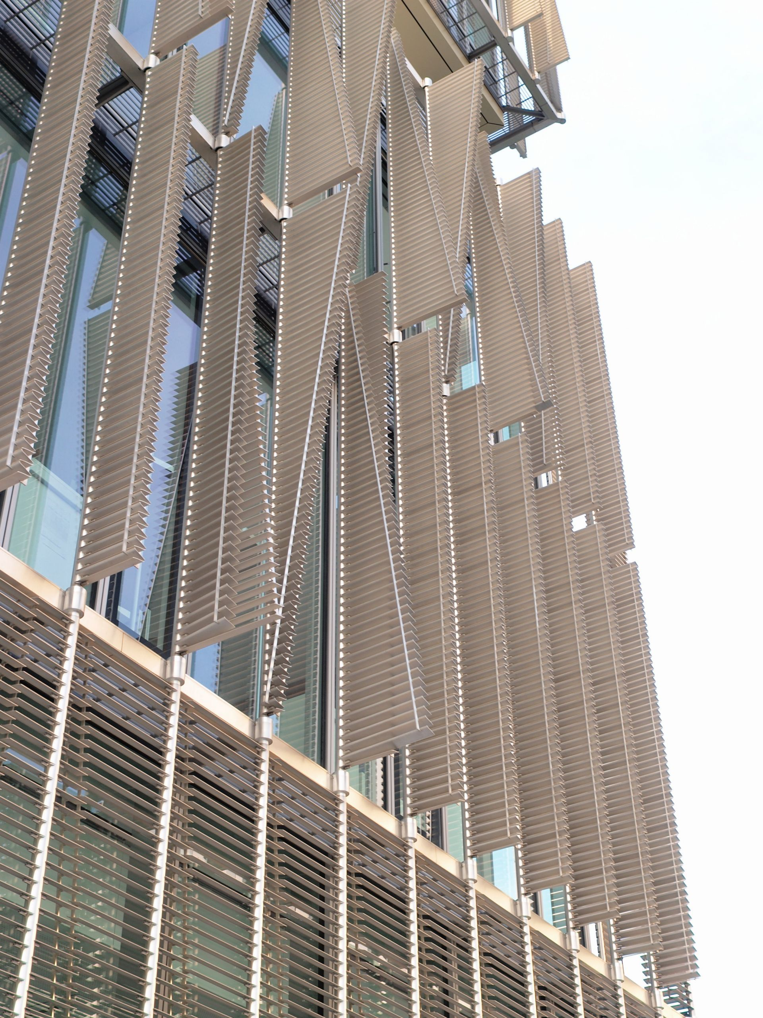

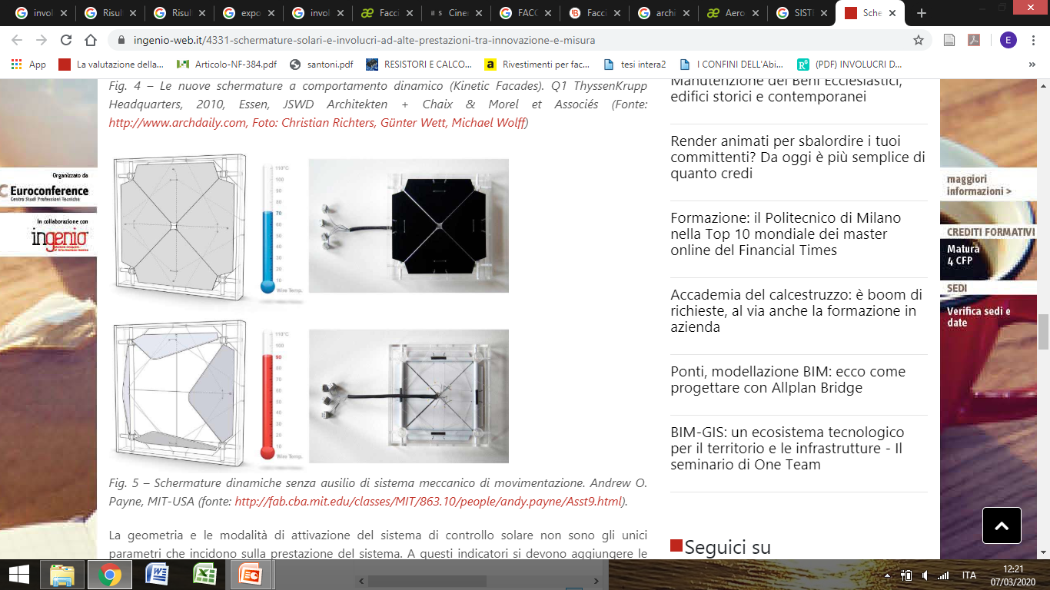
Crisis Response Scenarios
Strategies and Techniques for a “new” energy efficiency based on envelope performance
Source:http://fab.cba.mit.edu/classes/MIT/863.10/people/andy.payne/Asst9.html).

Slide 7
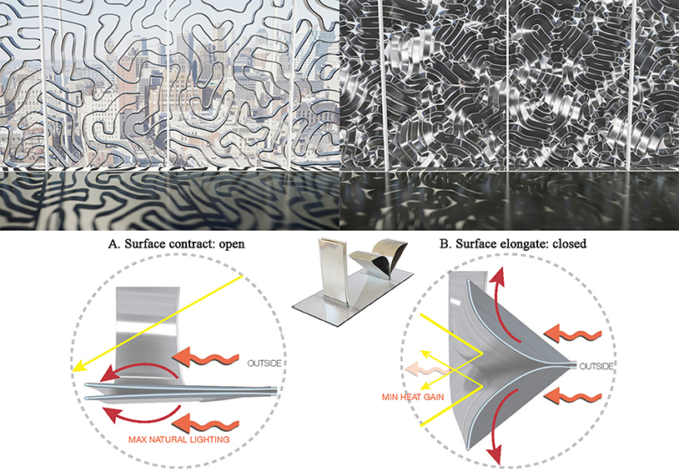
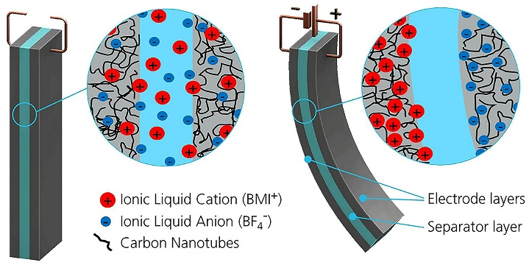
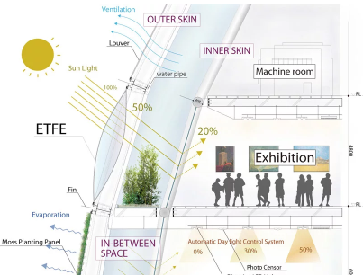
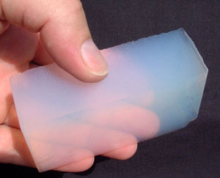

Crisis Response Scenarios
Materials and technologies for real envelope resilience

Slide 8
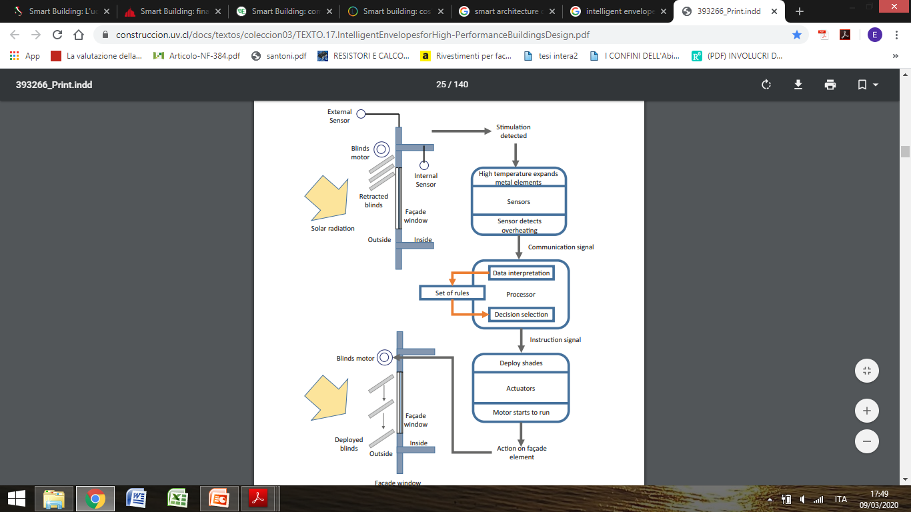
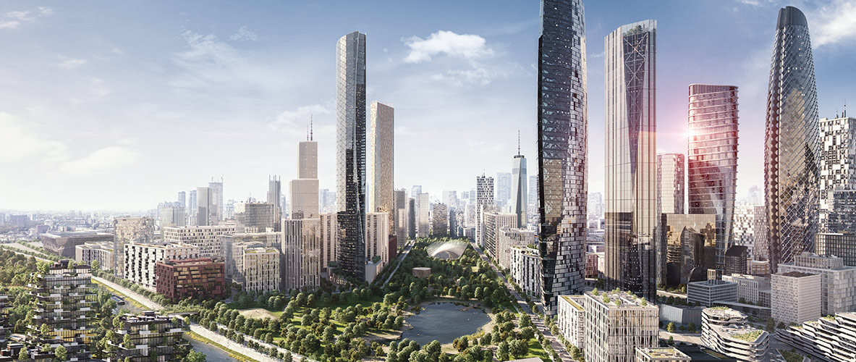
Crisis Response Scenarios
New sensorial envelope for the carbon neutrality of the city
Source: Adapted by the Buildings Performance Institute Europe.

Slide 9
Crisis Response Scenarios
Formulation of new standards, simulation
criteria and performance testing
Influence diagram for EN13830 testing of adaptive facades
Source: Illustration of the adaptive building envelope element linked to the calculation of heating and cooling load and internal temperatures according to EN ISO 52016-1.
Source: Building Performance Simulation and Characterisation of Adaptive Facades – Adaptive Facade Network

Slide 10
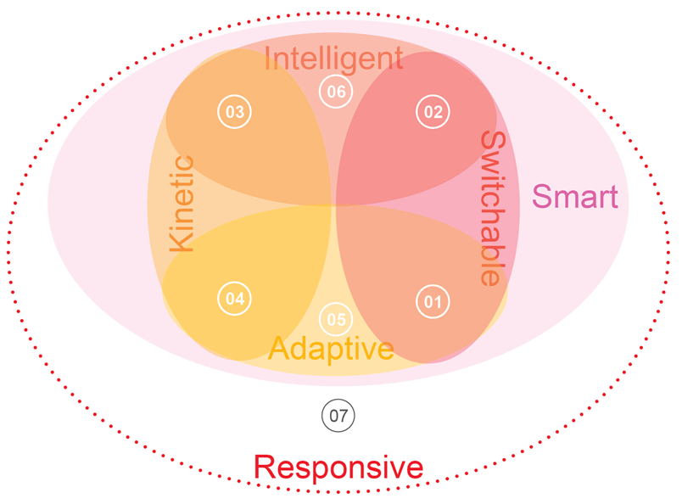
Innovation drivers for the envelope evolution
Technical strategies evolution
01 photochromic devices
02 electrocromic devices
03 automated dynamic shadings
04 self-actuating shape memory dynamic shadings
05 phase change materials
06 urban smart grids
07 manual dynamic shadings
Source: Carlucci, F. 2021. A Review of Smart and Responsive Building Technologies and their Classifications. Future Cities and Environment

Slide 11

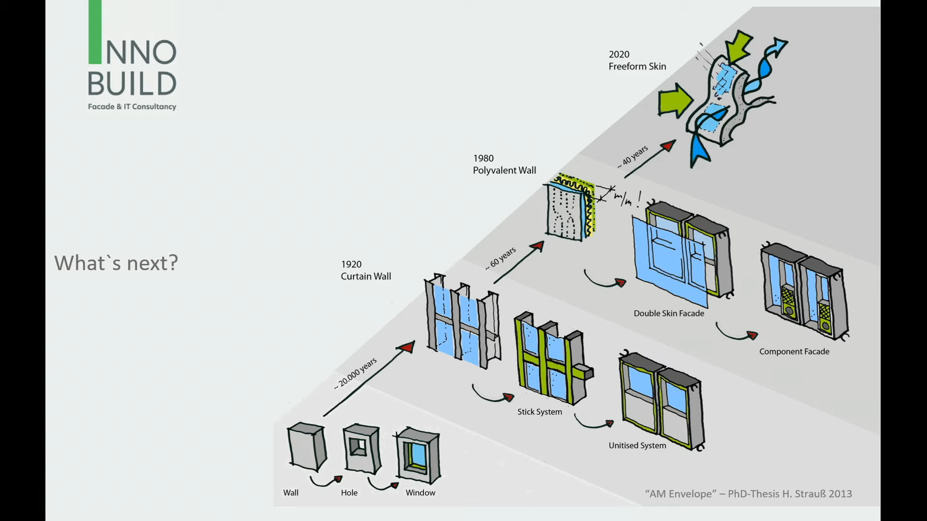

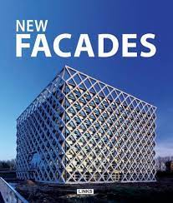


Innovation drivers for the envelope evolution
Typological Evolution
Source: Innobuild Façade & IT Consultance

Slide 12
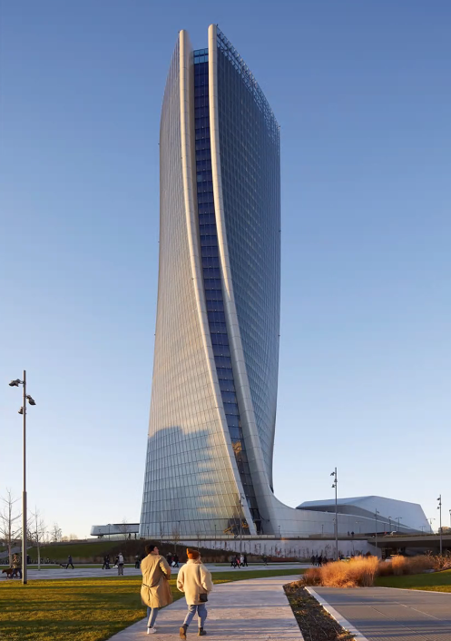
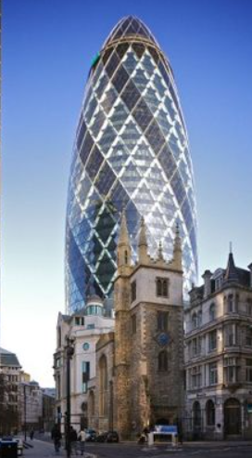
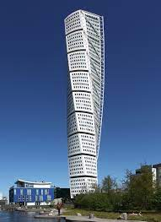
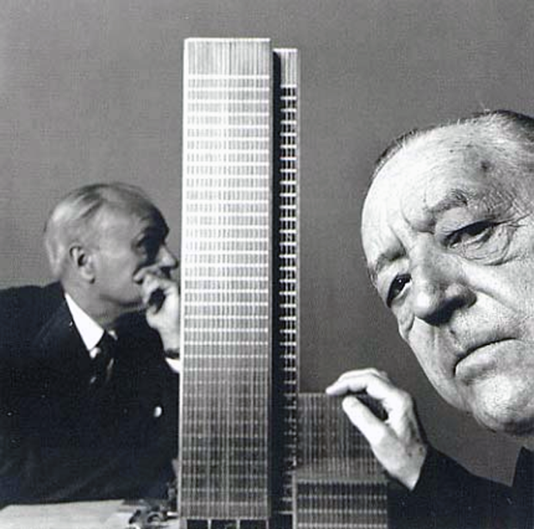
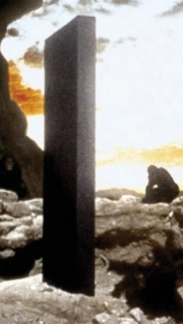
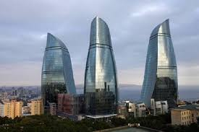

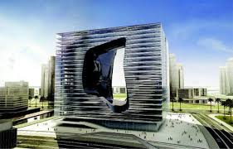
Innovation drivers for the envelope evolution
Morphological evolution

Slide 13
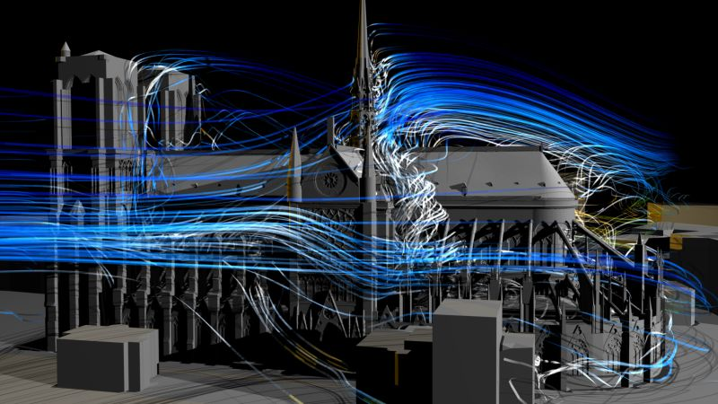
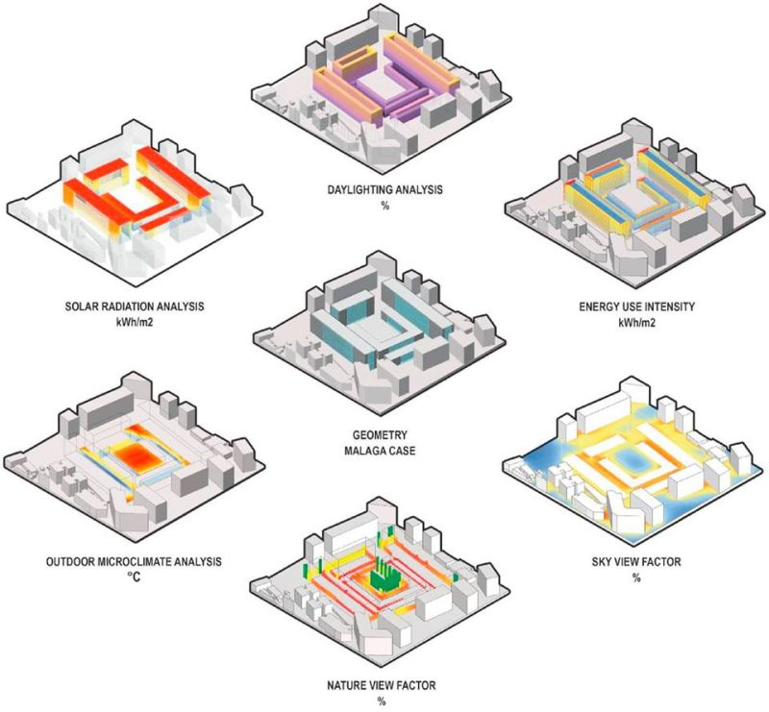
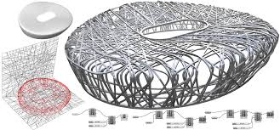
Innovation drivers for the envelope evolution
Design criteria evolution: simulation
and modelling
source:https://www.researchgate.net/publication/334327367_A_digital_workflow_to_quantify_regenerative_urban_design_in_the_context_of_a_changing_climate
Olympic Stadium in Beijing, designed by Herzog & De Meuron structure modeled with Rhinoceros and Grasshopper

Slide 14
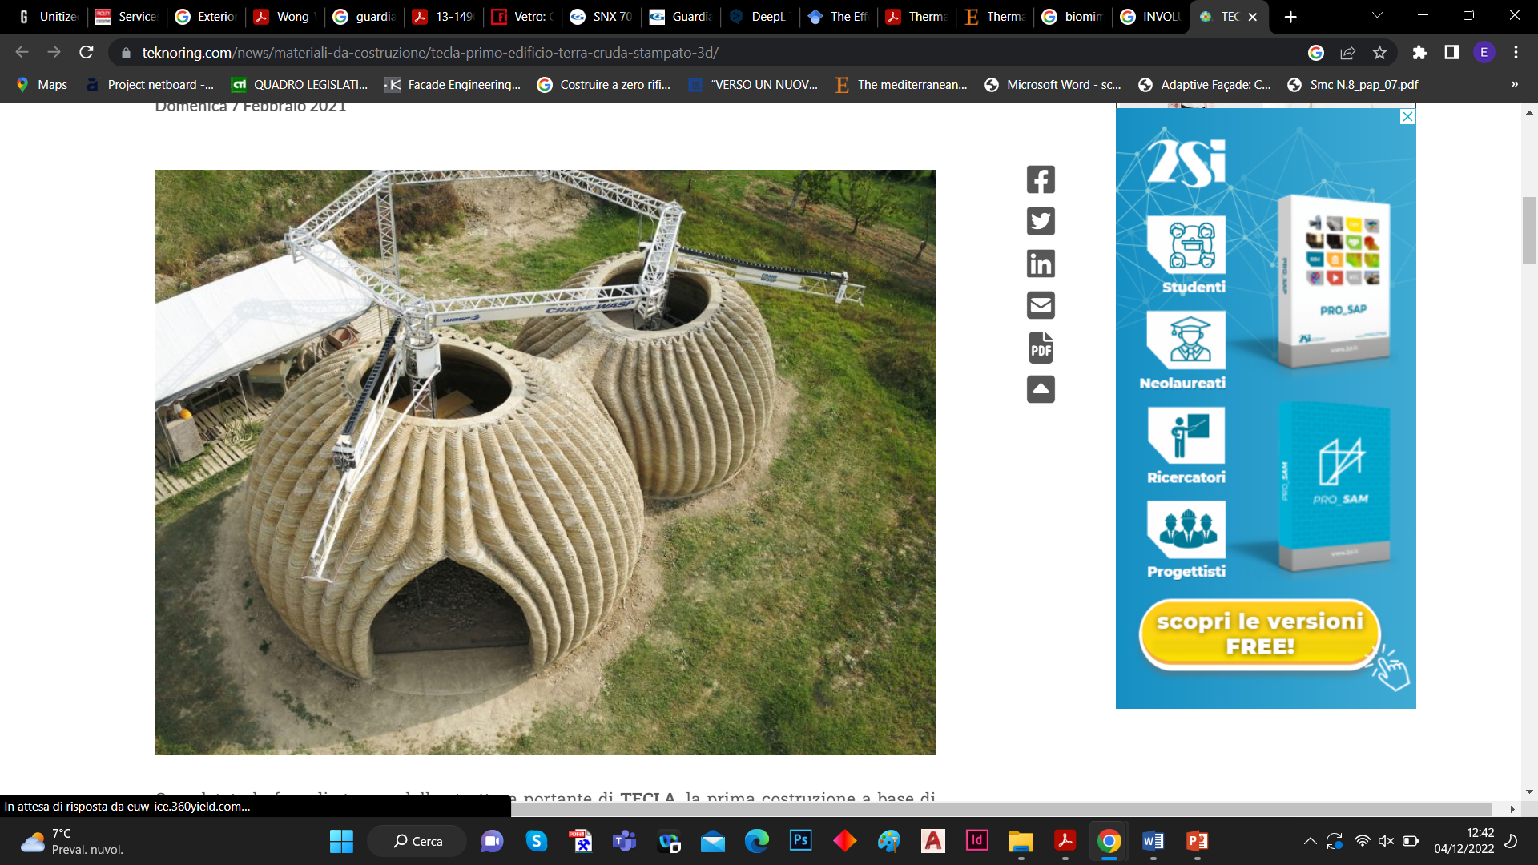
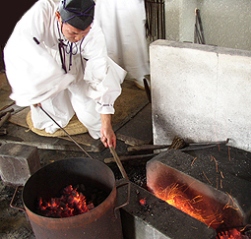

Innovation drivers for the envelope evolution
Construction processes evolution:
Additive Manufacturing
The first 3D printed eco-habitat

Slide 15
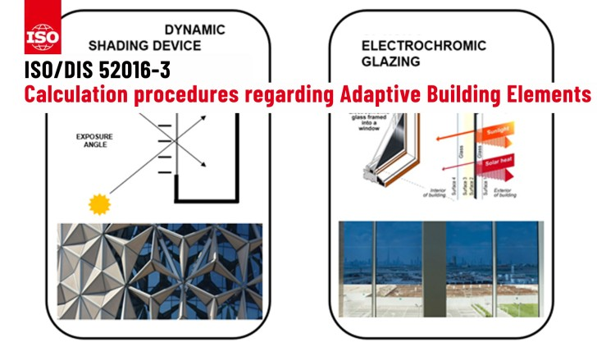
Innovation drivers for the envelope evolution
Standard and Regulations evolution

Slide 16
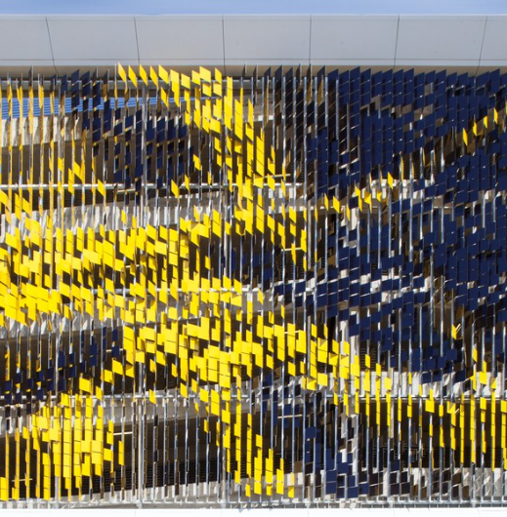
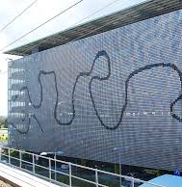
Innovation drivers for the envelope evolution
Performance characteristics evolution
Adaptive envelope: …Dynamic, Interactive, Integrated, Active, Responsive, Smart, Bio-Inspired, Kinetic….

Slide 17
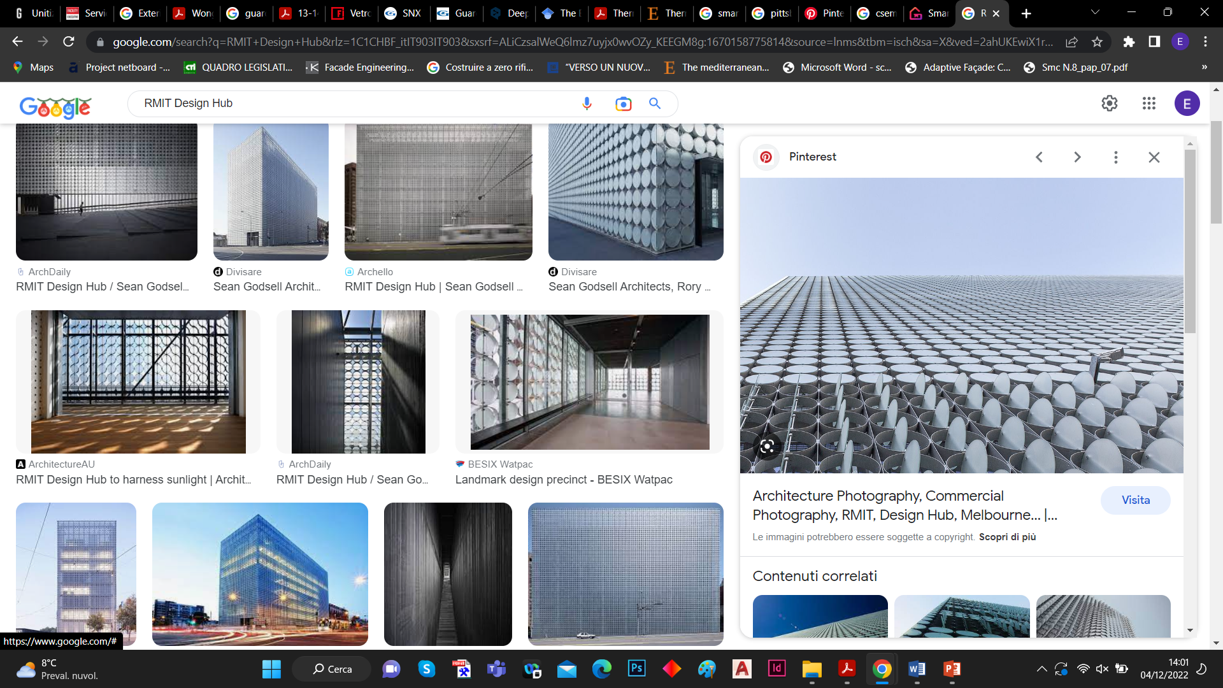
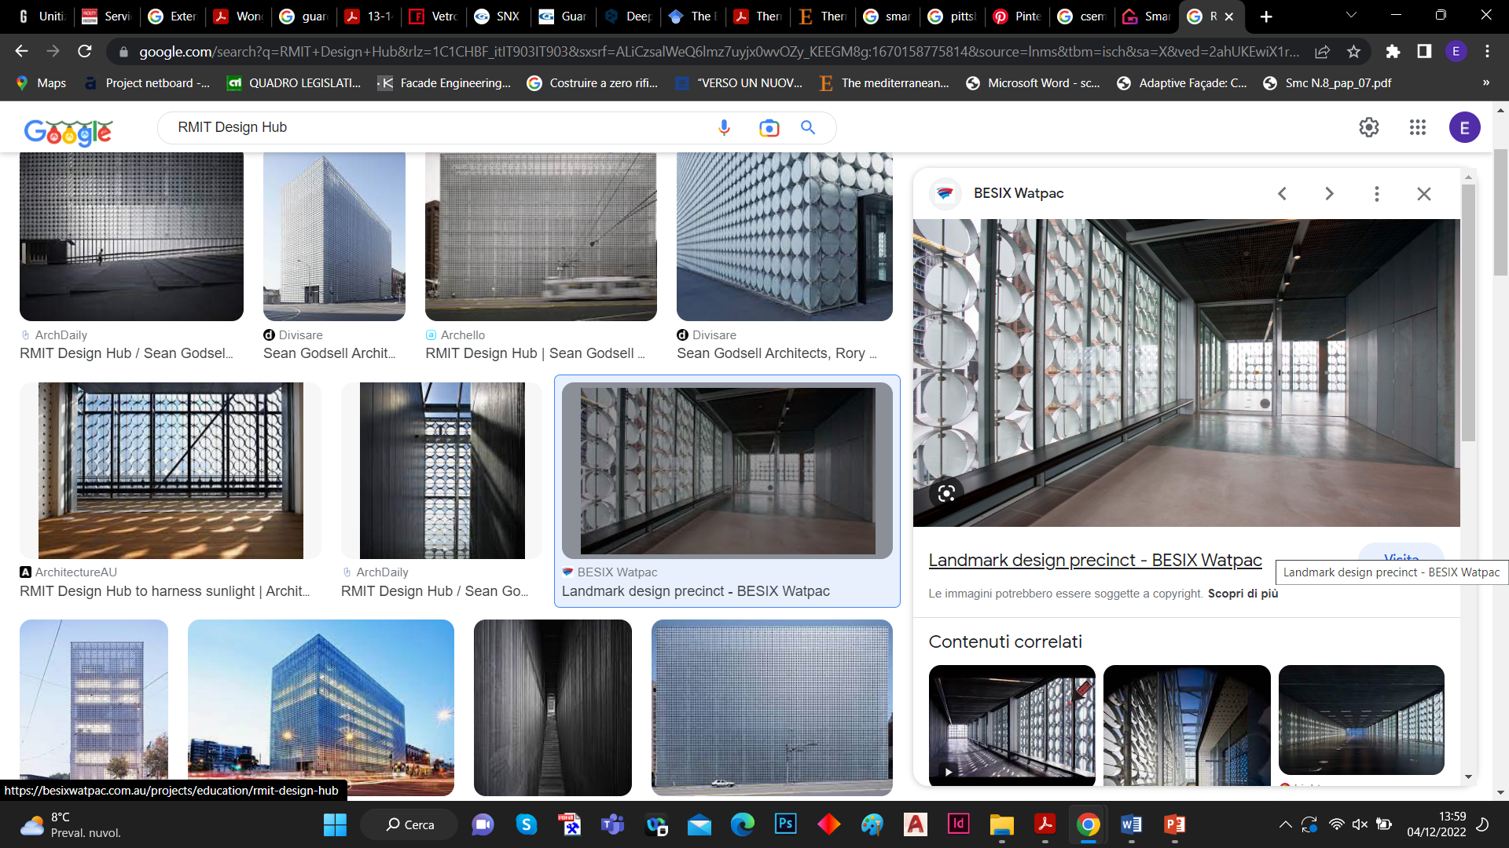
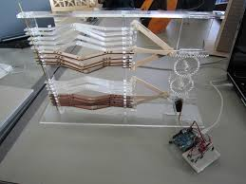
Innovation drivers for the envelope evolution
Performance characteristics evolution
Harvesting & Productivity (…prosumer envelope?)

Slide 18


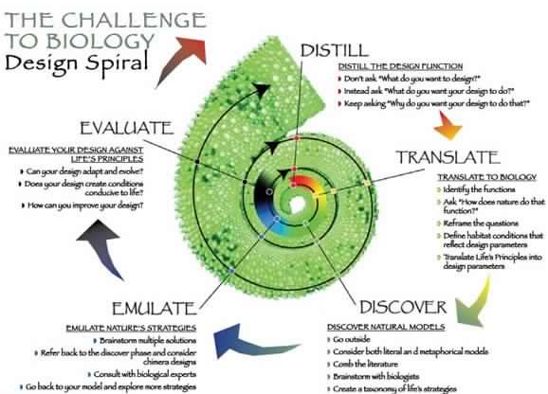
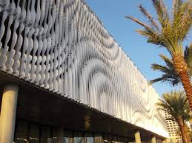

Innovation drivers for the envelope evolution
Performance characteristics
evolution:
Biomimicry

Slide 19
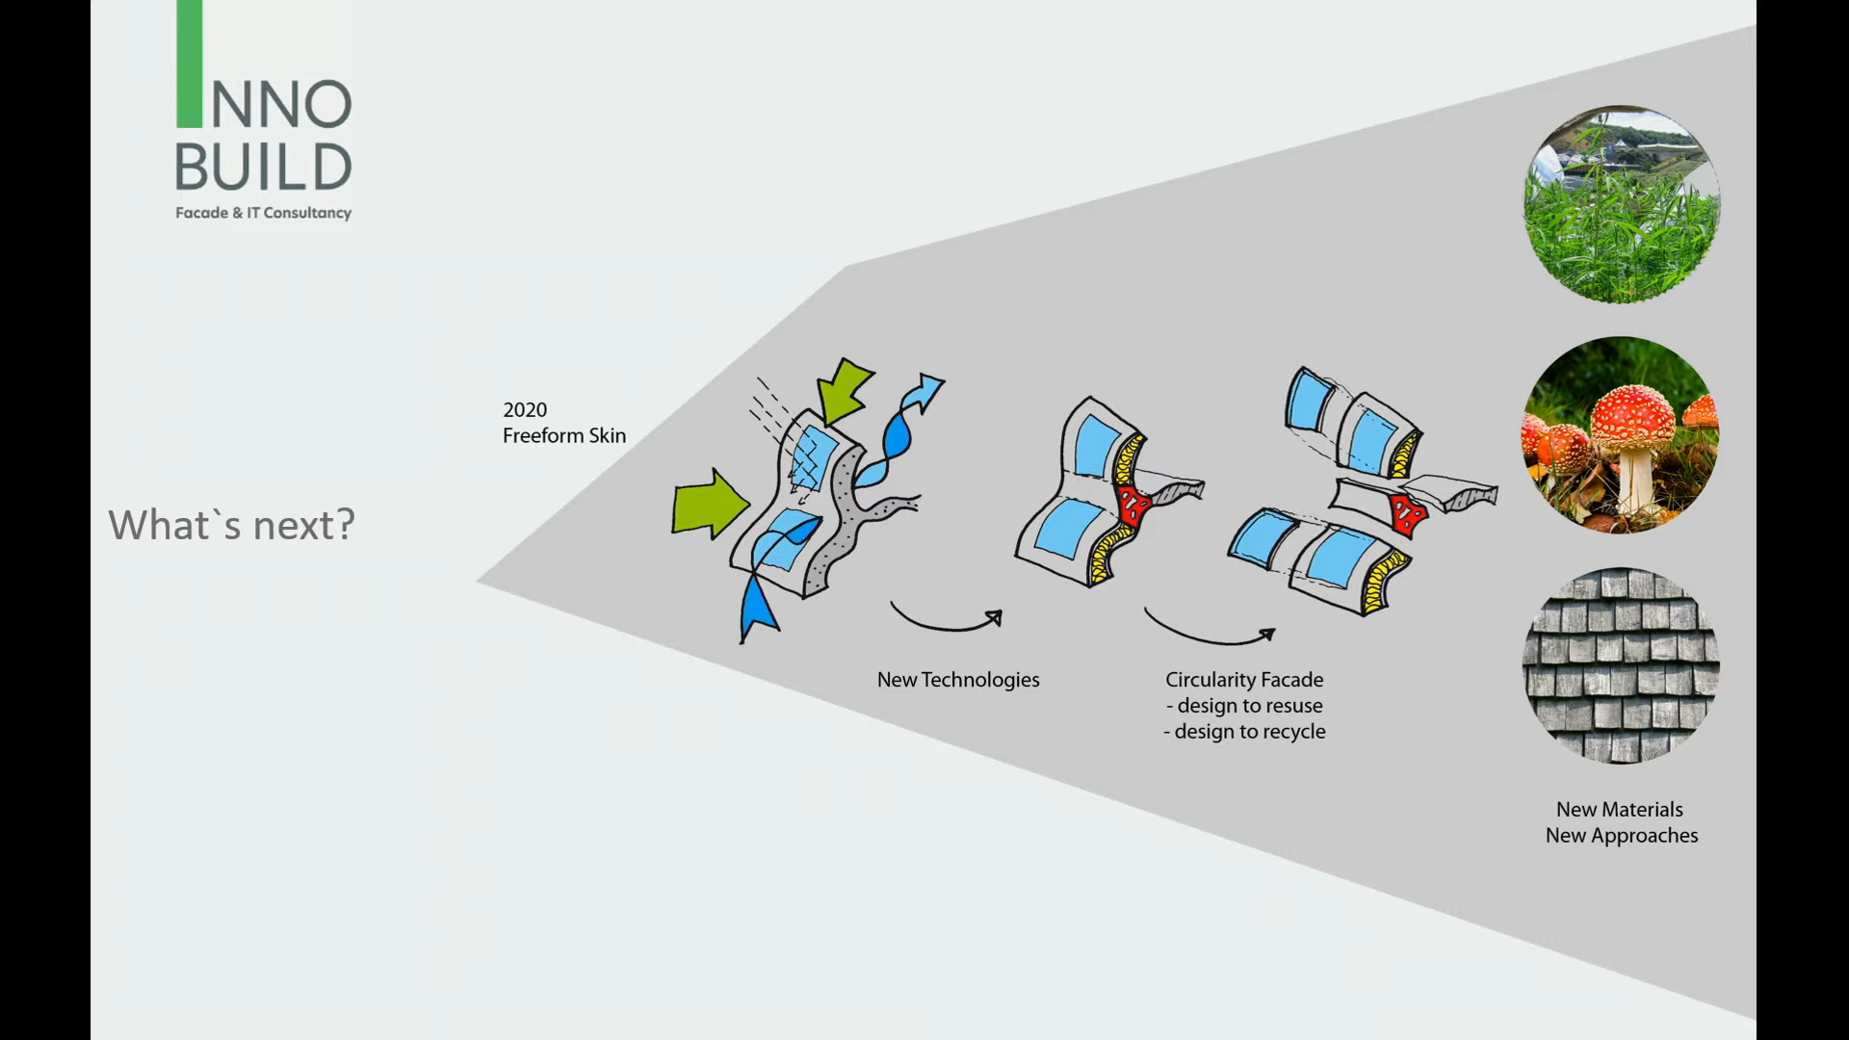
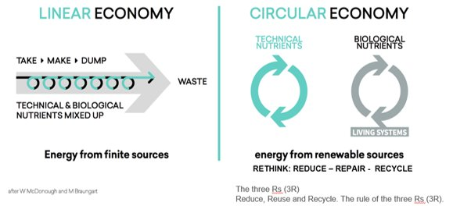

Innovation drivers for the envelope evolution
Performance characteristics
evolution: Circularity
1 define pupose of response
2 identify scale and inter-dependency
3 Identify functionality
4 Identify trigger and control
5 Identify interactions and requirements
6 Identify technological solutions
Source: Innobuild Façade & IT Consultance_”AM Envelope” – PhD Thesis H. Strauss 2013

Slide 20
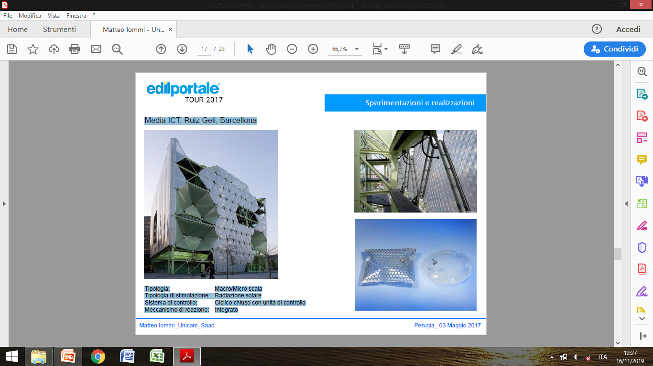
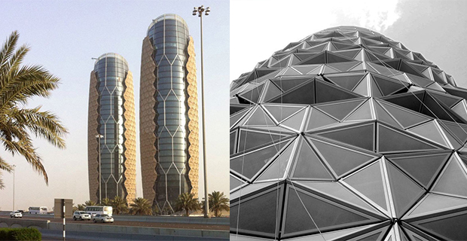

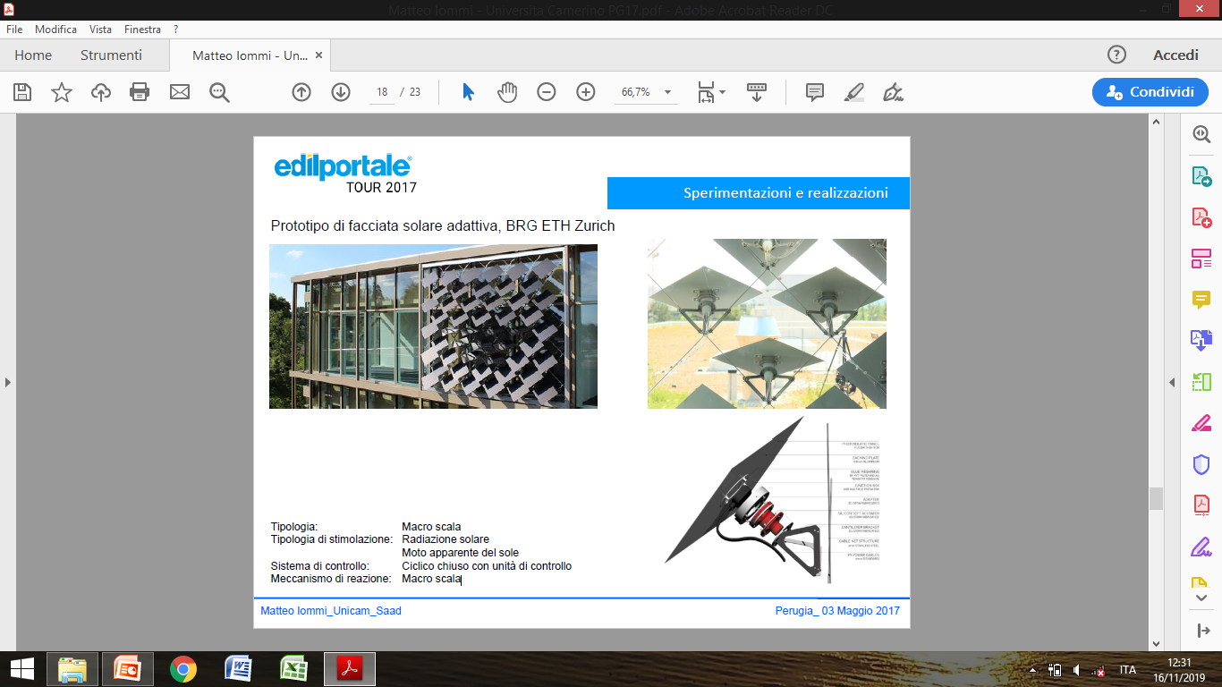
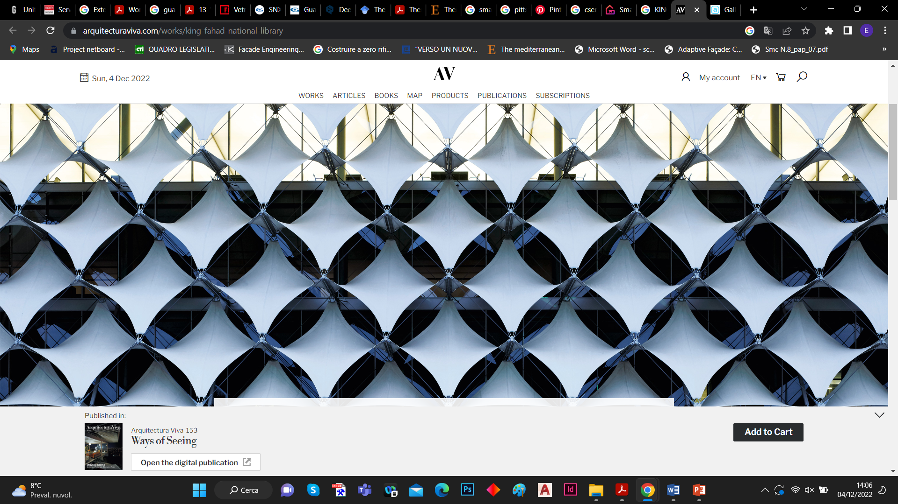
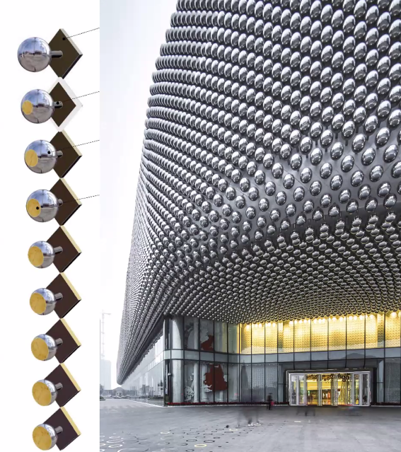

Innovation drivers for the envelope evolution
Performance characteristics evolution…
…High performances,
but:
Complexity Vs Simplicity ?
Transfer capacity ?
…?

Slide 21
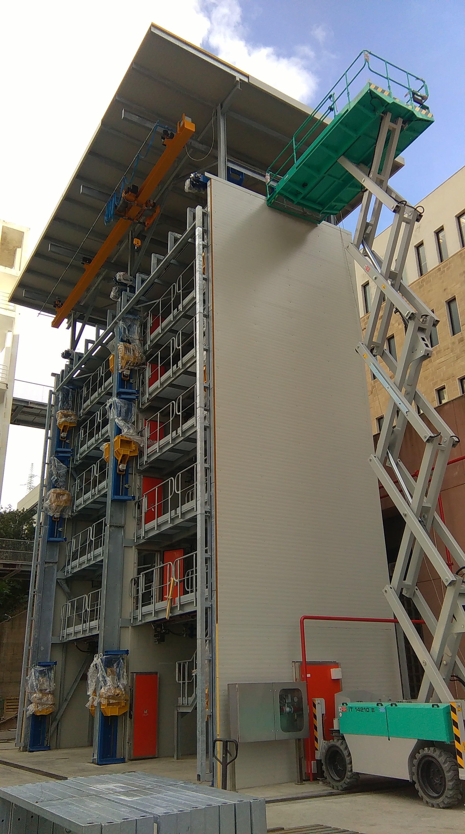
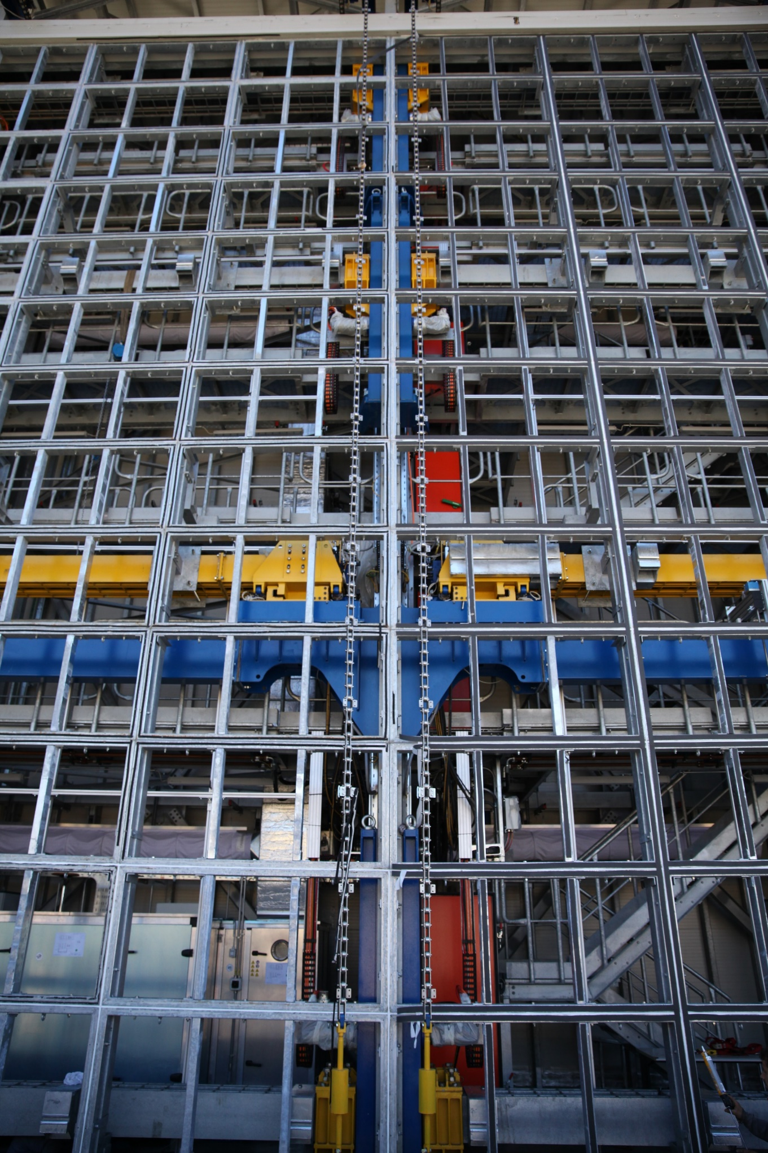
Trend indicators for the “new” challenges
Testing experiences for the identification of evolutionary trends
Some indicators extracted from TCLab-BFL testing activities of Mediterranea University of
Reggio Calabria

Slide 22
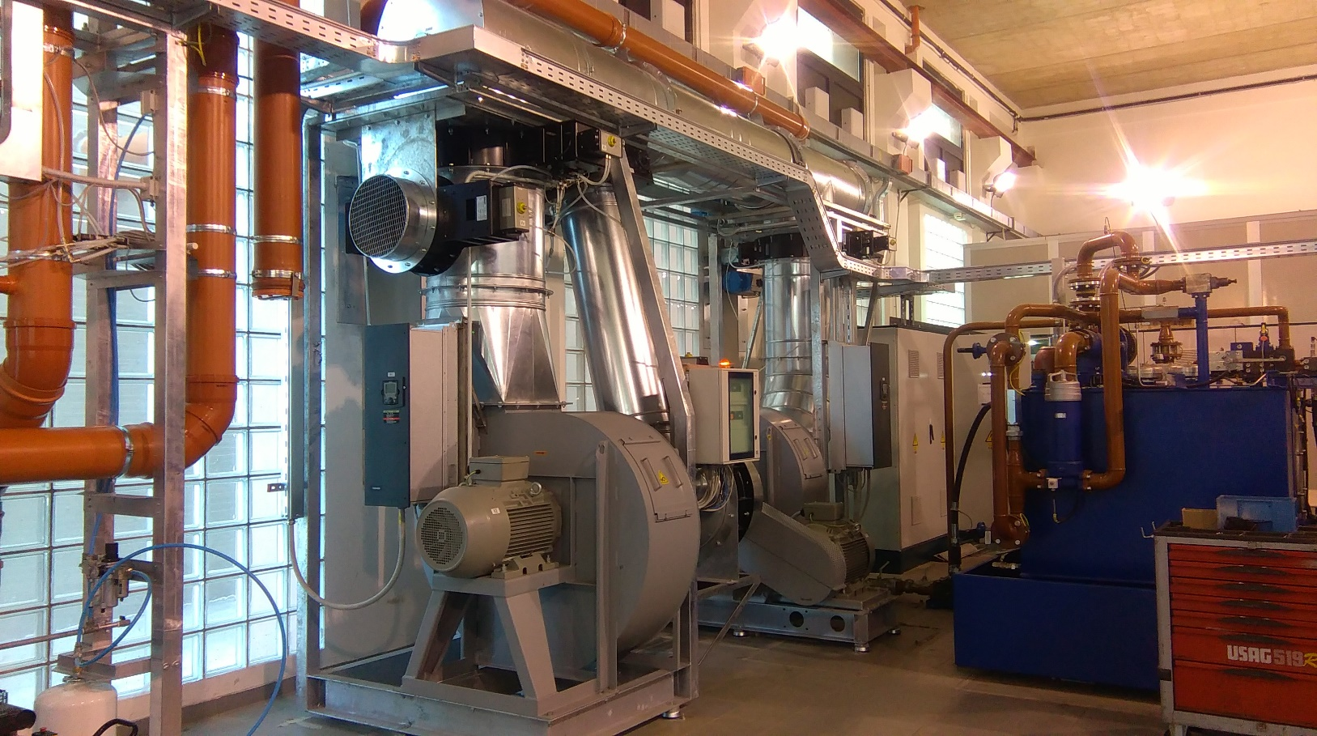






Trend indicators for the “new” challenges
Our main equipment

Slide 23






Trend indicators for the 'new' challenges
The most requested tests
ASTM E283-04 (2012)
ASTM E330 - 02(2010)
ASTM E331 – 00(2009)
ASTM E547-00 (2007)
ASTM E-1196
ASTM E-1886
Standard series UNI EN AAMA e ASTM
Standard Test Method for Determining Rate of Air Leakage Through Exterior Windows, Curtain Walls, and Doors Under Specified Pressure Differences Across the Specimen
Standard Test Method for Structural Performance of Exterior Windows, Doors, Skylights and Curtain Walls by Uniform Static Air Pressure Difference
Standard Test Method for Water Penetration of Exterior Windows, Skylights, Doors, and Curtain Walls by Uniform Static Air Pressure Difference
Standard Test Method for Water Penetration of Exterior Windows, Skylights, Doors, and Curtain Walls by Cyclic Static Air Pressure Difference
Standard Specification for Performance of Exterior Windows, Curtain Walls, Doors, and Impact Protective Systems Impacted by Windborne Debris in Hurricanes
Standard Test Method for Performance of Exterior Windows, Curtain Walls, Doors and Storm Shutters Impacted by Missile and Exposed to Cyclic Pressure Differentials
AAMA 501.1-05 Standard Test Method For Water Penetration of Windows Curtain
Walls And Doors Using Dynamic Pressure
AAMA 501.4-00 Static test method for evaluating curtain wall and storefront systems subjected to seismic and wind induced interstory drifts
- AAMA 501.5-07 Test Method for Thermal Cycling of Exterior Walls
AAMA 501.6 Dynamic test method for determining the seismic drift causing glass fallout from a wall system

Slide 24








Trend indicators for the “new” challenges
Some experiences

Slide 25



Trend indicators for the “new” challenges
The source of our indicators: Method statement , Technical report, Summary passed test

Slide 26

Trend indicators for the “new” challenges
Companies and Types of tests required

Slide 27

Trend indicators for the “new” challenges
Percentages of required tests and observation of deficits at different stages of testing

Slide 28








Trend indicators for the “new” challenges
The most recurrent deficits detected

Slide 29







Trend indicators for the “new” challenges
Some untested mock-up (why?)

Slide 30

Trends in demand for tests for new envelopes
Trends in the evolution of envelopes as measured by test requests to TCLab in the years 2019-2022
Jumbo size
Double skin thermal performances
Curved and Out-of-plane
Corner façades
Dynamic envelopes
New materials and textures
Integrated façades
Greater heights
Green façades
Debris control
Thermal cycles with condensation testing
...

Slide 31



TCLAB's response to trend demands
New Equipment and Instrumentation
Debris & Blasting apparatus
Condensation test chamber
Structural frames for corner, curved, out-of-plane and jumbo size facades

Slide 32



TCLAB's response to trend demands
Research Activity
Lead partner of HORIZON Project METABUILDINGLABS. A OITB_Open Innovation Test Bed, for a European network of envelope test laboratories
Partner Pilot Project of PNRR Italy Plan:
Climate adaptation plans for the reduction of the ecological footprint and ecological debt.

Slide 33












Trend indicators for the “new” challenges
State of the debate references for trend indicators

Slide 34
Trend indicators for the “new” challenges
Some trend indicators from the State of the Art
Performances
Processes
Legislation and Policies
Thermal
Acoustics
Climatic
Geological
Accidents (disasters)
Security
Social/Cultural
Safety
Sustainability
Future proofing
Cross Industry Innovation
Building Regulations
Design Codes
Safety Codes
Insurance policies
Future proofing
Accidents/ Disasters
Fabrication
Manufacturing
Handing
Transportation
Design
Construction
Dismanting
Safety
Aviation
Automobile
Aerospace
Energy
MEP System
Elaborated by report Meinhardt

Slide 35
Trend indicators for the “new” challenges
Some trend indicators and
performance driver from the State of the Art
Comfort
Physical
Sight-Glare, Visual acceptability, Aesthetics, Transparency
Sound-Acoustic – air borne/Vibrations
Physical sensation – heat/cold/Damp – Thermal insulation
Psycological/mental
Perception – (of safety, fears, Phobias – more intangibile/Subjective
Service – Ability
Processes
Integrity
Robustness
Bespoke solutions
Social / cultural
Adaptability / Inclusion
Operability and Ease of use
Cost
Aspirations
Bigger
Thinner
Greener
More durable
Increased Design life
Cost effective
Safety
Containment
Integrity
Prevent Injury
Aid rescue
Processes
Elaborated by report Meinhardt

Slide 36


Trend indicators for the “new” challenges
Ideal complexity of façades and real divergences
Interconnection of drivers: Multi-facetted influences……
….. resulting in facades having numerous diverging requirements and conflict.
Elaborated by report Meinhardt

Slide 37








What challenges for the envelope of tomorrow?
From IoT to IoE,
(Internet of Envelope)?
‘Living or Organic’ Envelope ?
Envelope for extreme environments
AI applied to envelope
Computational simulation Vs, or with, simulation in real context ?

Slide 38

Challenge scenarios and trend indicators for building envelope innovation
Thank you
mmilardi@unirc.it
Collaborations
Sponsors
Organized by

