Slide 1
D7.9. EDUCATIONAL KIT
Innovations For The Real World

Slide 2
Index
The problem of building energy consumption over Europe
The problem of building retrofit in the residential sector
Industrialised energy solutions in residential building retrofitting
  Industrialised solution of Heat Pump and ventilation (ELFOpack) supported by Photovoltaic energy.
    ELFOpack
    Photovoltaic Multi Control Inverter (MCI)
  Industrialised solution of DHW storage tank and ventilation.
    Enerbox thermal tank and ST collectors
    Heat Recovery Ventilation Unit (HRU)
  Monitoring and control for building management
    ICT infrastructure connecting and monitoring all the decentralised units
  Industrialised multifunctional ventilated façade
    Anchoring system
    Cladding system
Demonstration buildings:
  Zaragoza
  Rome

Slide 3
1. The problem of energy consumption over Europe

Slide 4

The problem of energy consumption in residential buildings over Europe
Almost 27 % of the total energy consumption in Europe is spent by residential buildings.
Despite the strict legislative framework, and the significant improvement of the energy efficiency, (1,4 % per year), the energy consumption of the residential buildings increased by 14 % between 1990 and 2012.
The most energy consuming activities of households are the following:
Space heating: 70%
Air conditioning and other appliances: 14%
Water heating: 12%
Cooking and lighting: 4%
However, cooling is increasing rapidly due to the climate change and may be the major consumption component in the future.

Slide 5

The problem of energy consumption in residential buildings over Europe
There are other factors that also affect the energy consumption in the building sector:
Climate change: cooling is increasing rapidly and may be the major consumption component in the future. Very high increasing rates in most of the southern European Countries (from 2005 to 2009):
Bulgaria: 100%
Spain: 30%
Italy: 30%
Energy poverty: financial problems oblige part of the population to consume less energy and satisfy partly their needs.

Slide 6
2. The problem of buildings retrofit in the residential sector

Slide 7
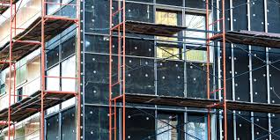
The problem of buildings retrofit in the residential sector
The need to reduce the energy consumption of the building sector, is widely recognized. It can be achieved through deep retrofitting of the building stock combined with a radical reduction of the needs of the new buildings.
However, in the residential construction sector, the lack of a systemic approach in planning, designing and execute the renovation of the building stock is one of the major barriers for the success of any retrofit project.
Moreover, the level of the required investments to minimize the energy consumption is considerably high, an issue that could be a barrier.

Slide 8
The problem of buildings retrofit in the residential sector
Some solutions can tackle these barriers:
Adaptable façade solutions and reliable and cost-effective HVAC systems, capable of being easily implemented.
Integration of renewable energy sources at building level, exploiting façades in addition to rooftops, will provide additional benefits and increase the energy efficiency by moving towards Nearly Zero Energy Buildings (NZEB).
Implementation of policies aiming to minimize the energy consumption of buildings:
  Searching solutions that decrease the energy load and the final needs
  Supplying the remaining energy load through renewable technologies
  Optimizing the management of the energy using smart and intelligent technologies
All these aspects have been discussed in BUILDHEAT project

Slide 9
3. Industrialised energy solutions in residential building retrofitting

Slide 10
Industrialised solution of Heat Pump and ventilation (ELFOpack) supported by photovoltaic energy

Slide 11
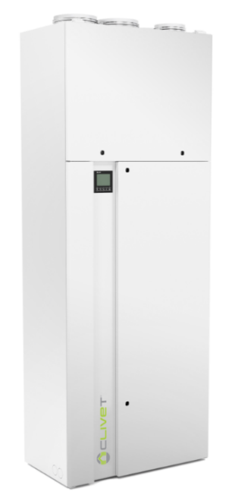
ELFOpack
ELFOPack was developed by CLIVET. It is a multifunction heat pump unit for stand-alone systems that simultaneously meets the needs of heating, cooling, dehumidification, production of domestic hot water, controlled mechanical ventilation with thermodynamic recovery and electronic filtering:
Optimal comfort thanks to the system that quickly adapts to the load conditions of the room and the thermal load;
The air is constantly filtered by electronic filters with efficiency levels exceeding 99.9%;
Controlled mechanical ventilation with thermodynamic recovery in winter and summer;
Air dehumidification in summer mode;
Extremely efficient production of domestic hot water in winter and free of charge in summer;
Free-cooling, that is, cooling free of charge under special environmental conditions;
Extensive use of renewable energy as it is fed with self-produced photovoltaic energy.

Slide 12
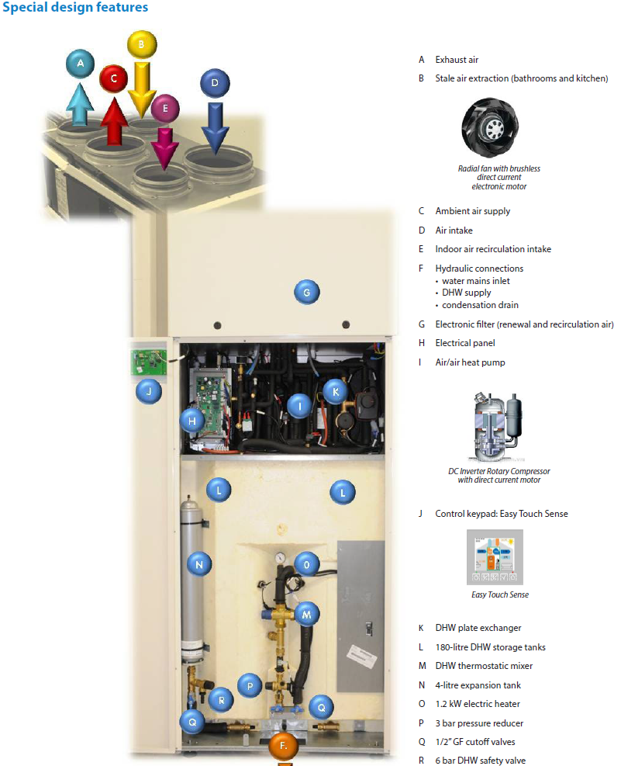
ELFOpack
Lower running costs;
Extremely low investment and quick installation, as all the functions are concentrated in one piece of equipment;
No works required for the gas connection, chimney and relative measures to ensure the system is in line with safety regulations;
Simple installation that does not need to be carried out by an expert;
Aeraulic ducts that can be integrated into industrial building solutions.

Slide 13
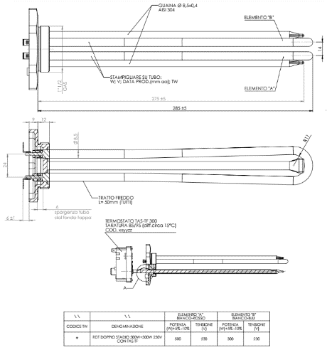
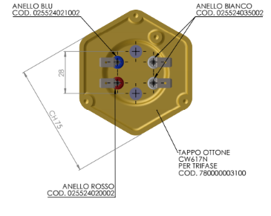
Technical aspects
When there is excess of PV electricity, this will be used to warm up ELFOPack’s domestic hot water storage tank through a thermal resistance.
ELFOpack has installed a thermal resistance with 800 W capacity for DHW production (ventilation fans do continuously run). This resistance is a three-stage, allowing to deliver/consume 300W, 500W and 800 W.
By activating 1, 2 or 3 stages we will be able to use as much electricity as possible in high generation hours enabling a simple and economic energy storage.
Technical draw this special thermal resistance application

Slide 14

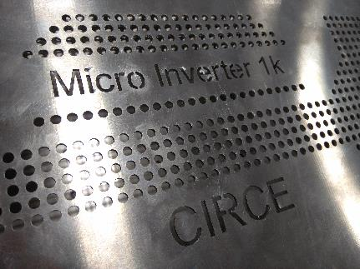
Photovoltaic Multi Control Inverter (MCI)
CIRCE has developed a 1 kW power Photovoltaic Multi Control Inverter adjusted to residential environments fulfilling the following characteristics:
Very low acoustic noise, due to the high switching frequency.
Small size: 3 to 1 size ratio compare to a conventional Silicon-based inverter.
High performance. Low energy losses.
Safety, including PV and grid protections.
Furthermore, the goals for the final series units have been:
Cost reduction.
Replicability.

Slide 15
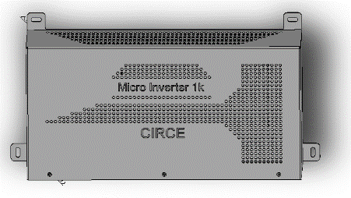
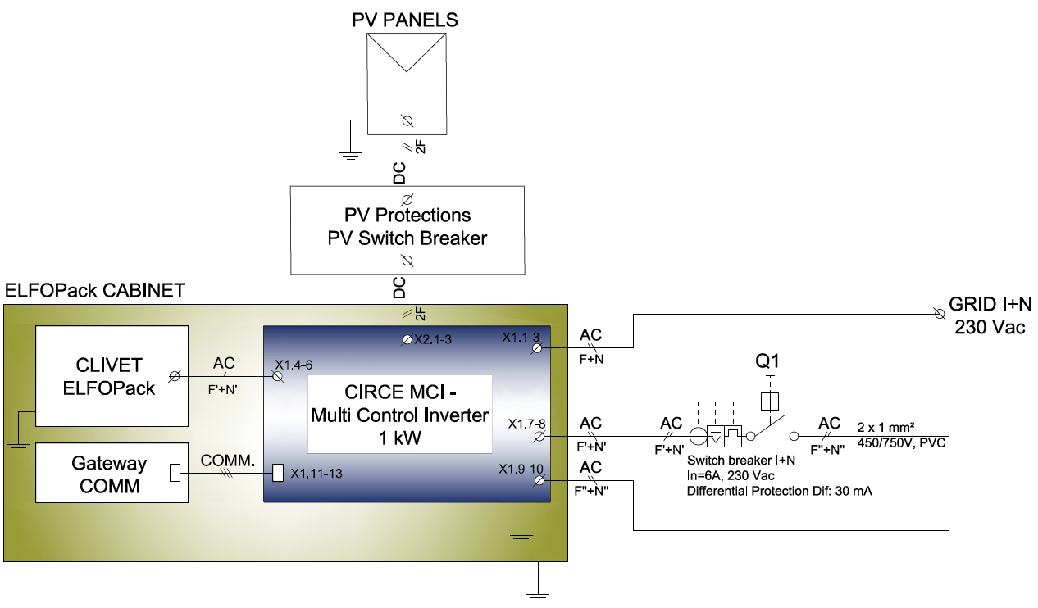
MCI technical aspects
Electrical indications:
  General Block Diagram:

Slide 16
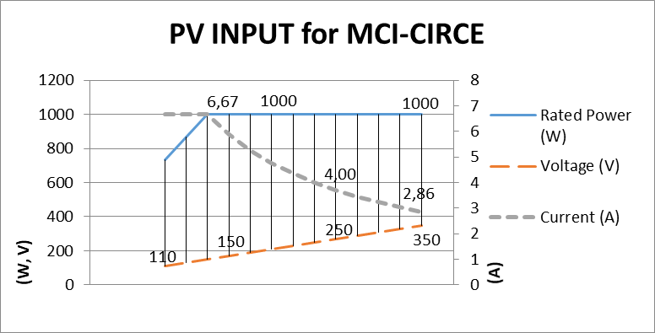
MCI technical aspects
Electrical indications:
  General Block Diagram:

Slide 17
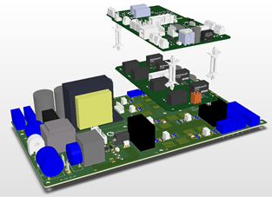
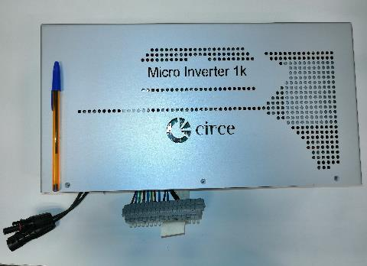
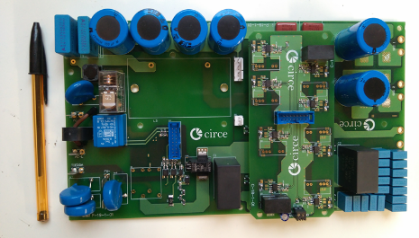
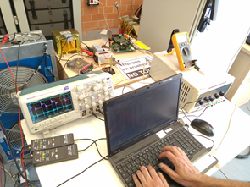
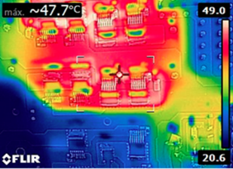
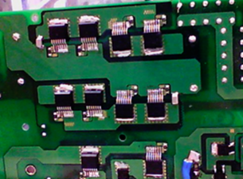
MCI technical aspects
Pictures:

Slide 18
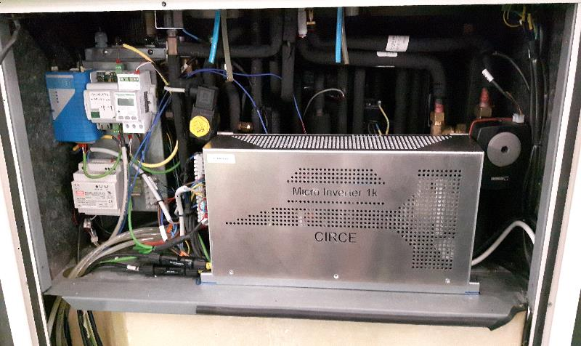
MCI technical aspects
Pictures:
  MCI installed inside the ELFOPack equipment:

Slide 19
Conclusions MCI
The MCI controls the electricity fluxes from the grid and the PV panels and gives the energy to the heating pump in the ELFOPack as it is required.
Heatsink, power electronics and magnetic components reduced in size and price thanks to the high frequency of the system.
The MCI can easily adapt to a bidirectional system. Therefore, it could be used also in storage systems.
Due to its modular design and parallelization, it is possible to increase the power capacity of the system.

Slide 20
Industrialised solution of DHW storage tank and ventilation

Slide 21
Enerbox thermal tank and ST collectors
The Enerbox, designed by PINK, is an innovative water storage system developed to supply hot water, heating and possibly cooling in residential dwellings.
The development of the innovative energy storage system (ENERBOX) by PINK had to take further requirements into account:
Hot water storage tank :
  Storage tank has to be able to cover the domestic hot water demand of each dwelling at any time of the day or night
  Prevention of legionella disease need to be considered.
  The insolation of the storage tank as the stand-by losses are influencing the energy efficiency of the whole system.
System integration and space requirements:
  At retrofit actions the storage system must be able to be flexibly adapted due to the given floor layouts and room heights.
  The routing of the supply lines for the hot water, the heating and if necessary, the cooling must be easily adapted to all conditions.
  The design of the storage tank must be compact with a very small base area

Slide 22
Enerbox thermal tank and ST collectors
Control and monitoring:
  The control system used after the renovation must ensure that hot water supply, indoor heating and, if necessary, cooling can be reliably managed.
  At the same time, however, it must also be ensured that the energy supply is as efficient as possible, using cost-effective and easy-to-use control components.
System integration of a ventilation unit:
  The ventilation system is a decentralized ventilation unit that operates with double flow ventilation and heat recovery, allowing the external air to be preheated or refreshed, depending on the season.
Minimal environmental impact:
  Use the thermal solar energy as a support for DHW production.

Slide 23
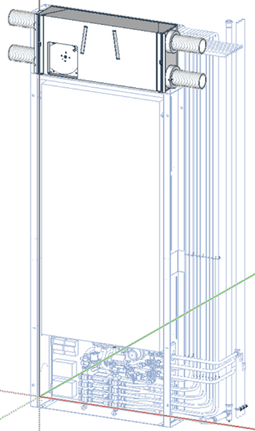
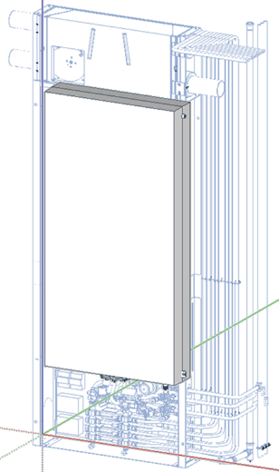
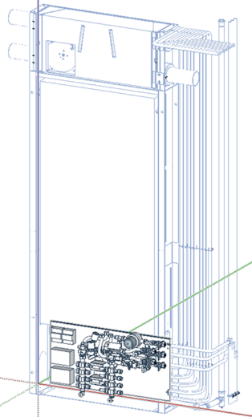
Enerbox technical aspects
Three main components in the Enerbox
Ventilation unit Storage tank Hydraulic unit

Slide 24
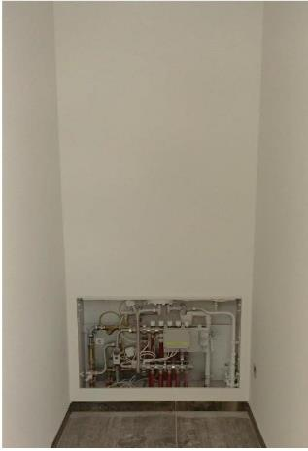
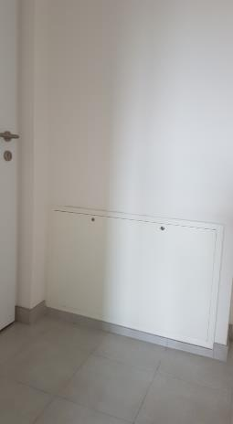
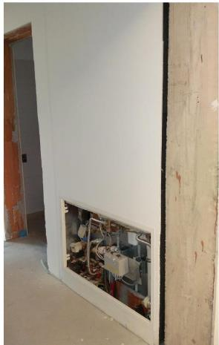
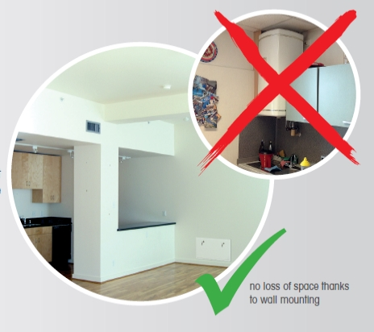
Enerbox technical aspects
Storage tank
The domestic hot water storage tank, which is the main component of the storage system, is especially designed to be able to be integrated in the wall-construction of a dwelling, which leads to big advantages during the integration into the demo cases of the project:
High space efficiency
High room usability
Esthetic and modern design
Possibility of integration of hydraulic and HVAC-components

Slide 25
Enerbox technical aspects
Storage tank
Able to reach a pressure resistance up to 50 bars
Design of the storage tank based on steel pipes.
  5 pieces of vertically orientated pipes with an inner diameter of 150mm are welded together with horizontal connecting pipes on the top and the bottom.
  The central pipe is equipped with a screwed flange and equipped with a heat exchanger.
Tank dimensions: 900(W)*1750(H)*200-290(D) mm
Made of molybdenum-bearing austenitic stainless steel, more resistant to general corrosion and pitting/crevice corrosion than the conventional chromium-nickel austenitic stainless steels. They also offer higher creep, stress-rupture and tensile strength at elevated temperature.

Slide 26
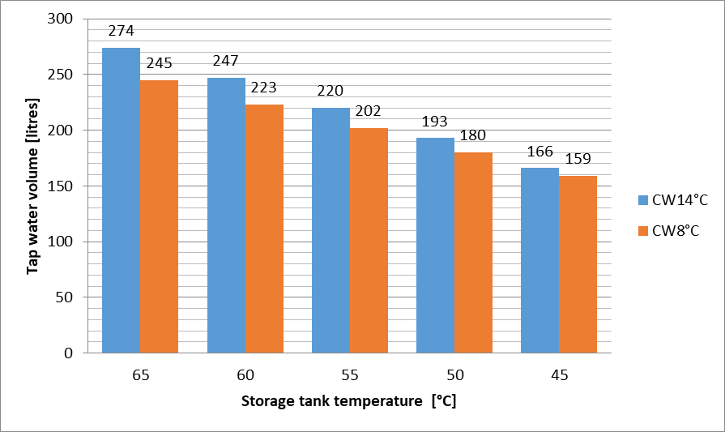
Enerbox technical aspects
Storage tank
The tank volume of 140 L is designed to address both comfort and hygienic aspects.
The tank is able to fulfil certain regulations regarding legionella prevention (e.g. minimum temperature) either by using the integrated heat exchanger with sufficient heat source temperature or by boosting the tank temperature by an optional electrical heating element.

Slide 27
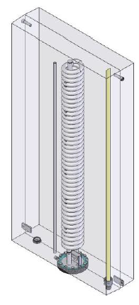
Enerbox technical aspects
Storage tank
The integrated heat exchanger is made of stainless steel corrugated pipe and located at the central storage pipe.
Thanks to the surface of about 2m² the temperature difference between the heating water and the domestic hot water is only 2-3ºK helping to keep the driving temperature for domestic hot water production as low as possible.
The heat exchanger is reaching the top of the tank and operated counterflow providing hot water very fast compared to standard tanks having the heat exchanger positioned at the bottom.

Slide 28
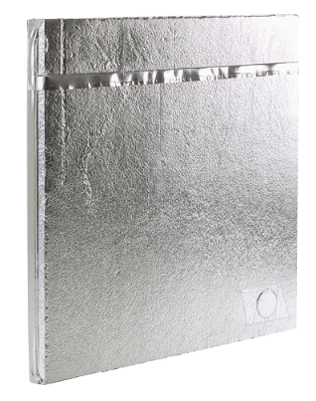
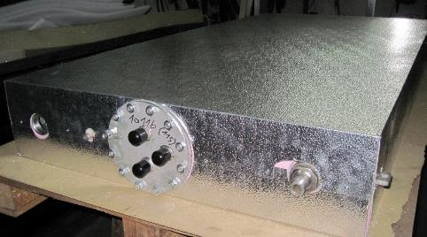
Enerbox technical aspects
Storage tank
To achieve an even better energy efficiency class (A) a very innovative component had to be integrated: Vacuum insulation panels (VIP´s) were added externally to the PU insulation.
These are flat panels for optimized temperature insulation that are based on the principle of the thermos flask. These panels offer unparalleled heat insulation at minimum thickness.
  Density: 160 - 230 according to DIN EN 1602 [kg/m³]
  Temperature resistance: -70 °C bis 100 °C (limited by the film), briefly until 120 °C °C
  Gas pressure rise : < 5 mbar/year (at thickness = 15 mm, room temperature) mbar
  heat transfer coefficient (U-Wert): 0,18 (at thickness = 20 mm) [W/(m²*K)]

Slide 29
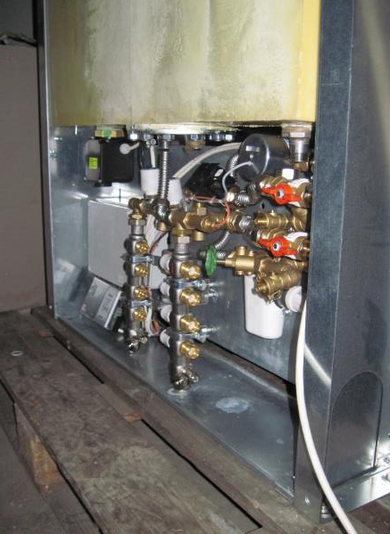
Enerbox technical aspects
Hydraulic module
The hydraulic module, which is located in the lower part of the storage system, contains all the components for the following different areas:
  Hydraulics – components for DHW preparation and heating (cooling) such as adjustment valves, manifold, ball valves, safety valve and drain
  Control – components for the control system such as control valves, actuators and temperature probes
  Monitoring – components for the monitoring system and such as flowmeter, water meter and temperature probes.

Slide 30
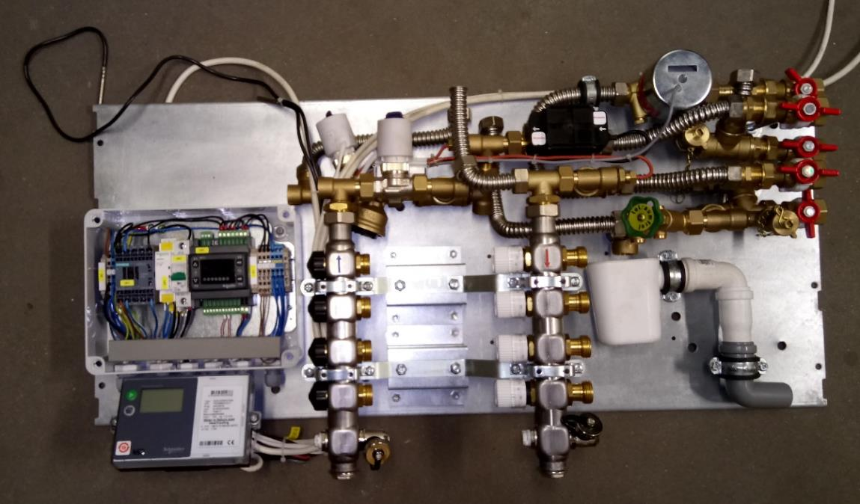
Enerbox technical aspects
Hydraulic module

Slide 31
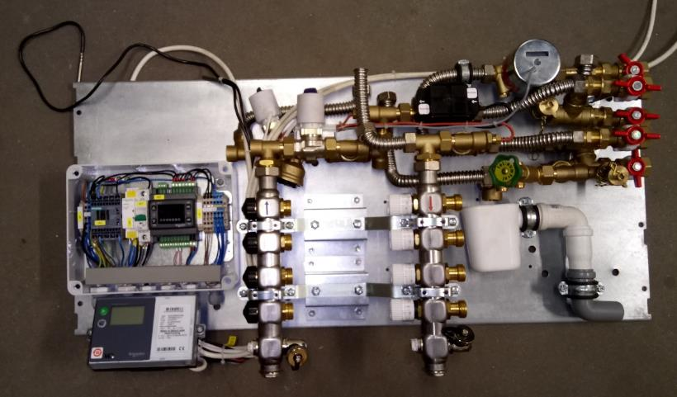
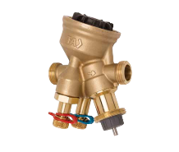
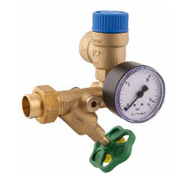
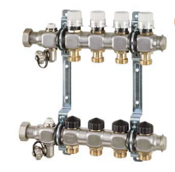
Enerbox technical aspects
Hydraulic components
Control valve of the hydraulic unit
Safety group of the manifold
Manifold of the hydraulic unit

Slide 32
Enerbox technical aspects
Control and monitoring components
Water meter of the hydraulic unit
Ultrasonic heat meter of the hydraulic unit

Slide 33
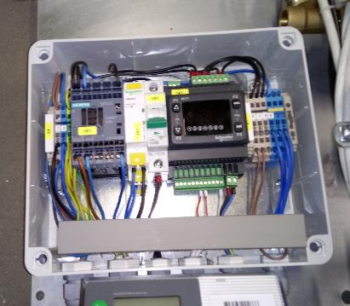
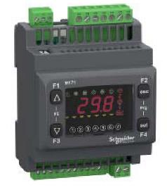

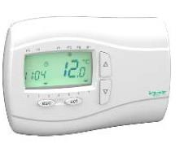
Enerbox technical aspects
Switchbox
Switchbox
Electrical components
PLC of the switch box

Slide 34
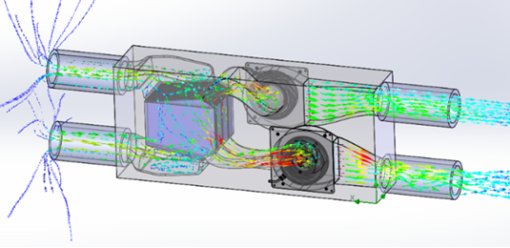
Heat Recovery Ventilation Unit (HRU)
Due to the limited available place, a small HRU unit on the top of the Enerbox has been selected as the best solution by AIRRIA.
The design consists in two ventilators with improved performance in acoustics and energy efficiency.

Slide 35
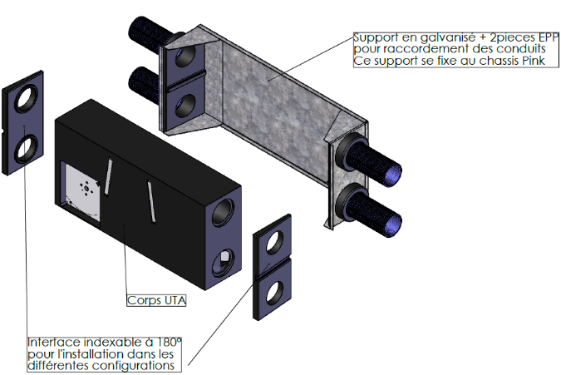
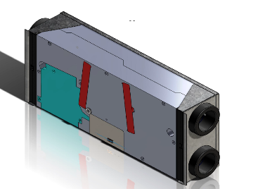
HRU technical aspects
After designing the basis of the unit, the detailed integration of the HRU within the Enerbox has been done:
  The unit is installed and removed easily from the Enerbox in case of maintenance needs.
  Left and right configurations have also to be possible, due to the symmetricity of the design.

Slide 36
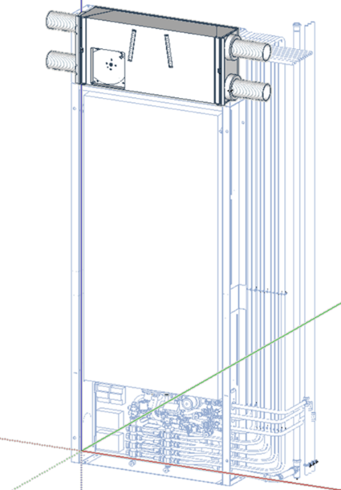
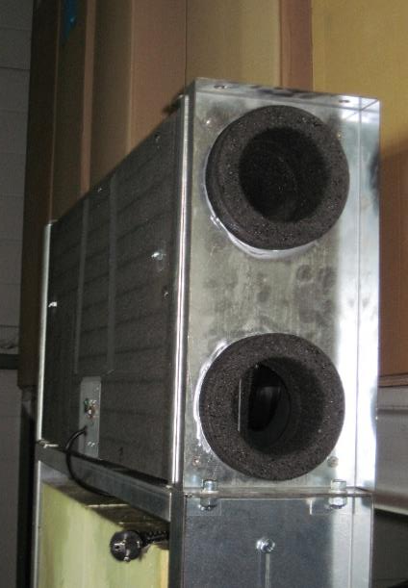
HRU technical aspects
Enerbox storage tank with ventilation unit integrated on top
Detail of the with ventilation unit integrated in the Enerbox

Slide 37
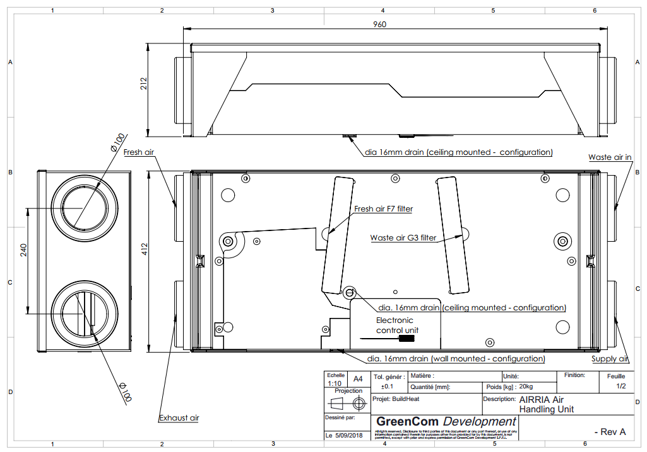
HRU technical aspects
Interfaces (fresh, waste, supply, exhaust air + drain + electrical control unit + filter access)

Slide 38
Monitoring and control for building management

Slide 39




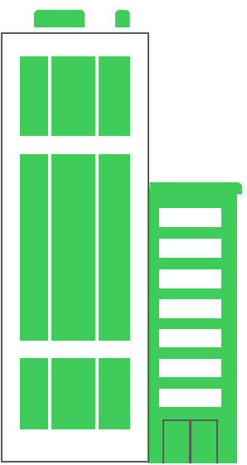



ICT infrastructure connecting and monitoring all the decentralised units
Monitoring and Control Architecture
High Level Control Rules
Data Processing and Control Rules:
PLCs
Servers
Gateways
Safe and Reliable Protocol
Data from and to the field:
Input as Probes and Sensors
Output as Valves and Actuator
Direct Contacts or
Open and Standard Protocols

Slide 40
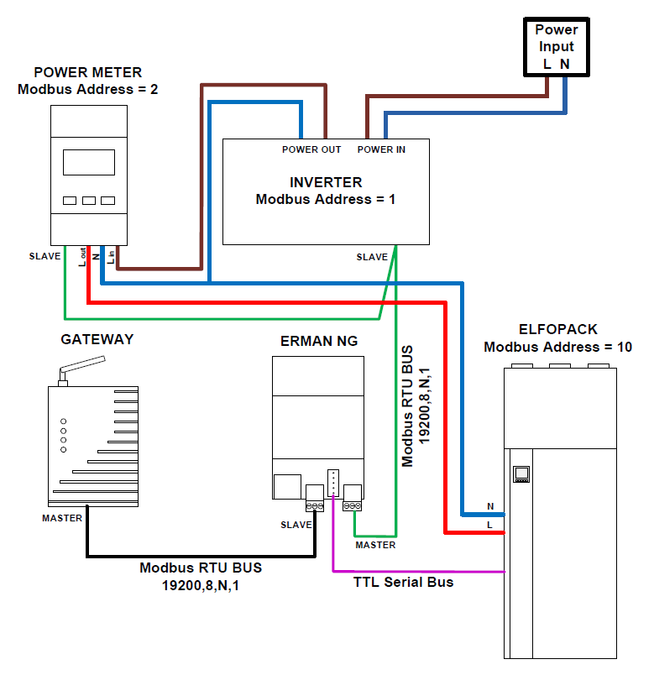

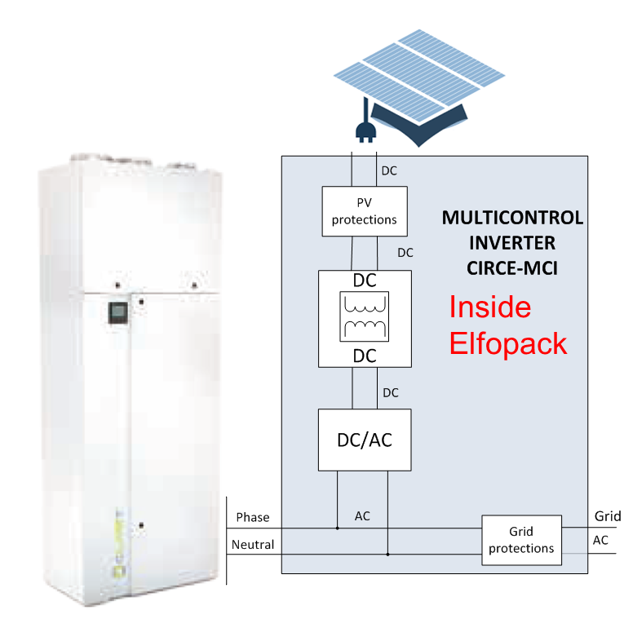

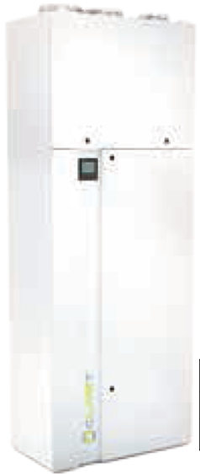


SCHNEIDER ELECTRIC contribution on CLIVET solution
Monitoring and Control Solution for Distributed H/C Plants
Elfopack, an Air-to-air Heat-Pump for
  Heating/Cooling
  Mechanical Ventilation
  DHW Storage
Devices inside the Elfopack interconnected with Modbus RS485 protocol.
A gateway per machine collects data from field and transfers them to the cloud.

Slide 41
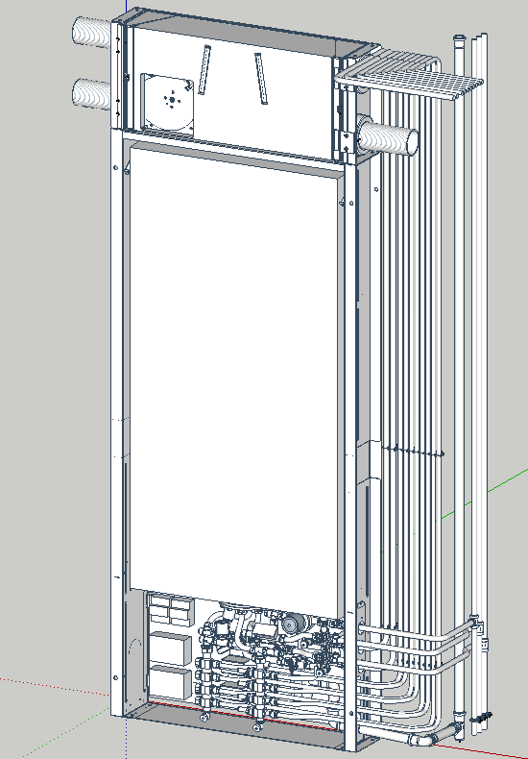
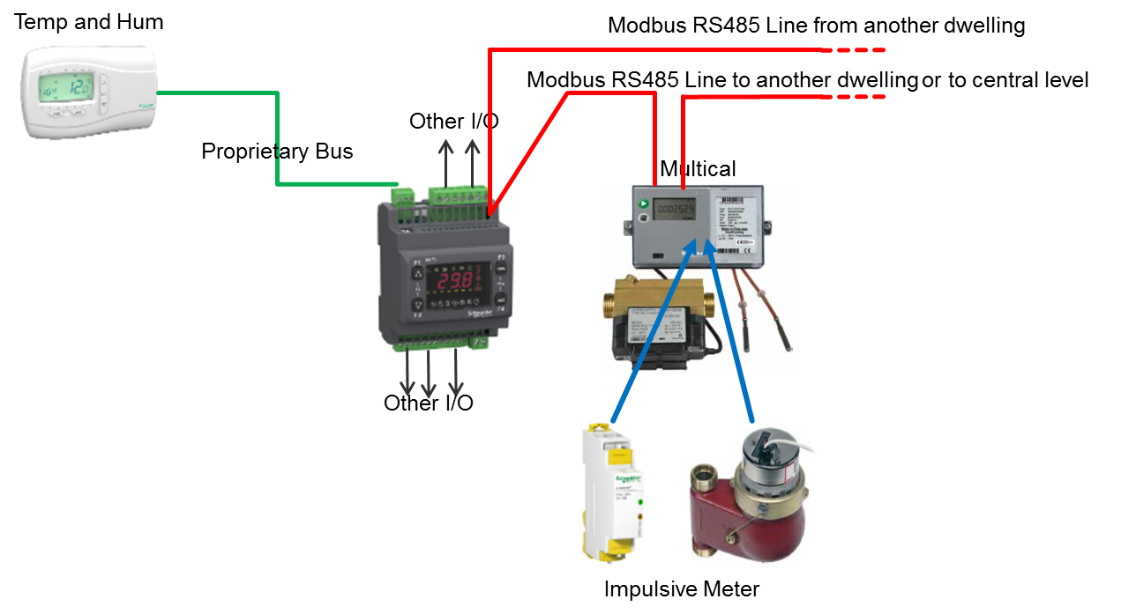
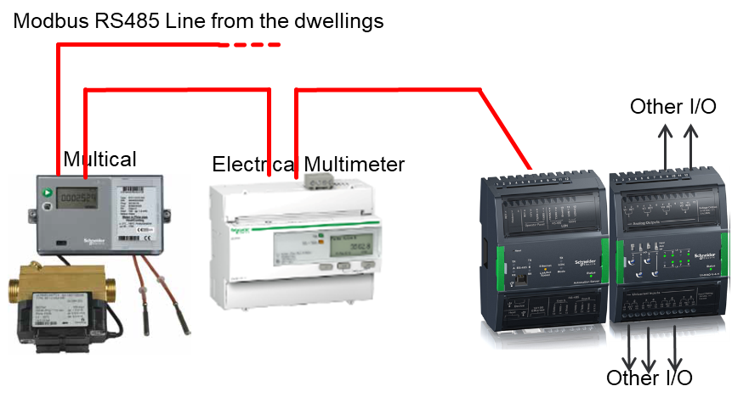
SCHNEIDER ELECTRIC contribution on PINK solution
Monitoring and Control Solution for Centralized H/C Plants
Distributed tank + Hydronic Module for H/C and DHW preparation.
Central Thermal plant to distribute Hot water for all the building
Single Modbus RS485 line with one Gateway per Building for the cloud connection.

Slide 42

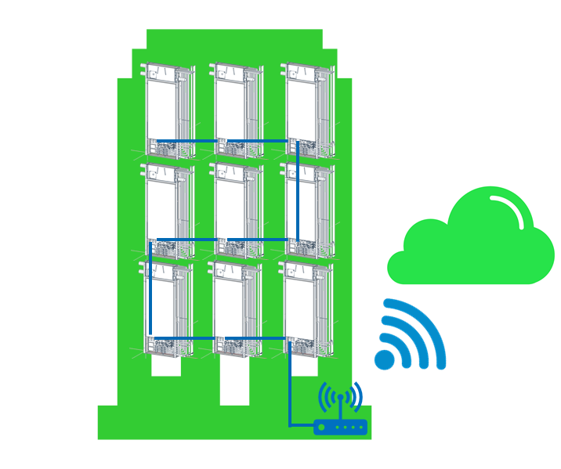
Technical aspects
Monitoring and Control Architecture (Adaptable and Scalable)
Distributed Solution
Centralized Solution

Slide 43





Technical aspects
Level 1 and Level 2 Architecture and App Development
High level control/optimization algorithms running in the cloud and exchanging data with the field
Data recorded on BuildHeat database and accessible by:
  Mobile App (developed for BuildHEAT)
  BIM software with its own graphic environment
Minimal and user friendly design/environment.
End User environment independent form the technological application installed
The «status» of the leaf will represent how tenants are using energy.

Slide 44
Industrialised multifunctional ventilated façade

Slide 45

Anchoring system
The façade system core is the aluminium frame pre-assembled in macro panels developed by HALFEN. Two transoms and two mullions of identical section compose each macro-panel. The assembling is done with a 45° connection welded or fixed mechanically with an internal angular plate.
The soft insulation layer has a minimum thickness of around 80 mm in order to cover the metal brackets (macro-panel anchors) and the eventual building services (pipes for hot water, ducts for air supply and removal) fixed at the wall surface.
A continuous layer of gaskets is installed at each macro-panel edges, guaranteeing the rainwater tightness to protect the soft insulation layer.
  vertical gaskets are inserted in each macro-panel before installation,
  continuous horizontal gasket is installed after one macro-panels’ row installation is finalised.

Slide 46

Anchoring system technical aspects
Mechanical behaviour
The frame shape has been verified to allow a maximum flection of 0.5 mm for a macro-panel height (slab-to-slab distance) of 3 m.
Each macro-panel is hanged on a curtain wall standard bracket, which allows tri-dimensional adjustments.
Vertical section
Horizontal section

Slide 47
Cladding Polymer Concrete (PC)
Polymer concretes are a type of concrete that use polymeric resins to replace cements as a binder, to reduce density and weight.
Commercial Polymer Concretes are usually compound of two different materials; crushed minerals (like marble, calcium carbonate, dolomite, others) and polyester resin. Its density varies from 2.100 kg/m³ to 2.350 kg/m³, and the bending strength from 10 to 40 MPa.
A new solution has been developed by ACCIONA in order to:
  Reduce material density.
  Keep the same panel´s thickness (17mm), which means lower panel´s basic weight (kg/m2) due to the lower density.
  Use of recycled materials including expanded recycled glass spheres
  Improvement of fire reaction, until achieve the required classification to be installed in Italian and Spanish demo case (B- s2- d0), according to EN 13501-1

Slide 48


PC technical aspects
Composition
Unsaturated polyester resin
Aluminium Tri Hydroxide (ATH)
Calcium carbonate (CaCO3)
Expanded recycled glass spheres
Physical and mechanical properties
Density: 1050 – 1100 hg/m3
Bending strength: 15,14 Mpa
Thickness: 17 mm
Width: 850 mm
Length: 1650 mm

Slide 49

Cladding technical aspects
Macro panel: Passive cladding
The passive cladding (Polymer Concrete) is fixed using a special screw (MDE8) that is mechanically inserted into the panel along the factory production line implementing the fixing point of each cladding panel. This screw is then fixed to a stainless-steel plate system, which allows to regulate the position of each panel and to anchor it to the macro-panel frame.
Horizontal section of the PC panel fixing system anchored to the macro-panel frame
Vertical section of the PC panel fixing system

Slide 50




Industrialised multifunctional façade: technical aspects
Anchoring system + insulation panels + Polymer Concrete (PC)

Slide 51


Industrialised multifunctional façade: technical aspects
Macro panel: Passive cladding
Top view of the HALFEN channel with steel plate and fixing for the PC panel
Side view of two macro-panels: bracket, vertical and horizontal gaskets are in evidence

Slide 52
Demonstration buildings :
Zaragoza (Spain)
ZAVI

Slide 53


Demonstration buildings: Zaragoza (Spain)
3 stories building with a ground floor and an underground car park level.
53 dwellings distributed in 5 staircases.
The building is a linear block with the main façades facing North and South.
Kitchen and living rooms are mainly South facing, with balconies at all floors.
Bedrooms are located on the north side of the building with smaller windows.

Slide 54
Zaragoza demo building construction
Foundation and main structure in reinforced concrete.
Masonry facade is composed by the following layers, outside to inside: 12 cm outer bricks layer, 4 cm glass fibre panels, 5 cm inner brick layer covered with plaster. Exterior framework edges (painted concrete).
Windows made of anodised aluminium without thermal break (7cm thick frame), except doors that are in painted steel. Windows are double glazed 4/6/4 except in stairs and entrance doors to the buildings, that are 6 mm single glazed. In 6 of the 53 dwellings double glazed windows have been replaced in the North façade to mitigate air infiltrations due to wind pressure.
PVC roller blinds.
Overhangs in terraces orientated to the South for shading in summer.
Ceramic lattice in terrace zones.
Sloping roof clad with ceramic shingles.

Slide 55


Zaragoza demo building services
Electricity is the only energy source of the building.
Individual DHW is produced by electrical boilers, mostly of 50 litres capacity.
Heating is generated by radiators and resistance electrical heaters. An extensive use of catalytic butane heaters is present. Only two apartments have air conditioning machines.
Moreover, the building hasn’t got elevators which means that the common electrical consumptions are limited to lighting of common areas and water pumps.

Slide 56

Zaragoza demo technical aspects
North facade: additional external insulation (ETICS 10cm; λ=0,037W/m2K) with coating paint supplied by MIG.
South facade: two design solutions.
1st and 2nd floor: on central walls, where there are no balconies, external insulation (ETICS 10cm; λ=0,037W/m2K) with coating paint supplied by MIG.
In the remaining areas of the facade, rockwool insufflated in cavity walls, where accessible. In order to avoid thermal bridges at the wall-to-floor connection, rockwool (6cm; λ=0,034W/m2K) will be installed in the false ceiling under the terraces.

Slide 57

Zaragoza demo technical aspects
East facade: three design solutions.
Ground floor: existing bricks facade without intervention, as it is the enclosure of not heated spaces.
1st 2nd and 3rd floor: BuidHeat façade with the following layers:
  MIG paint applied to the existing bricks;
  Rock wool (12cm; λ=0,034W/m2K) installed on the existing facade after the Halfen anchors to create the new thermal line of the building and avoid thermal bridges;
  Rock-wool (6cm; λ=0,034W/m2K), air cavity (2cm) and CORIAN “Glazier White” as cladding panel.
  16 PV panels installed and connected to the heat pump of two flats.
Side roof wall: external insulation (ETICS 10cm; λ=0,037W/m2K) with coating paint supplied by MIG.

Slide 58

Zaragoza demo technical aspects
West facade: two design solutions.
1st 2nd and 3rd floor: BuidHeat façade with the following layers:
  MIG paint applied to the existing bricks;
  Rock wool (12cm; λ=0,034W/m2K) installed on the existing facade after the Halfen anchors to create the new thermal line of the building and avoid thermal bridges;
  Rock-wool (6cm; λ=0,034W/m2K), air cavity (2cm) and CORIAN “Glazier White” as cladding panel.
  16 PV panels installed and connected to the heat pump of two flats.
Side roof wall: external insulation (ETICS 10cm; λ=0,037W/m2K) with coating paint supplied by MIG.

Slide 59
Zaragoza demo technical aspects
Basement and ground floor ceilings:
The ceiling of the basement is insulated with rock wool panels installed under the slab (6cm; λ=0,034W/m2K)
Inside the false ceiling of the ground floor, rockwool insufflated in the existing cavity (15cm; λ=0,038W/m2K)

Slide 60


Zaragoza demo technical aspects
Under the terraces and flats with exterior floor:
Inside the false ceiling of the flats under the terraces, rockwool insufflated in the existing cavity (15cm; λ=0,038W/m2K)
Under the slab of the 1st floor, external insulation (ETICS 10cm; λ=0,037W/m2K) with coating paint supplied by MIG.
Roof:
Rockwool (20cm; λ=0,038W/m2K) is positioned above the existing insulation (fiberglass 6cm) on top of the slab.
Windows and doors:
All the external windows have been removed and replaced with new ones with high performance, as described in Figure 53, left hand picture.

Slide 61
Implementation of the solutions
Replacement of electrical heaters and radiators with ELFOPack units by Clivet.
The system is an air to air multifunction heat pump which can satisfy the domestic hot water (DHW) needs of dwellers, thanks to the 180 L water storage, as well as the thermal loads for air conditioning.
ELFOPack provides both heating in winter and cooling and dehumidification in summer and the supply of air renewal necessary to guarantee the comfort for the dwellers.
ELFOPack is a plug and play solution, so the installation causes minimum disruption to the tenants during the refurbishment works.
A new false ceiling has been installed in the dwellings for integration of the ELFOAir system. It’s a traditional air distribution system designed with the aim of reducing the pressure drop along the lines and guarantee the optimum distribution of air to the rooms.
The ELFOPacks that was installed in the dwellings are not standard units: in each unit an innovative multi-control inverter (MCI), designed by Circe, is able to manage in the most efficient way the power flux from the grid and from PV panels that are placed on the east and the west façade and on the roof.

Slide 62

Implementation of the solutions
At daytime, the DHW and HVAC systems can be powered up by photovoltaic energy reducing the electrical consumption from grid.
This solution helps to further reduce the primary energy consumption, which is already very low for heat pumps, if compared to electric boilers and radiators.
The system is also optimized for solar PV power peaks.
Due to Spanish regulation limits (Spanish regulation limits in 2018), in presence of an excess of energy generated by PVs compared to ELFOPack consumptions, the available energy is not fed into the grid, but stored into the ELFOPack thanks to an electrical resistance in its storage able to reduce the on time of the compressor.

Slide 63


Implementation of the solutions

Slide 64
Comparison of energy demand and consumptions

Slide 65
Demonstration buildings :
Rome (Italy)
ARUP

Slide 66


Demonstration buildings: Rome (Italy)
The building is a residential multi story building built in 1971, with 8 residential floors, a basement and a ground floor.
The building involves a total number of 80 flats, all assigned as properties to private owners.
The typical surface area of the dwellings is 96m² and its actual average primary energy consumption is approx. 120kWh/m²year, including heating and domestic hot water consumptions.
The total energy bill per apartment is approx. 1200 €/year.

Slide 67



Rome demo building construction
The typical exterior wall has a thermal transmittance value ranging from 0.97 W/m²K for the typical masonry wall with perforated bricks, to 4.5 W/m²K for the concrete panels located above and below windows.
Most of the existing windows are timber-framed with 4mm single glazing and a U-value(glass) of 5.7W/m²K.
Facade is composed by the following layers, outside to inside:
  10 cm outer bricks layer
  10 cm air cavity
  8 cm inner brick layer covered with plaster.
  Exterior framework edges (painted concrete).

Slide 68
Rome demo building services
The heating system is centralized and shared with three other buildings which have the same geometry, surfaces and volumes of the DC building.
In 2015, a calorimeter was installed on the main gas pipes from the centralized boiler to each of the three buildings, in order to measure the real buildings’ heating consumptions.
Individual boilers are currently used for the DHW production.
Centralized cooling and mechanical ventilation systems are not installed in the building.

Slide 69

Rome demo technical aspects
The BuildHEAT façade system developed for this building is composed by the “macro-panel” base unit with a slab to slab height and it is designed in two alternatives to allow for fixing of ceramic cladding panels along East and West elevations and solar thermal collectors on the South elevation.
External finishing panels
Aluminum macro-panel frame
Punctual brackets for macro-panels fixing (positioned along the inter-floor slab)
Continuous soft insulation layer
Air duct and pipe
Existing wall

Slide 70


Rome demo technical aspects
Cladding panel: two solutions
Ceramic cladding panel: The passive cladding are ceramic tiles fixed through special screws (MDE8) mechanically inserted into the panel. This screw is then fixed to the stainless-steel plate system to regulate the position of each panel and to anchor it to the macro-panel frame.
Solar thermal collector: Panels can be installed both in vertical and horizontal position. The macro-panel frame (HALFEN channel) is cut to let hydraulic connections and corrugated stainless-steel pipes to link adjacent collectors.

Slide 71

Rome demo technical aspects
Insulation
A soft insulation panel (thermal conductivity 0.033 W/(mK)) with a thickness of 80mm and a rigid additional one was designed to guarantee the required thermal resistance of the overall wall assembly.
Ventilated air cavity
Airgap thicker than 20 mm. The cavity between the inner insulation layer and the cladding panel can be either ventilated or filled with additional insulation where required by climate conditions and thermal requirements.
Raisers
Pipes and ducts are fixed to the existing wall and then covered by the soft insulation layer.

Slide 72

Rome demo technical aspects
Façade sub-structure and aluminium anchoring system
The sub-frame of each macro-panel is composed by two transoms and two mullions of identical sections. The frame of the macro-panel is then hang to the existing building structure through the upper transom to the load bearing brackets that are fixed back to the slabs.

Slide 73


Rome demo technical aspects
Façade sub-structure and aluminium anchoring system
The installation follows this process:
Fixing of the brackets for the new façade macro-panel to the existing building slab;
Installation and fixing of pipes and ducts;
Fixing of the soft insulation layer at the existing wall through conventional fixing systems;
Positioning and fixing of the pre-assembled macro-panels by hanging them to the anchoring brackets

Slide 74
Implementation of the solutions
The intervention on the heating, cooling and DHW production foresees the replacement of the existing centralized generation system of the building with a unique generation system for HVAC and DHW, serving each staircase independently. In order to minimize the distribution thermal energy losses, each staircase has its own generation unit installed on the rooftop.
Each staircase system is integrated with its own photovoltaic plant, installed on the building roof.
Due to the orientation of the building and the architectural and structural constraints, only one solar thermal collector field is installed on the South façade and coupled to the closest staircase system.
In order to maximize renewable energy harvesting and storage, a central DHW tank (one per staircase) is connected to wall-mounted storage for DHW uses, one per apartment.
The dwelling storage is integrated into an “ENERBOXX” that includes a mechanical ventilation system and a hydronic module. At dwelling level, five fan coils are installed in each apartment, replacing the existing high temperature radiators.

Slide 75

Implementation of the solutions

Slide 76

Implementation of the solutions
ENERBOXX
It is a prototype of an innovative box that includes a water storage tank for domestic hot water uses, a mechanical ventilation unit and a hydraulic module connected to the fan coils circuit. Moreover, the hydraulic module is coupled with a DHW and H&C monitoring system to track the dwelling consumption.

Slide 77
Comparison of energy demand and consumptions
The energy savings of the building generated by the interventions on the envelope and HVAC systems, have been evaluated by means of dynamic simulations.

Slide 78
BuildHeat retrofitting conclusions
Renewable Energy Sources have been integrated in the façade cladding: Photovoltaics panels in Zaragoza and storage thermal collectors in Rome. Both demos allow for the integration of ducts, cables and pipes within the façade system.
The demo cases of Rome and Zaragoza propose a centralized and a de-centralized HVAC system respectively, both using heat pumps and dwelling ventilation units.
In fact, the use of a heat pump with respect to a gas boiler or electric heater, entails a significant improvement of the energy efficiency and hence, a reduction of the energy consumption for heating, cooling and DHW.
Moreover, the ventilation unit provides fresh air in the dwellings, and limits thermal losses due to windows opening.

Slide 79
BuildHeat retrofitting conclusions
Despite the difference of the two solutions adopted in Rome and Zaragoza – centralized vs de-centralized, air-to-water vs air-to-air heat pump – both improve the installation works by minimizing the disruption for the inhabitants and allows for the integration of the new machines in the usually limited areas available in the existing dwellings
The demo cases are representative of repetitive building typologies that can benefit from a larger scale of renovation works.
In fact, the developed packages are scalable and will find a more effective and affordable use if they would be implemented in several similar buildings in a district.
Interventions on a larger scale will also promote further costs reduction and smarter financing mechanisms.

Slide 80

Partners

Slide 81
Thanks!

